Slide 1
Public Goods Tool
Christian Gossel

Slide 2
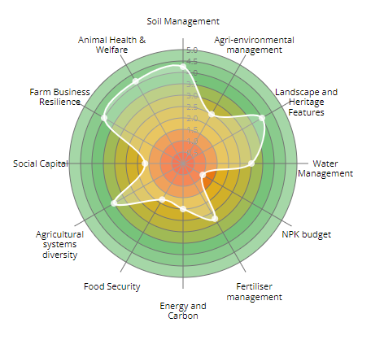

History
Originally developed in 2011 by ORC for Natural England.
Holistic farm sustainability assessments for quantifying the success of Organic Entry Level Stewardship (OELS) schemes.
12 areas of sustainability assessed through questions, filled out either by the farmer themselves or alongside a researcher.
Various iterations since:
388 farms across 13 countries
11 EU projects, 7 UK projects, and 6 PhDs
Open source and publicly available:
https://www.organicresearchcentre.com/PG-Tool/
organicresearchcentre.com

Slide 3
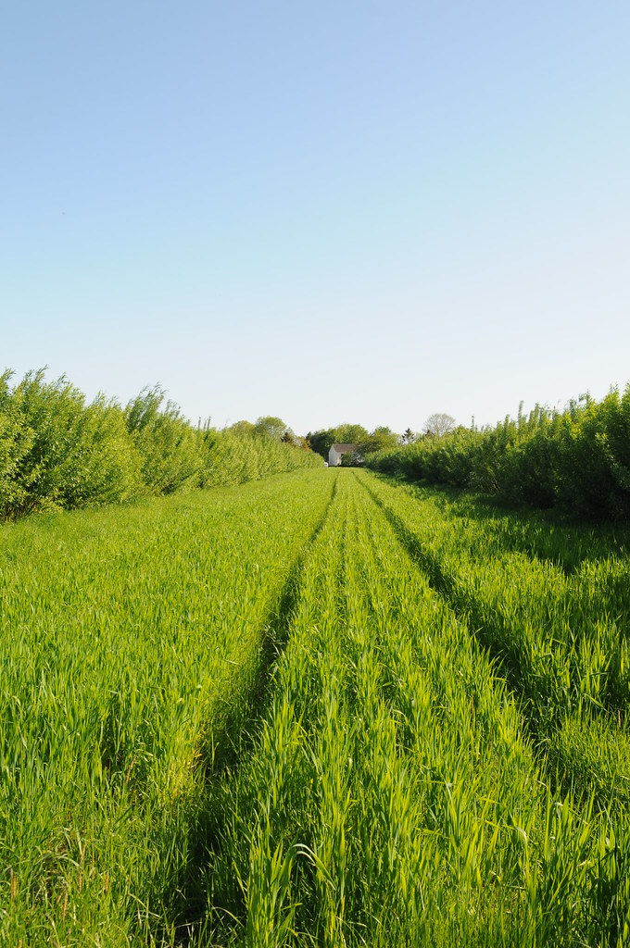
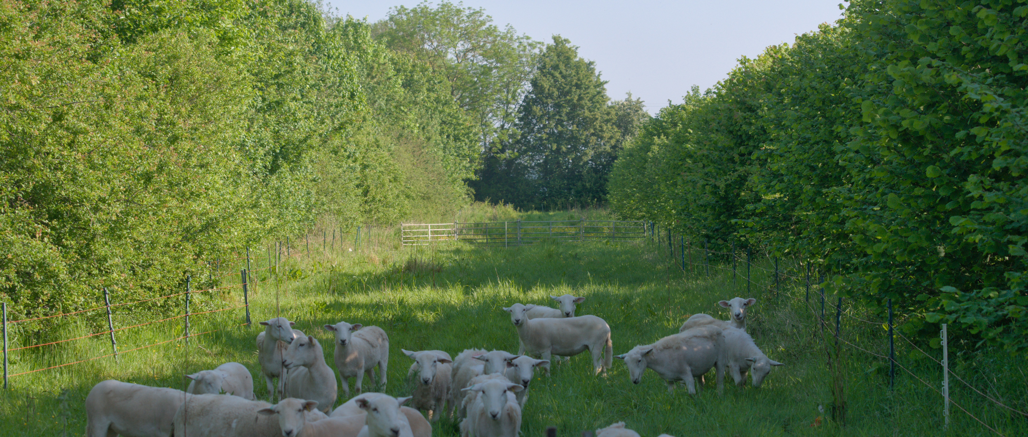
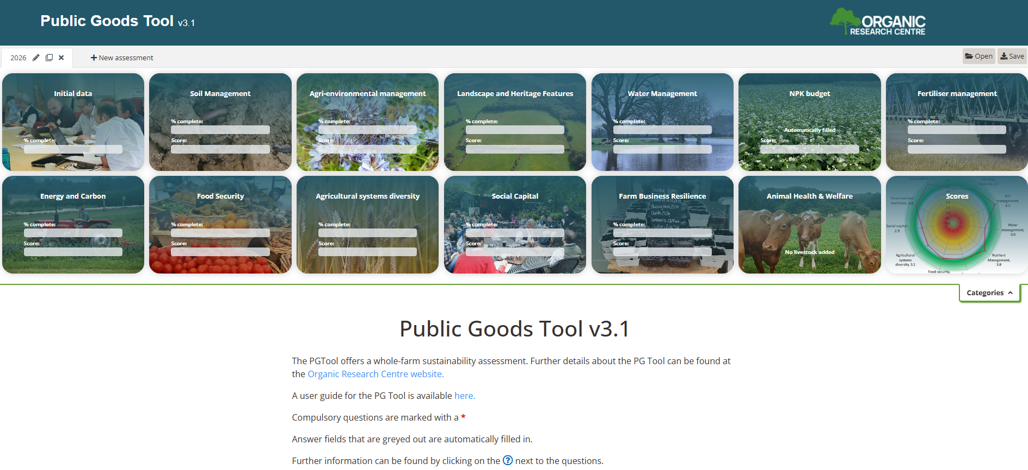

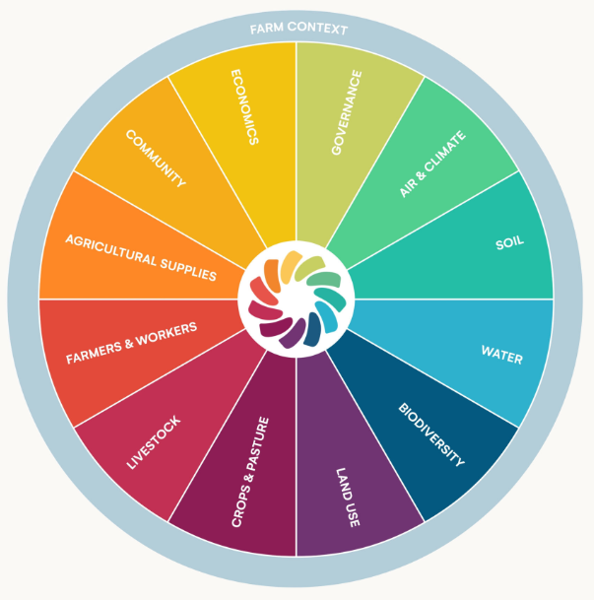


Further development
organicresearchcentre.com

