Slide 1
Proven agroforestry business models and value-chain integration
Johannes Schmitt johannes.schmitt@geo.uni-marburg.de Deutschhausstraße 10 35032 Marburg 20.01.2026

Slide 2
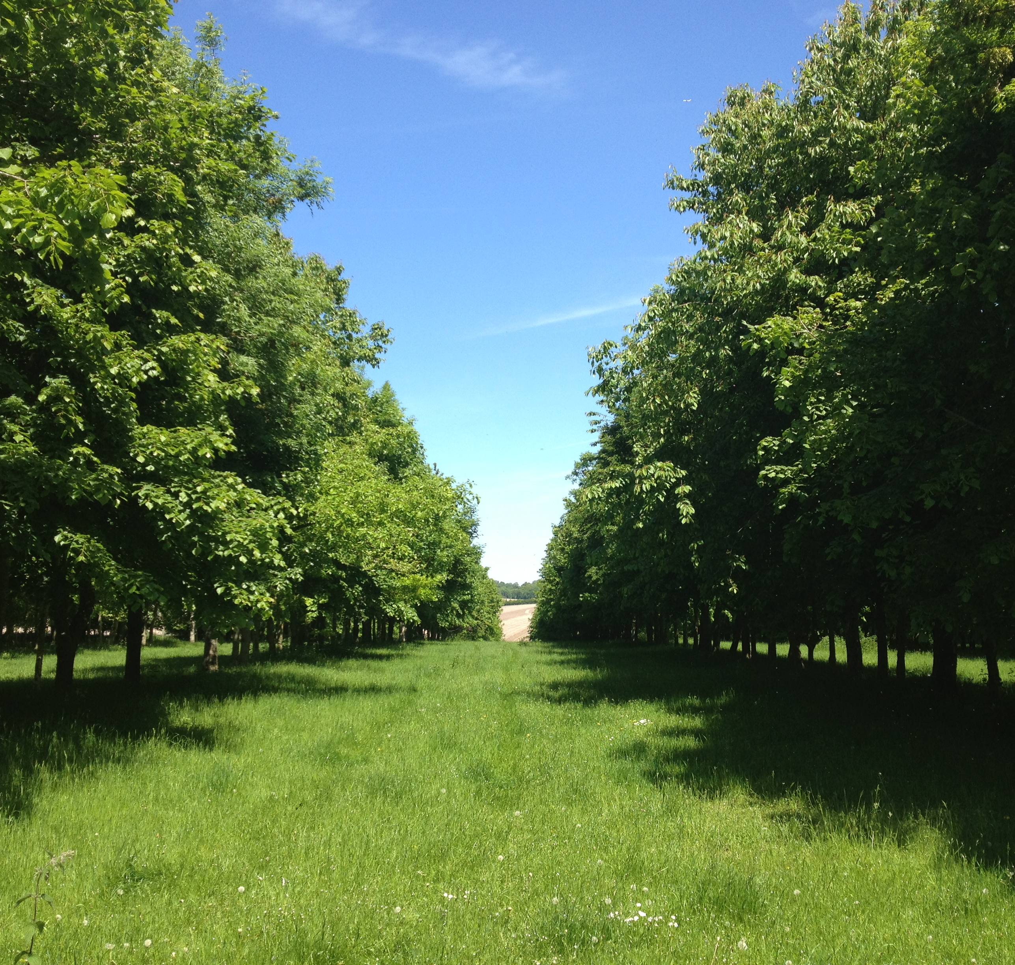
Agroforestry Basics
Traditional agricultural practice with a long history of implementation across various cultural and geographical contexts
Deliberate combination of woody perennials with crops and/or livestock in spatial or temporal configurations
Agroforestry can be practiced across conventional, integrated, and organic agriculture
It contributes to climate change mitigation, soil conservation, biodiversity enhancement, and the overall improvement of landscape resilience and ecological integrity

Slide 3
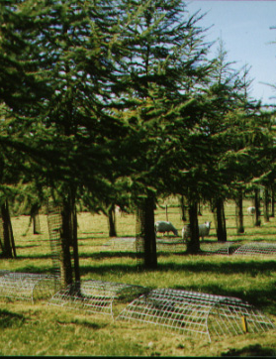
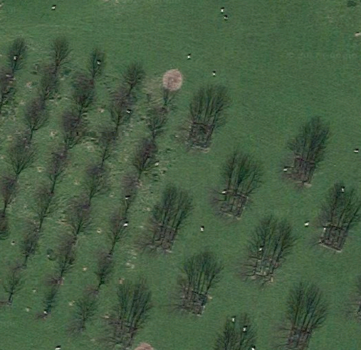
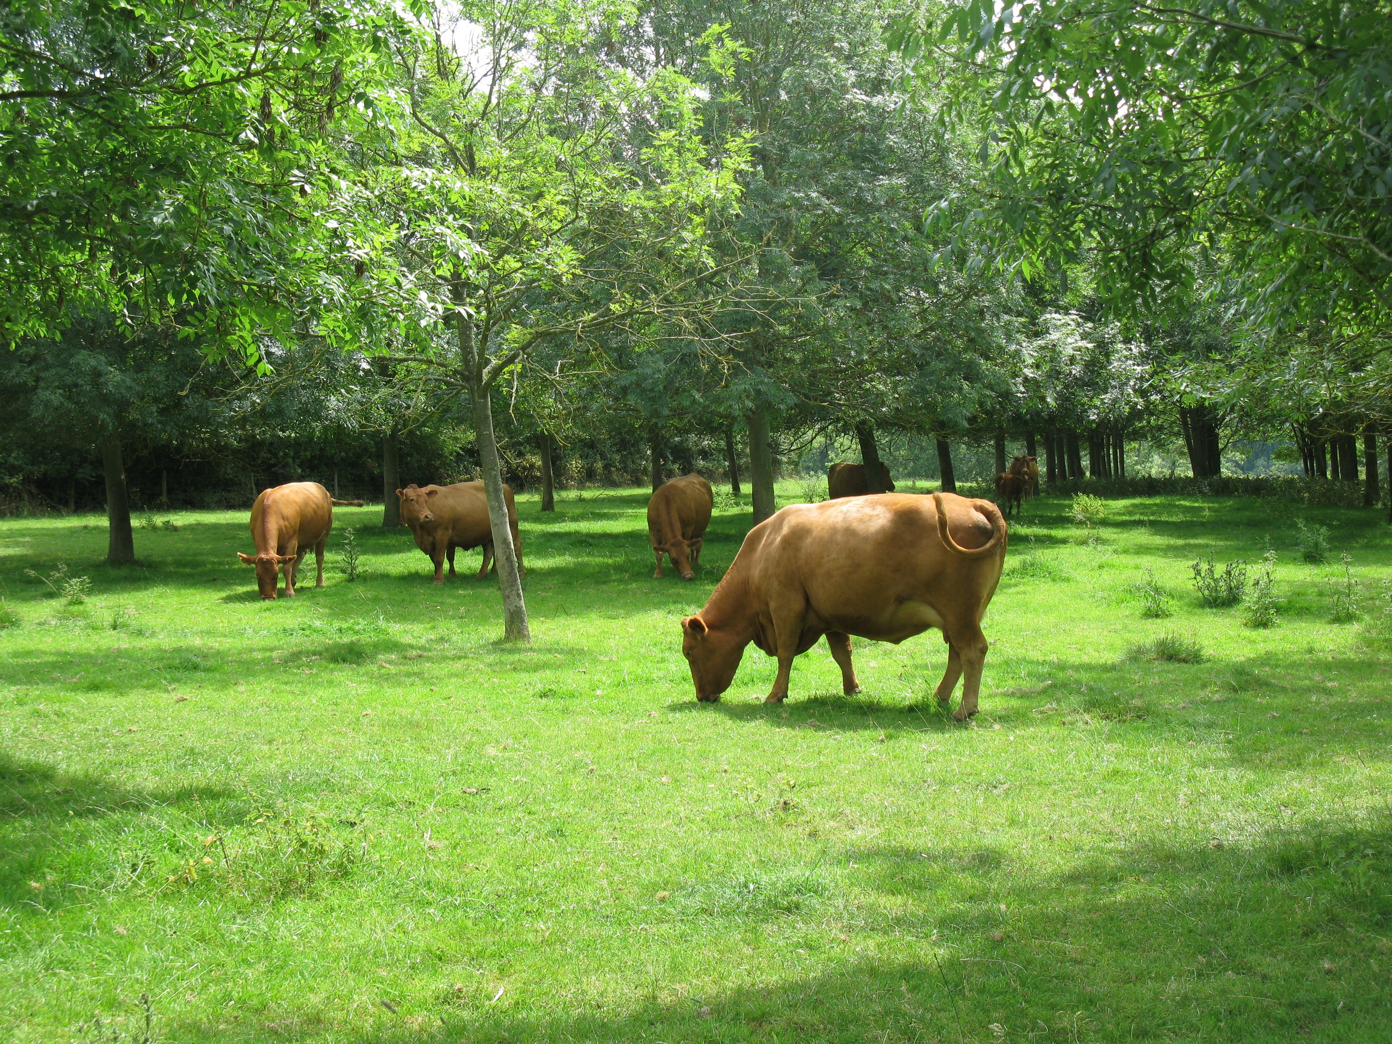
Why should a farmer adopt Agroforestry?

Slide 4
Why should a farmer adopt Agroforestry?
Diversify production
Reduce specific input costs
Enhance agricultural productivity

Slide 5
Why should a farmer adopt Agroforestry?
Diversify production
Reduce specific input costs
Enhance agricultural productivity
=>Create a more sustainable and resilient farming system
=>Create a more sustainable and resilient farming sys

Slide 6
Why should a farmer adopt Agroforestry?
Diversify production
Reduce specific input costs
Enhance agricultural productivity
=>Create a more sustainable and resilient farming system
=>Create a more sustainable and resilient farming sys
How can this be achieved on the farm level?

Slide 7
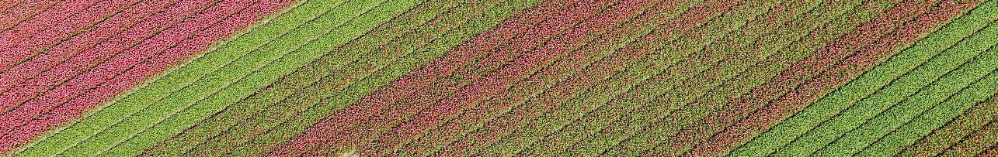
General findings across 24 case studies
Economic diversification as a central driver of agroforestry adoption
Diversified outputs stabilise income
New income streams through fruit, nuts, honey, timber, carbon credits, tourism, or education
Buffering against volatile markets and reducing dependency on single commodities
Predominance of short food supply chains (SFSCs)
Success depends on short food supply chains and strong local identity

Slide 8
General findings across 24 case studies
Agroforestry improves animal welfare and microclimate
Processing captures added value and enhances brand visibility. Labour-intensive but increases profitability and consumer trust
Monetises ecosystem services; early examples of blended finance models
Integration of tree residues into energy systems reduces input costs and carbon footprint
Diversification into experiential services like agrotourism fosters public awareness and supports rural employment, with strong social and cultural co-benefits

Slide 9
General findings across 24 case studies
Integration across farms fosters regional identity and shared ecosystem management, supporting multifunctional landscapes and circular economies

Slide 10
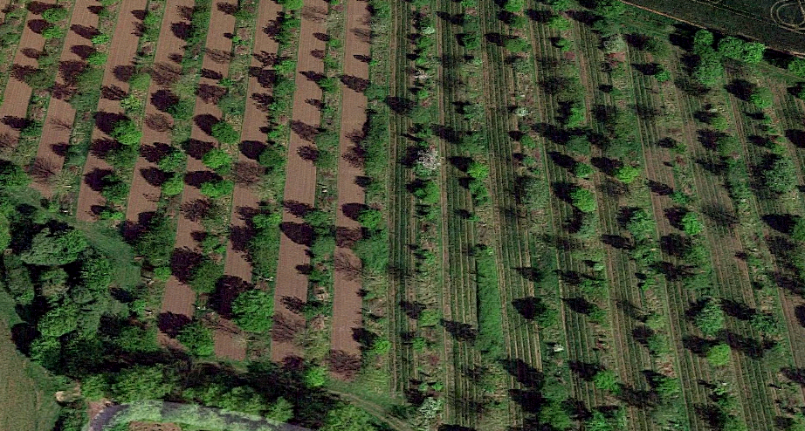
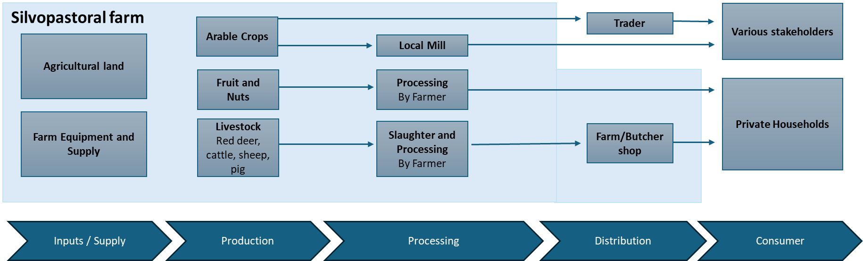
Case 1: Belgian farm

Slide 11
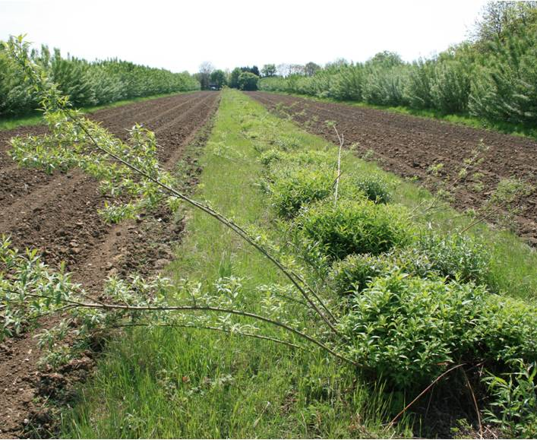
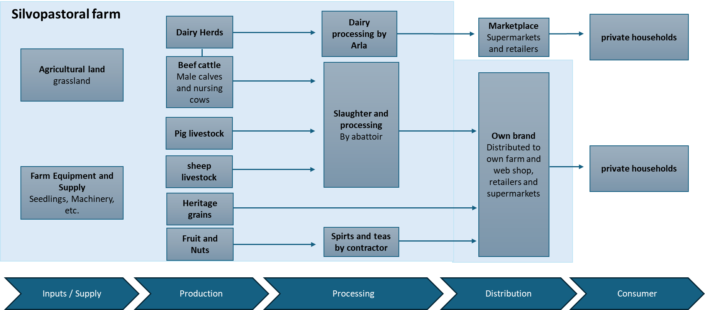
Case 2: English Farm

Slide 12
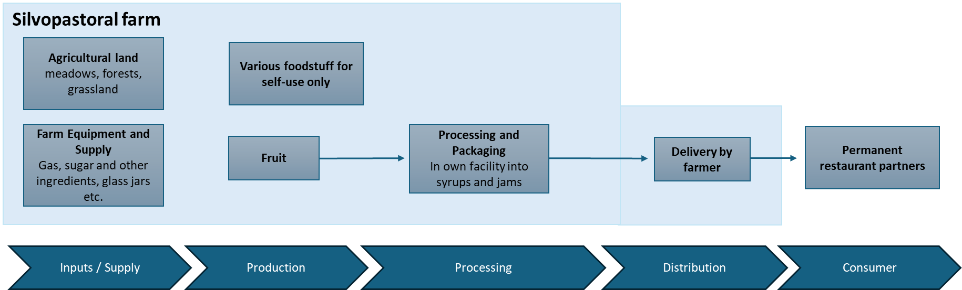
Case 2: Hungarian farm

Slide 13
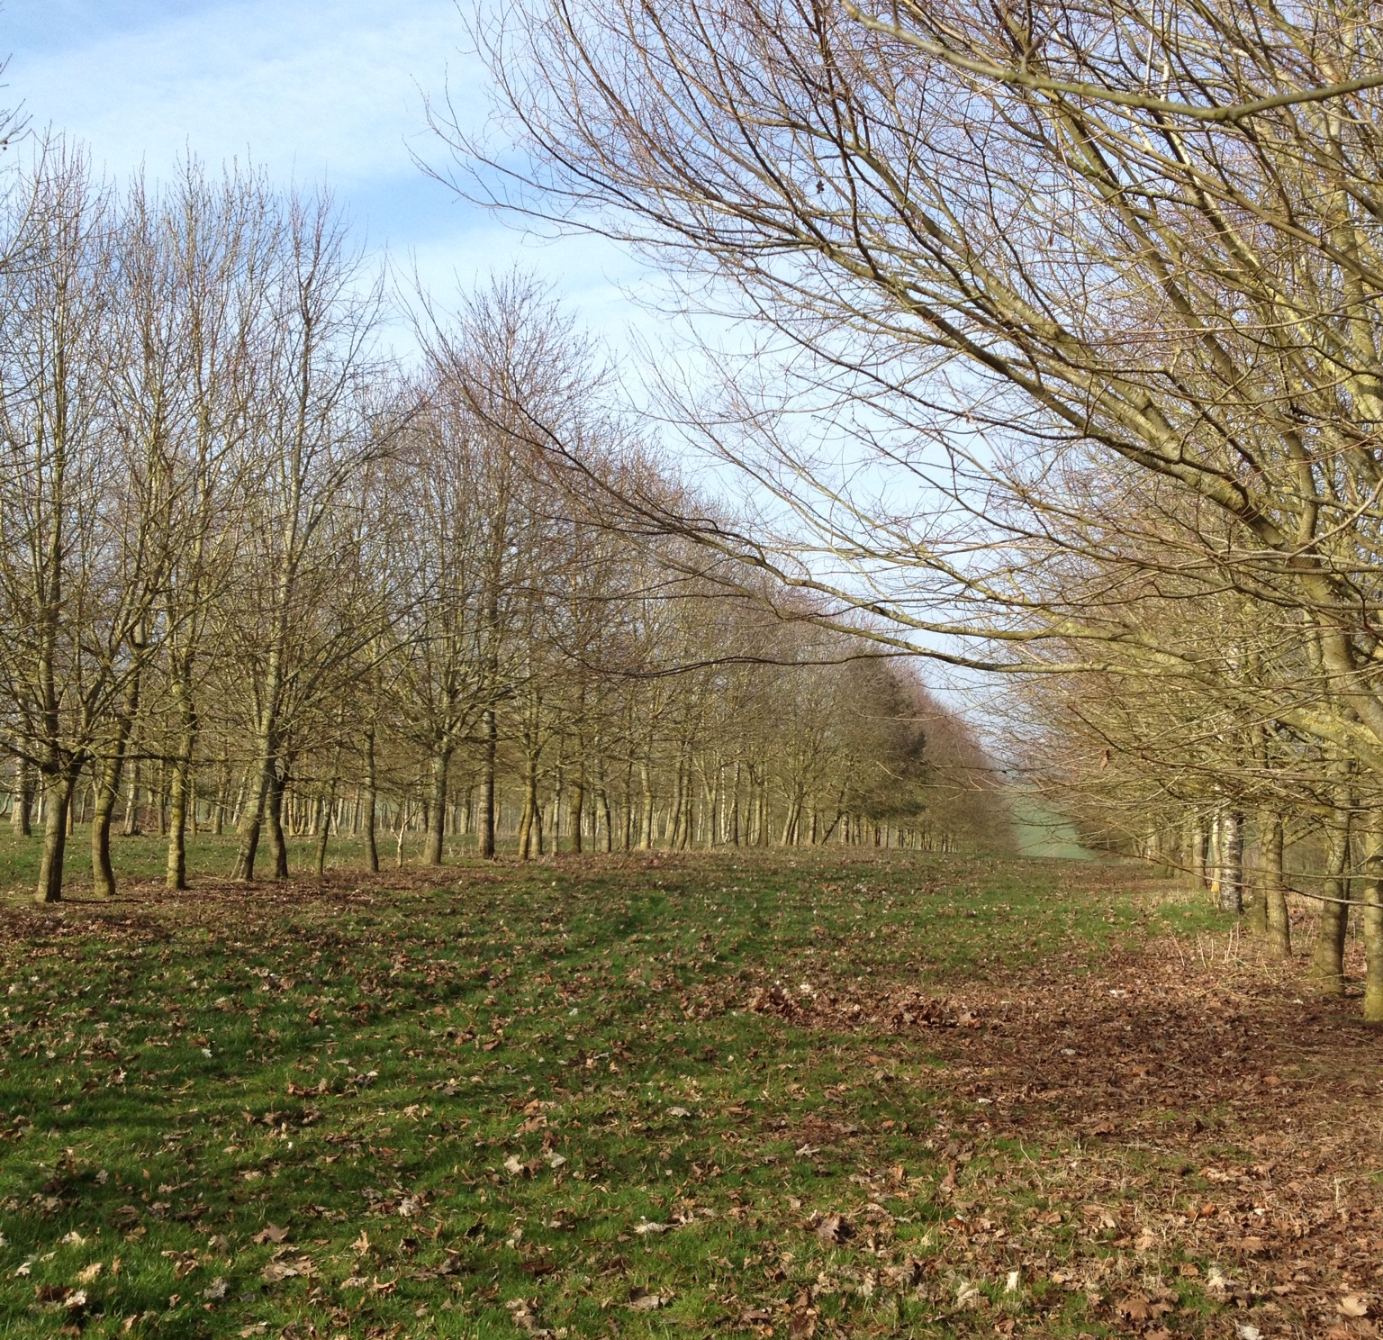
Key Takeaways
Farms are not centered around agroforestry, agroforestry is centered around the farms needs.
Agroforestry is not a separate form of agriculture like conventional, integrated, or organic farming; it improves the respective form.
Agroforestry can be fitted on every farm and benefits its work.
It is better to have planted trees yesterday.

Slide 14
Thank you for your attention!

