Slide 1

EMANES ANNUAL CONFERENCE 2025
Finance Scheme for upscaling Regenerative Agroforestry
Tiago Zibecchi, EMEA Researcher

Slide 2
Ultimate goal is to upscale AF in the EU by Designing and Testing a Sustainable Finance Scheme
For that, we had to first understand EU’s current Policy and Finance landscape. What are the underlying conditions? Barriers? Opportunities? Drivers? Incentive Mechanisms? Existing Gaps? Trends?
Policy | Finance
Regulatory Framework: What are relevant certifications / laws /projects in place affecting AF farmers? Demographics: Who are AF farmers? Average profile? Farms Size? Maturity/ Adoption Year? Skills? Human Resources? Infrastructure? Cooperatives? Country-specific Analysis: What are differences concerning Land Tenure, Land Use and Distribution, Typology, Public Subsidies, Taxonomy, Advisory Services, Private sector contributions, etc…? | Farmers’ financial situation: Is it professionalized? Do farmers have clear business plans? Indicators: Cash-Flow projections? ROI? Debt? Loans conditions? Market Orientation: Value chain? Market Access? Consumers (Demand side)? Who are the stakeholders? Investors? Risks? Innovation, Digitalization and MRV Efforts: ES tracking (Carbon, Biodiversity, Soil, Water)?

Slide 3
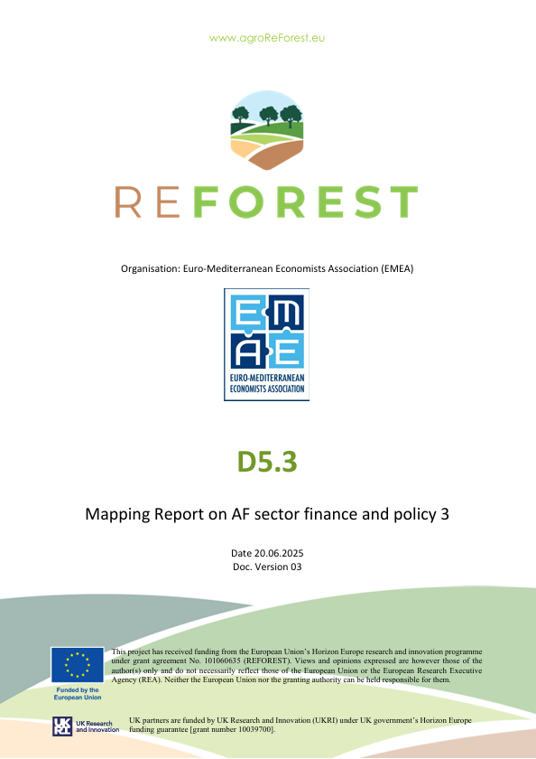
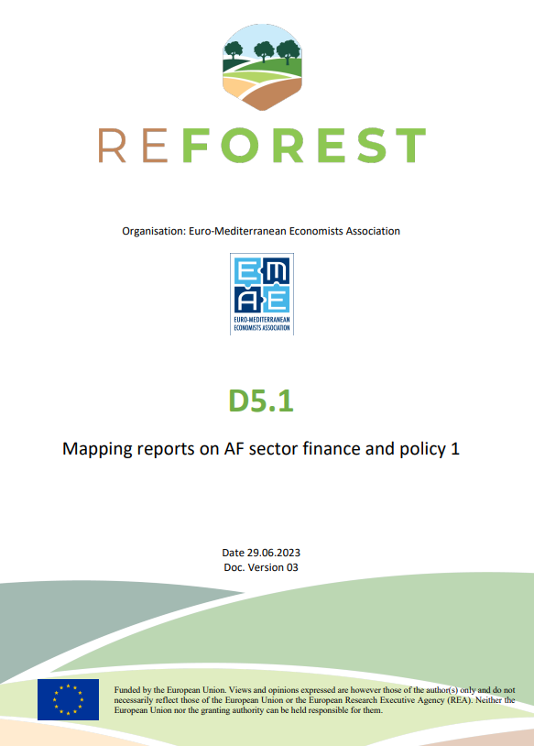
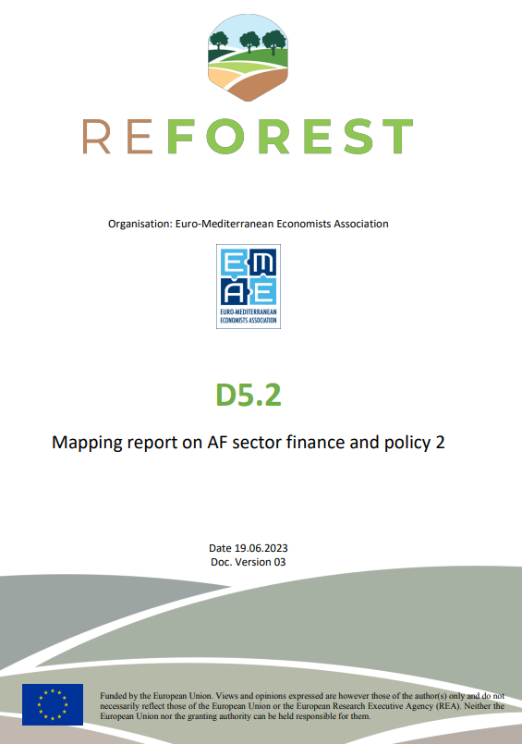
Series of Mapping Reports
Prepared and published by Ivan Hajdukovic (2023)
Prepared and published by Tiago Zibecchi (2025)

Slide 4
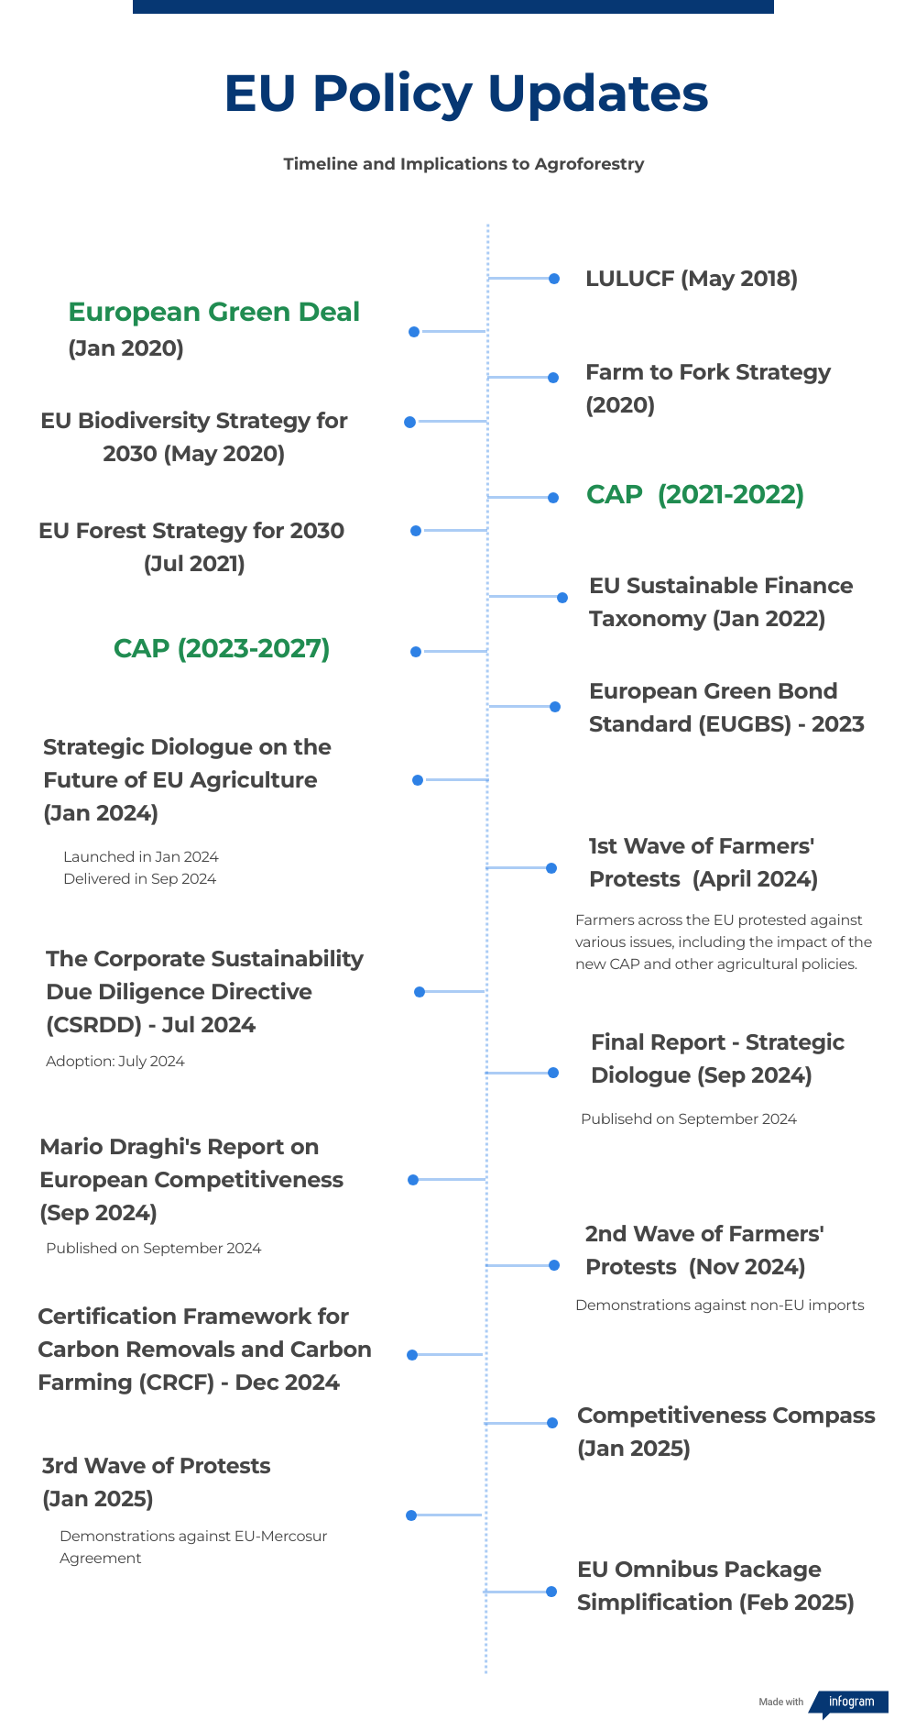
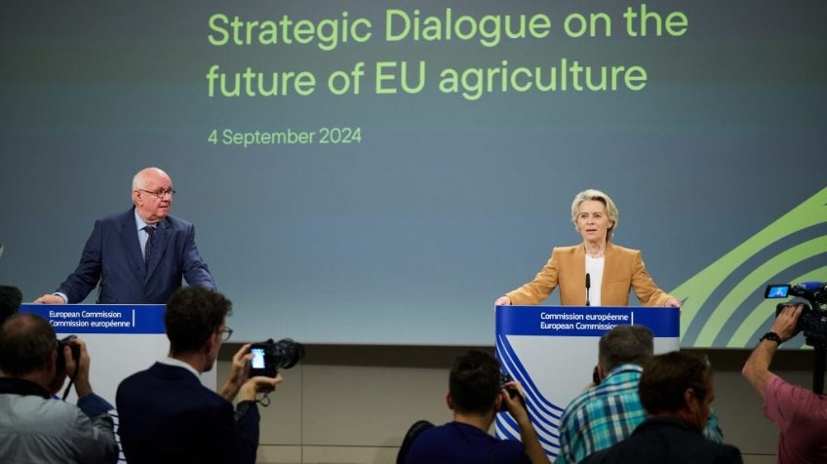
Mapping Report - Policy
MOTIVATION
Country-level Case Studies Analysis (Typology; Taxonomy; Historical Land Reforms, Use and Distribution; Advisory Service; Fiscal Budgets)
Evaluation of recent CAP and Green Deal frameworks (EU Policy Updates) to identify gaps and opportunities for AF
Assessment of public, private, and philanthropic funds for AF projects (innovative and blended finance incentive mechanisms)
Identification of structural barriers and enabling conditions for investment uptake
Economic Literature review on Payments for Ecosystem Services (PES), AF’s Economic Valuation and CBA models
What it’s in dispute at a global level?
EU Commission's"Triple Win Scenario" in agrifood policy.
improving farmer livelihoods
lowering carbon emissions
ensuring food security and price stability
+ COP and Trade policy Agreements considerations

Slide 5
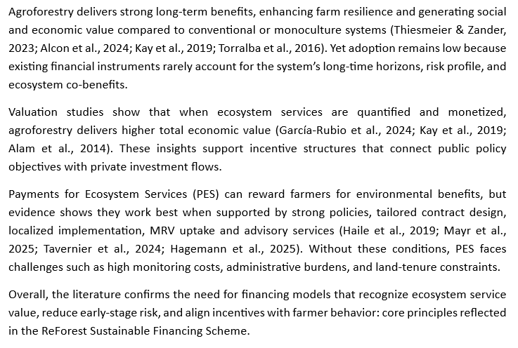
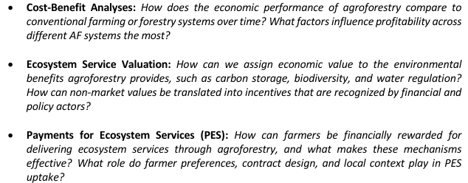
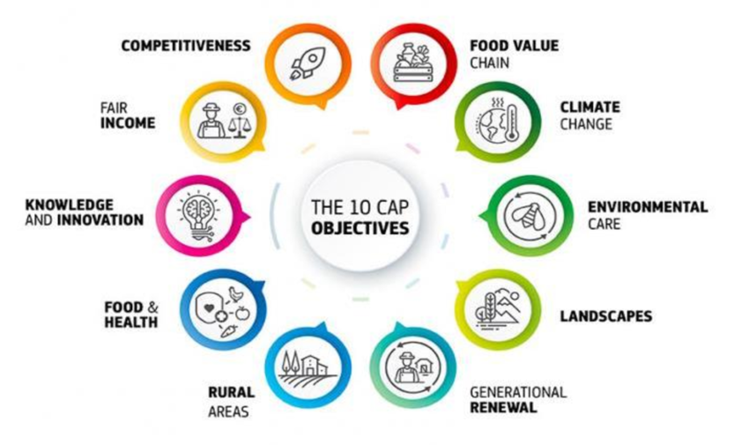
Mapping Report - Finance
Key Insights from Literature Review
MOTIVATION

Slide 6
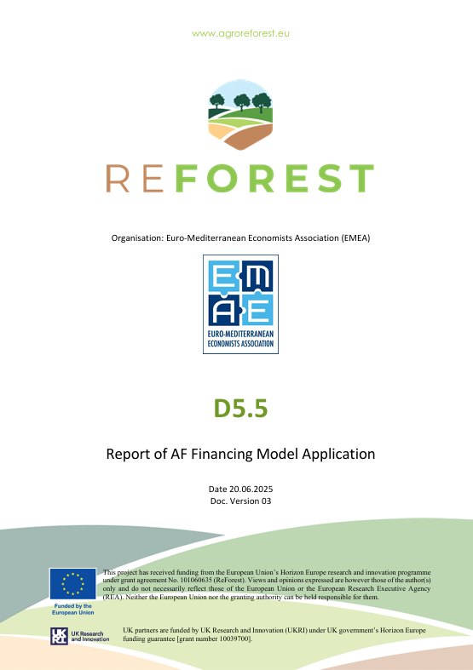
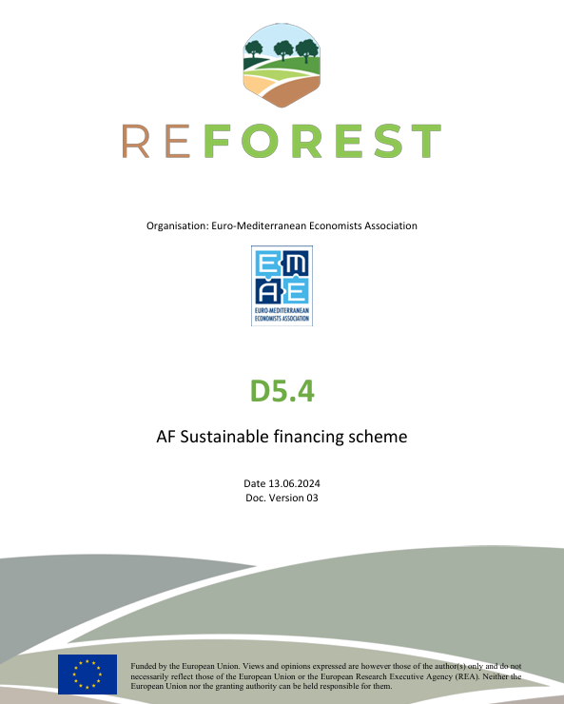
Design and Application of ReForest Financing Scheme
Application
Theory
Prepared and published by Ivan Hajdukovic (2024)
Prepared and published by Tiago Zibecchi (2025)

Slide 7
Proposed Sustainable Financing Scheme for AF
Ex-Ante based payments
Result based payments
Action based payments
Advisory Services
Ref.: COWI, Ecological Institute, and IEEP (2021); Den Heder (2017); Guimarães et al., (2023); Hadjukovic (2023); Kay et al (2019); Mc Donald et al (2021); Sheid et al (2023)
The Sustainable Financing Scheme was co-designed in Deliverable D5.4 (Hadjukovic,2023) through iterative consultations with REFOREST partners and Living Labs. It integrates findings from WP5 Mapping Reports, Stakeholder Feedback, and Literature Review on blended finance and PES mechanisms to create a hybrid model stress-tested with LL’s and extended EU & UK farmers.

Slide 8
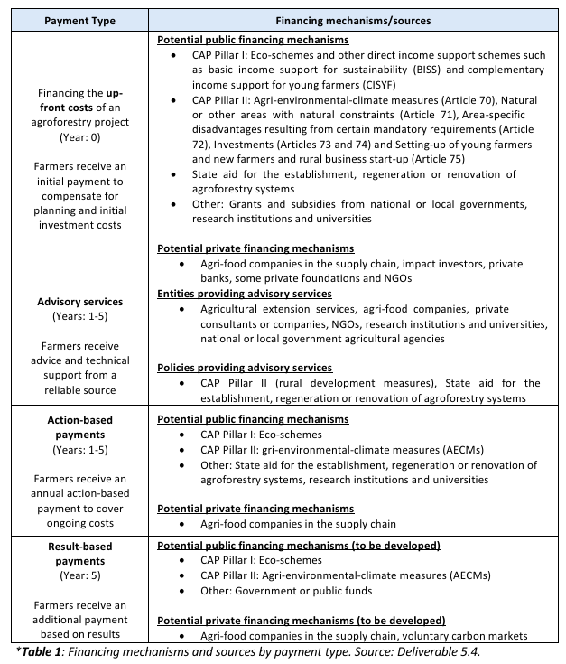
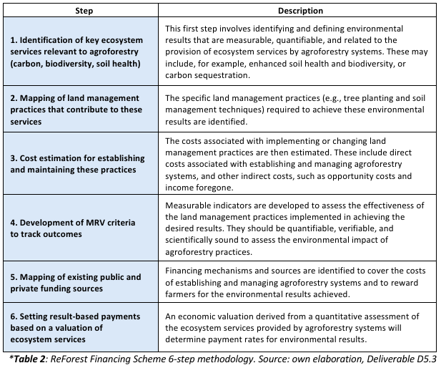
Scheme’s Methodological approach

Slide 9
Baseline Scenario (Subsidies/ CAP based)
5 Year Prototype Phases* | Proposed Scheme | Traditional / Subsidiary Based Payments
Prior to Project Implementation (Upfront) | Ex-ante payments | - CAP Pillar I & II -> Planning and initial setup grants for feasibility studies, land assessment, and initial project setup. - State Aid -> Initial research and infrastructure setup funding.
Year 1: Establishment of AF Systems | Action-based payments | - CAP Pillar I (Eco-schemes) -> Subsidies for sustainable planting practices, rewarding practices that benefit the environment and climate beyond usual requirements.
Years 1-5: Management of AF Systems | Hybrid payments | - CAP Pillar II (Rural Development) -> Funding for ongoing management and operational costs, enhancing system resilience and productivity. - Operational State Aid -> Support for sustainable agricultural operations. - Direct Payments -> Basic income for compliance with sustainability practices.
Year 5*: *or End of the Project | Result-based payments | - CAP Pillar II: Rewards for achieving sustainability targets at project completion.
Extra / Conditional Payment Services | Other existing Payments | - Young Farmers: Targeting under 40-year-old farmers - CRISS: Targets smaller farms for higher per hectare support. - PSF: Simplifies payments to reduce burdens.

Slide 10
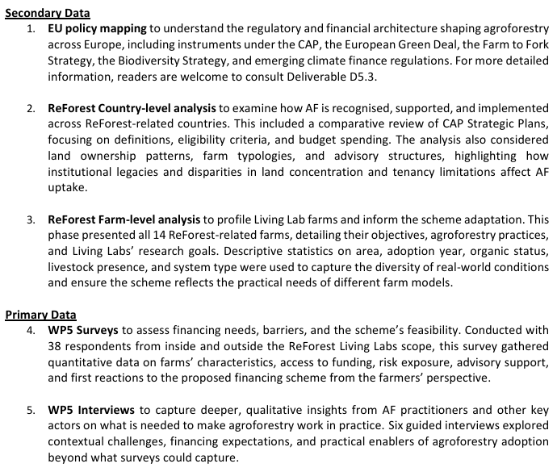
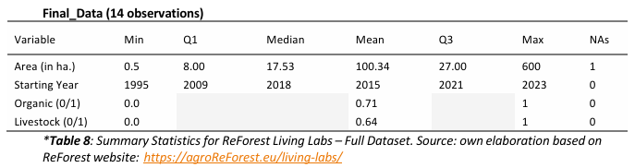
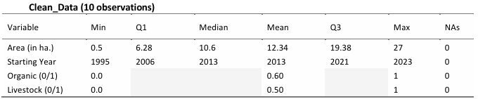
Financing Scheme Living Labs'Application
Overall Data
ReForest Living Labs – Discriptive Data
Belgium (1); Bulgaria (1); Czech Republic (2); Denmark (1); Germany (1); Hungary (3); England (5)

Slide 11
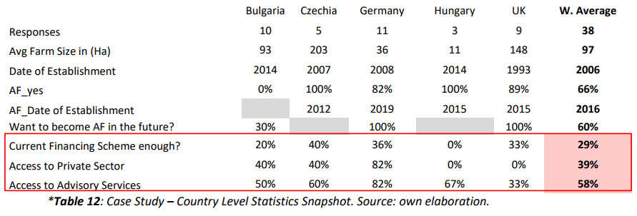
Living Labs Survey shows

Slide 12
Living Labs Survey shows
Financing Gap | Only 1/3 of farmers say their Current Financing Scheme is enough to mantain their AF practices
Private Sector Involvement Gap | Only 1/3 of farmers engaged with Private Sector Investments
Advisory Service Gap | Around 60% of farmers are connected to some form of Advisory Services
* Data Based on 38 Farmer responses from five EU countries (Bulgaria, Czechia, Germany, Hungary and the UK) under the ReForest D5.5 survey.

Slide 13
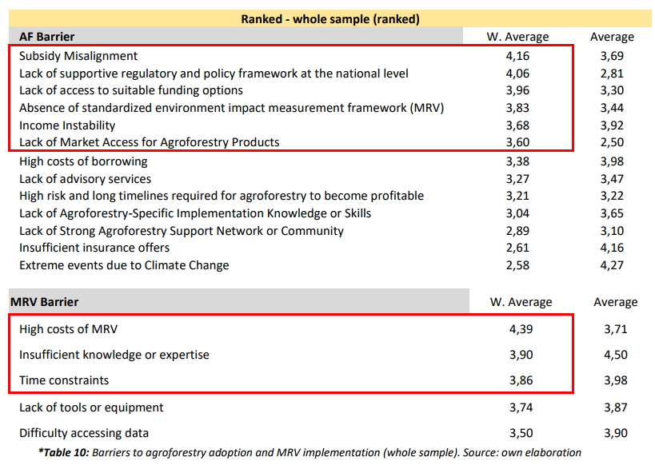

Slide 14
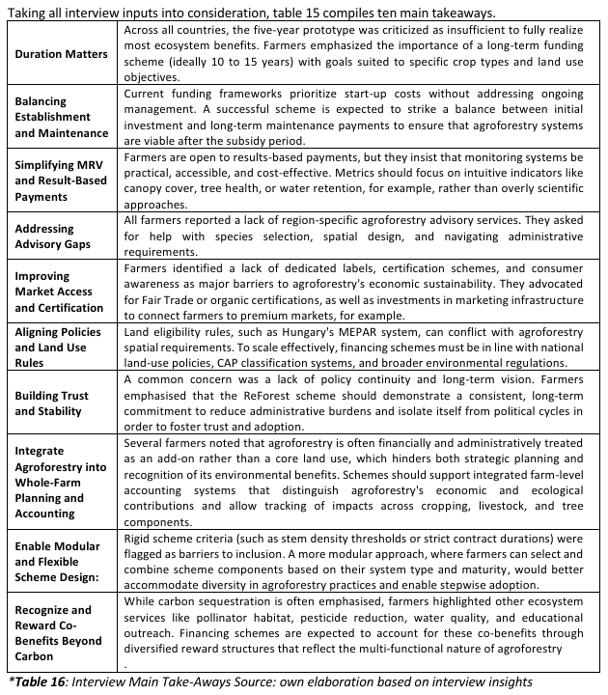
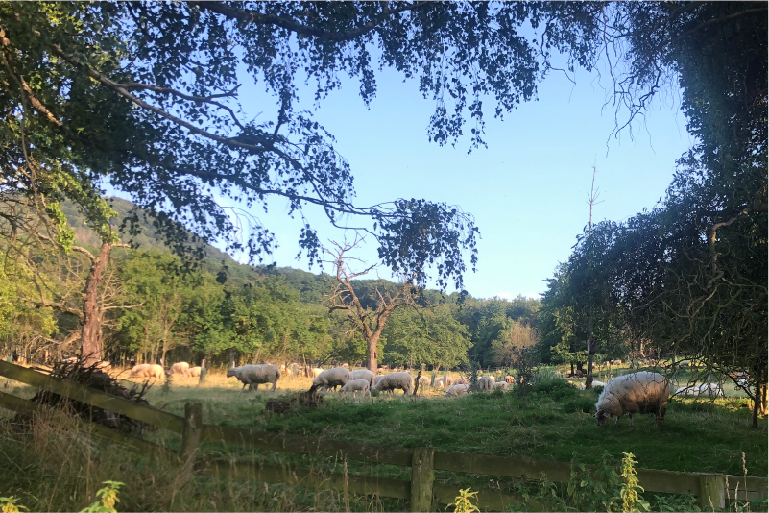
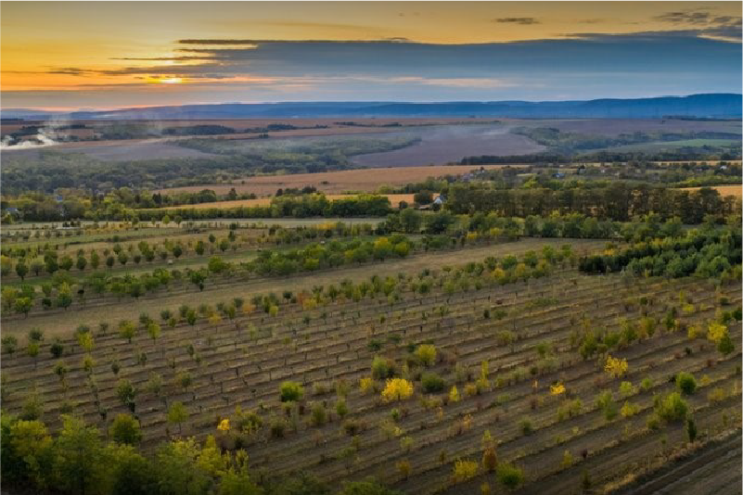
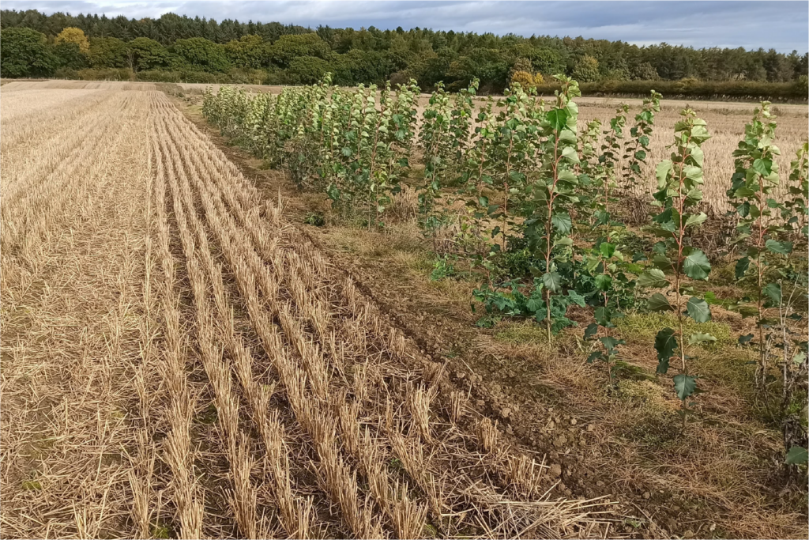
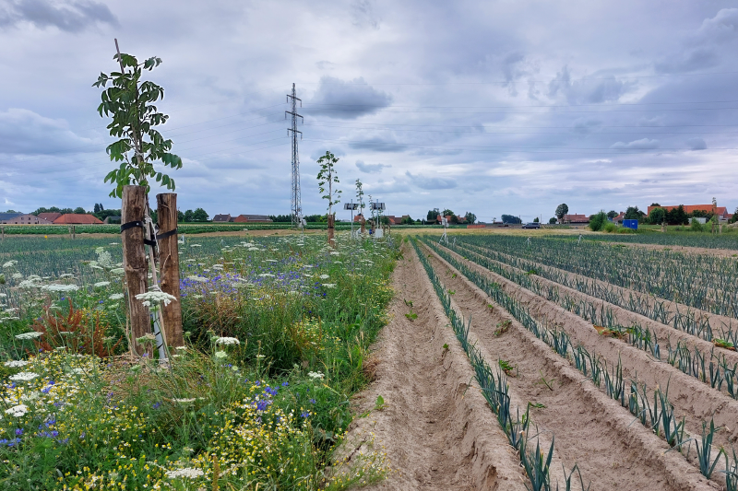
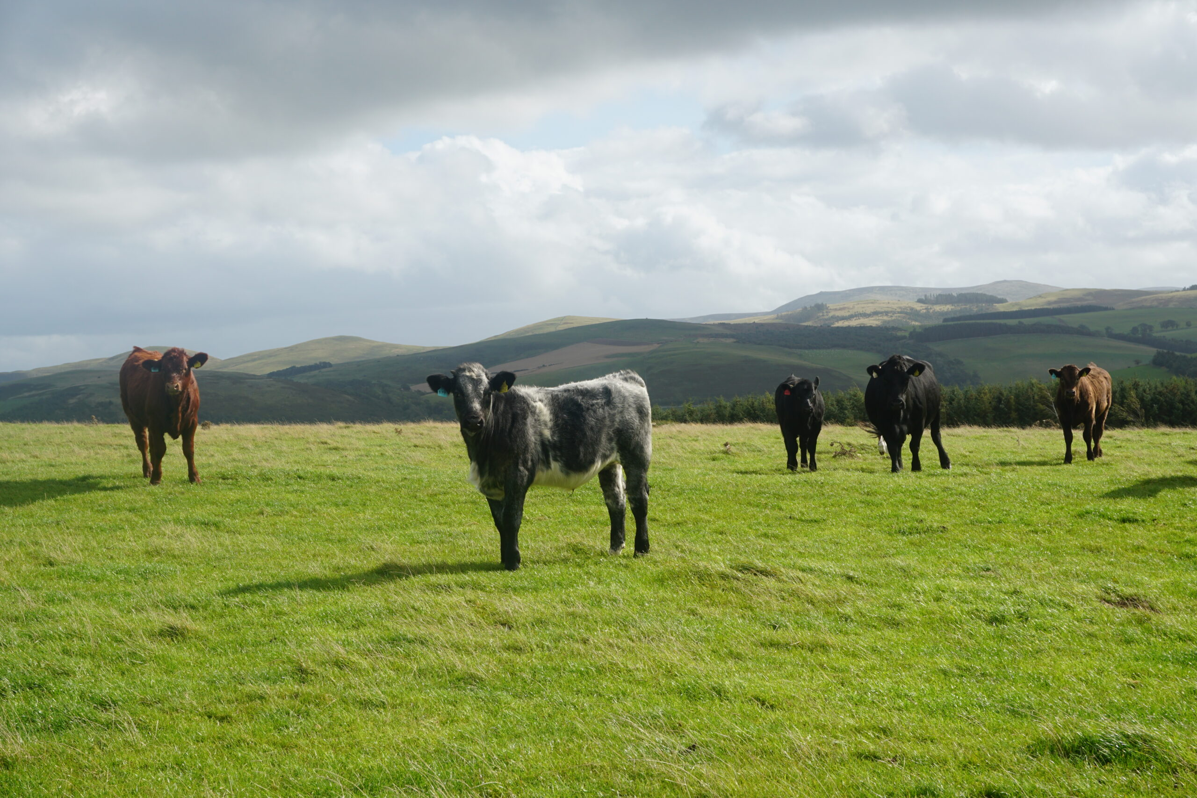
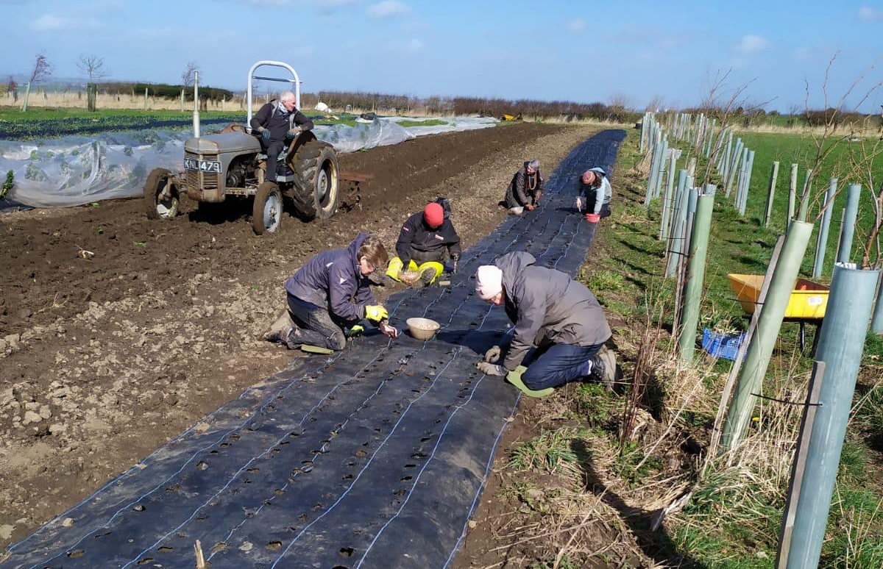
Living Labs Interviews shows

Slide 15

Upcoming Research Paper*
Quantifying ReForest Financing Scheme impact on farmers’ performance using Decision Analysis Model

Slide 16
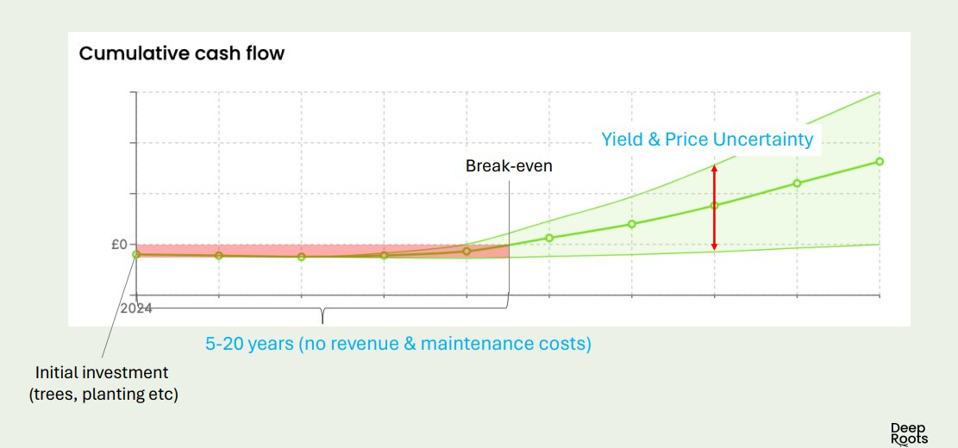
ReForest Financing Scheme
Stylized Typical AF Farmer Financial Projection
De-Risking and Blended Finance mechanisms**
Action Based Payments
Ex-Ante Payment
Hybrid - Results Based Payments
Advisory Service

Slide 17
De-Risking and Blended Finance mechanisms**(1/2)
Incentive Mechanisms | Brief Discription / Economic Rationale | CBA Model Application / Funding Channel | Real Case Study - Examples
Seed Funding and Grants from NGO and Philantropic Foundations | Provide early-stage or transition funding for AF projects through grants, concessional loans, or catalytic capital from major donors, foundations, and impact-driven funds. *Co-funding schemes that blend donor capital with public subsidies or guarantees | One time - Upfront funding [€] Annual (periodic) - Seasonal/ Seed Funding funding [€] | GIZ; Climate and Land Use Alliance (CLUA); Moringa Fund; Terra Bella Fund; UNDP Small Grants Programme; WWF Landscape Finance Labs; EIB/GEF blended pilot funds
Nature Capital Markets and Certification Schemes | External accredited organs that measure and certify carbon storage and biodiversity enhancements, increasing project credibility and investment appeal | Carbon Market Credits *case study: analysis on the decision to join Carbon market – size and age matters MRV funding support [€] Cost of Certification / Sponsors [€] | Verra (VCS) and Jurisdictional and Nested REDD+ (JNR); European – ETS and Voluntary Schemes; CRCF Regulation Policy; Gold Standard; emerging biodiversity markets; JNR & jurisdictional REDD+
Impact Investment, Blended Finance & Crowdlending and Crowdfunding Platforms | Funds looking for positive social and environmental returns. Series of online platforms that raise funds from many investors, ideal for community-based, cooperatives or smaller agroforestry projects. | Loan amount [€] Interest Rate [%] Repayment of loan from year [grace periods] Annual Repayment amount [€/year] | AraraSeed; Growahead; Crowdfarming ; Greenmatch, Sitawi Finance for Goodblended funds under GEF/IFAD; Triodos sustainable agriculture financing
Risk-Mitigation / Sharing Instruments | Reduce the financial exposure of farmers and lenders, enabling long-term investments with delayed returns. These instruments cover early losses, climate shocks, or credit risk, making lending more accessible and lowering financing costs. | Initial investment risk covered by Guarantee instruments (collateral component) [€] First-Loss Capital & Climate Insurance *case study: Parametric Insurance | USAID’s Development Credit Authority (DCA), African Development Bank’s Partial Risk Guarantees, European Association of Guarantee Institutions (AECM), AVHGA, ISMEA, emerging parametric insurance (e.g., Oxfam, WFP pilots)

Slide 18
De-Risking and Blended Finance mechanisms** (2/2)
Incentive Mechanisms | Brief Discription / Economic Rationale | CBA Model Application / Funding Channel | Real Case Study - Examples
High-Quality, Site-Specific Advisory & Technical Assistance Services | Specialised advisory services improve farmer decision-making, reduce design errors, and increase long-term productivity. Also improves access to financing by providing management plans, budgets, and documentation required by lenders or public authorities. | One-time consultation cost [€] Annual Cost of Service [€/year] Rate over all experience with adv service [%] Rate the service based on the design created from advisor [%] | ReForest Living Labs, Agforward (UK) Agroforestry Network, Dehesa Advisory Service (Spain), Bavarian State Institute for Agriculture (Germany), (Danish) Agricultural Advisory Service, (Hungarian) Research Institute of Organic Agriculture, (Czech) Agroforestry Association
Integrated Value-Chain & Processing Infrastructure Finance | AF becomes economically viable when farmers have access to processing, storage, logistics, and market infrastructure. Dedicated finance for value-chain assets (e.g., nut cracking, fruit drying, timber processing, cold storage) increases product value and reduces post-harvest losses. | Specific /favoring credit lines *case study on the decision to join cooperatives Cost of shared cooperative equipment [€] Annual operation and maintenance cost for infrastructure [€/year] | Multiple Development Banks, European Investment Bank (EIB), IFAD Projects, national cooperative banks; development finance institutions (DFIs); IFAD value-chain projects; EIB agriculture infrastructure loans; national rural development grants; cooperative processing clusters in Spain, France, Italy.
Advance Purchase Agreements (APAs) & ESG-Aligned Procurement Contracts | Forward long-term contracts secure future revenue streams by guaranteeing the purchase of AF products before production. APAs reduce price volatility, support early investment decisions, and strengthen farmers’ bargaining power in value chains. | Carbon and biodiversity forward contracts / Price Guaranteed at [€/t] Reduction in price uncertainity [%] Additional price consumers are willing to pay for sustainable/regenerative products [%] | Fairtrade International, Agroforestry Network, Forest Carbon Partnership Facility , Nestlé’s Sustainable Sourcing Program, Propagate Ventures, Global Environment Facility, Mendelez
Digital Tools, Climate-Tech Startups & Data sharing Platforms | Collaborations that drive innovation, scale solutions, and provide financial or technical support. These partnerships can accelerate AF adoption trough better decision making and MRV levels . | Digital Tool Subscription [€/year] Planning and report generation cost [€/year] | INRES Decision Analysis Modeling, The LandBankingg Group;; FarmTree; DeepRoots; INTACT; FarmSafe; many others - check: Tools, Data and Projects Catalogue - DigitAF

Slide 19
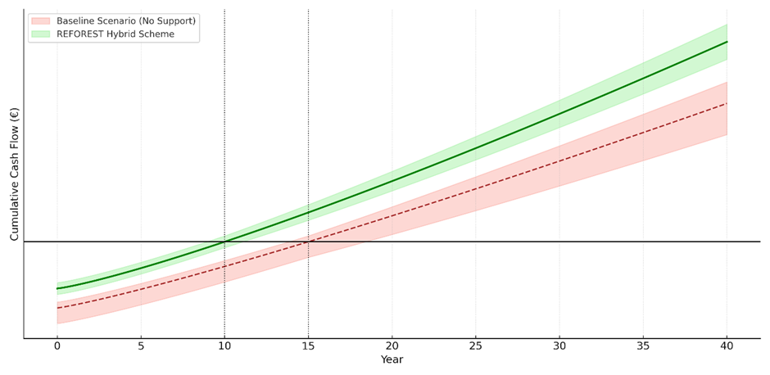
Stylized Cumulative Cash Flow Projection – Baseline vs. ReForest Scheme
Note: The FarmTree tool supports the design of agroforestry projects by modeling long-term costs, revenues, and ecosystem service benefits across various tree–crop–livestock combinations. It uses ReForest farm-level input data, such as tree species, crop rotation, planting density, yield forecasts, labor costs, and maintenance schedules, to simulate annual cash flows over a multi-decade horizon. The tool applies time-phased cost and revenue curves that reflect the biological growth cycles of perennial systems and integrates assumptions about market prices, discount rates, and subsidy schemes. Scenario analysis allows comparison between conventional systems and agroforestry alternatives, making it easier for users to assess investment feasibility, break-even points, and long-term profitability under varying policy and market conditions.

Slide 20
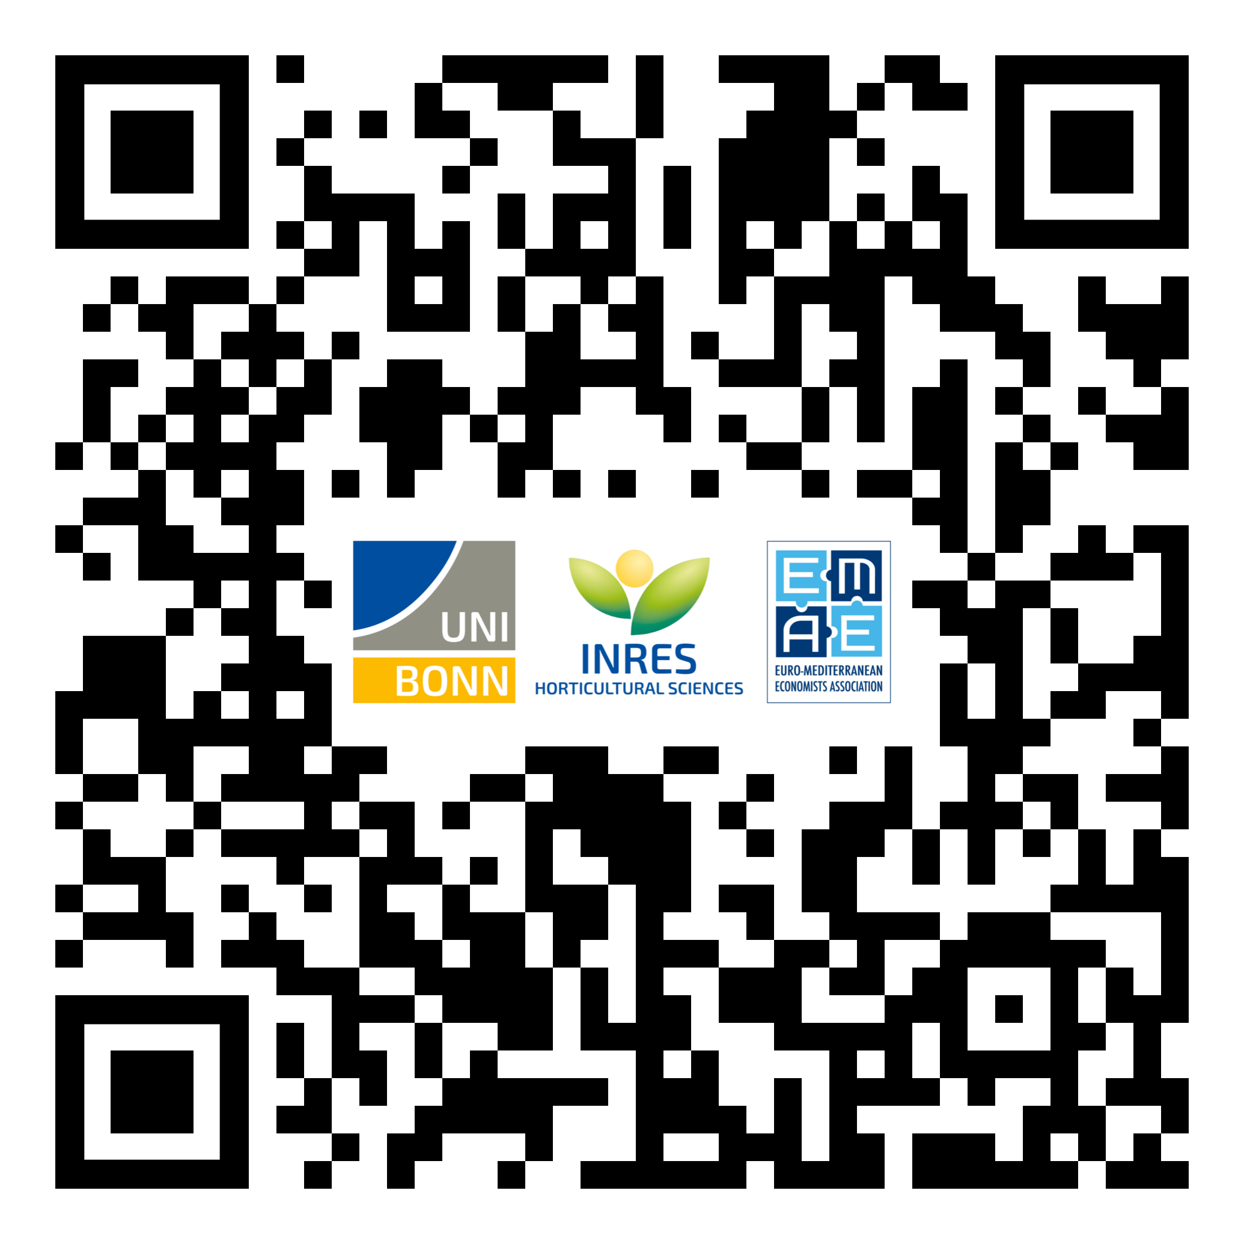
Dynamic Management Tool + EMEA’s Financial Scheme
https://agtools.app/af-financial-scheme-europe/

Slide 21
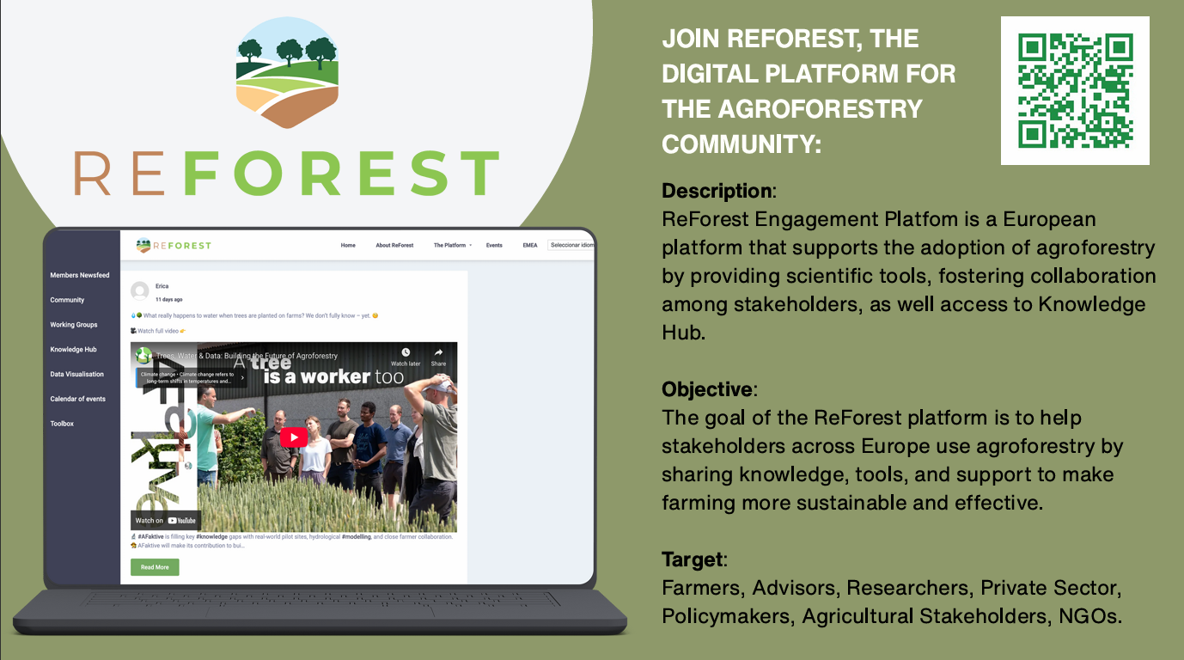
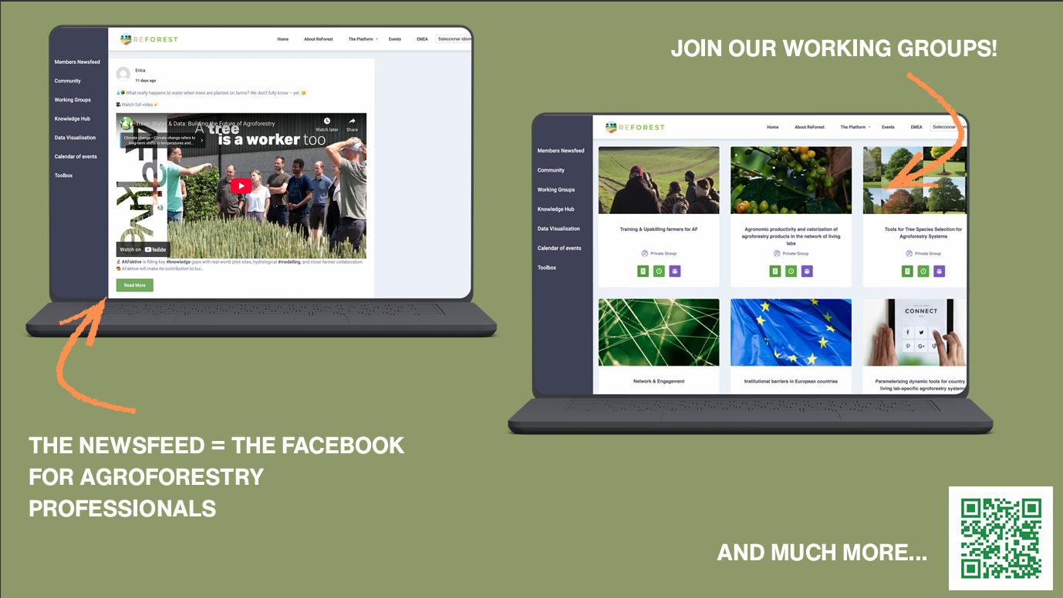

Slide 22
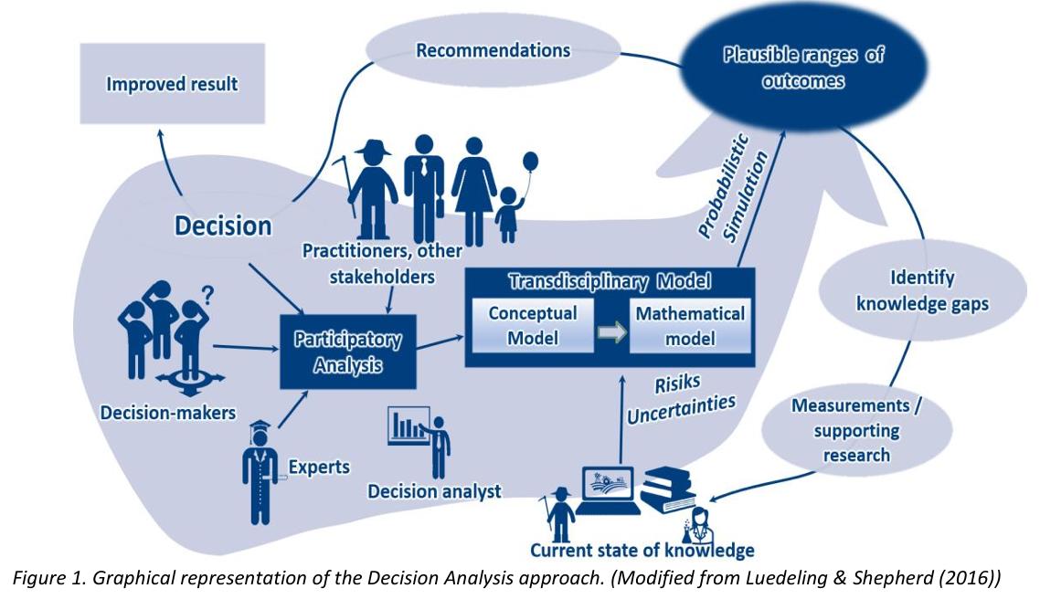
Decision Analysis Approach

Slide 23
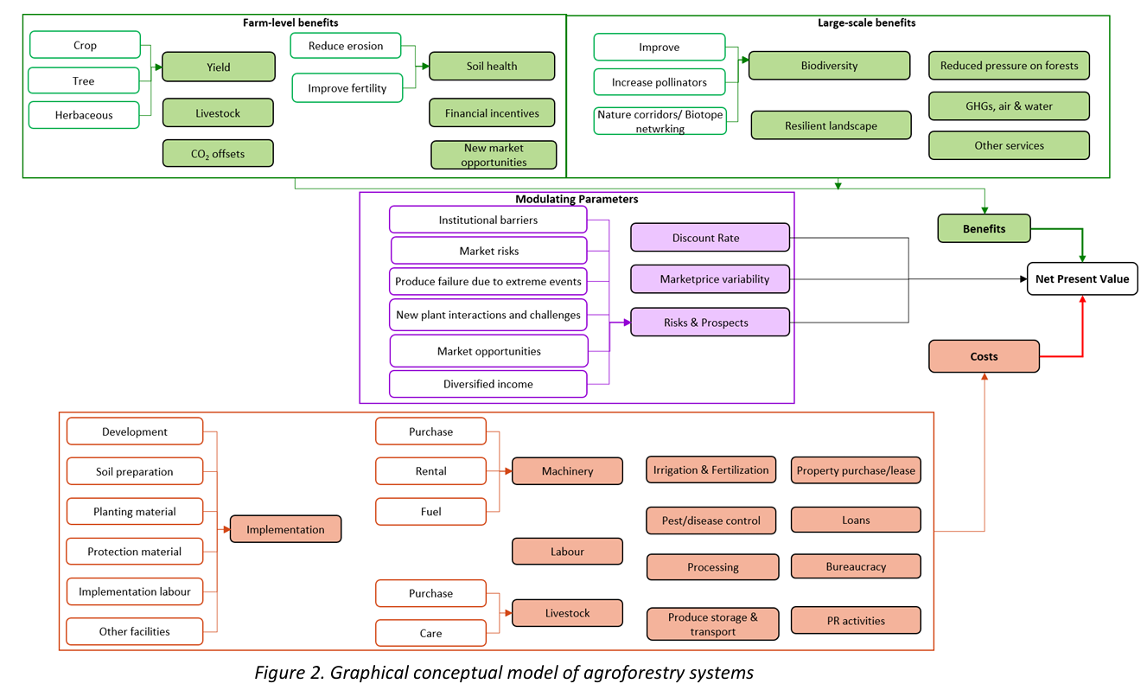
Decision Analysis Approach

Slide 24
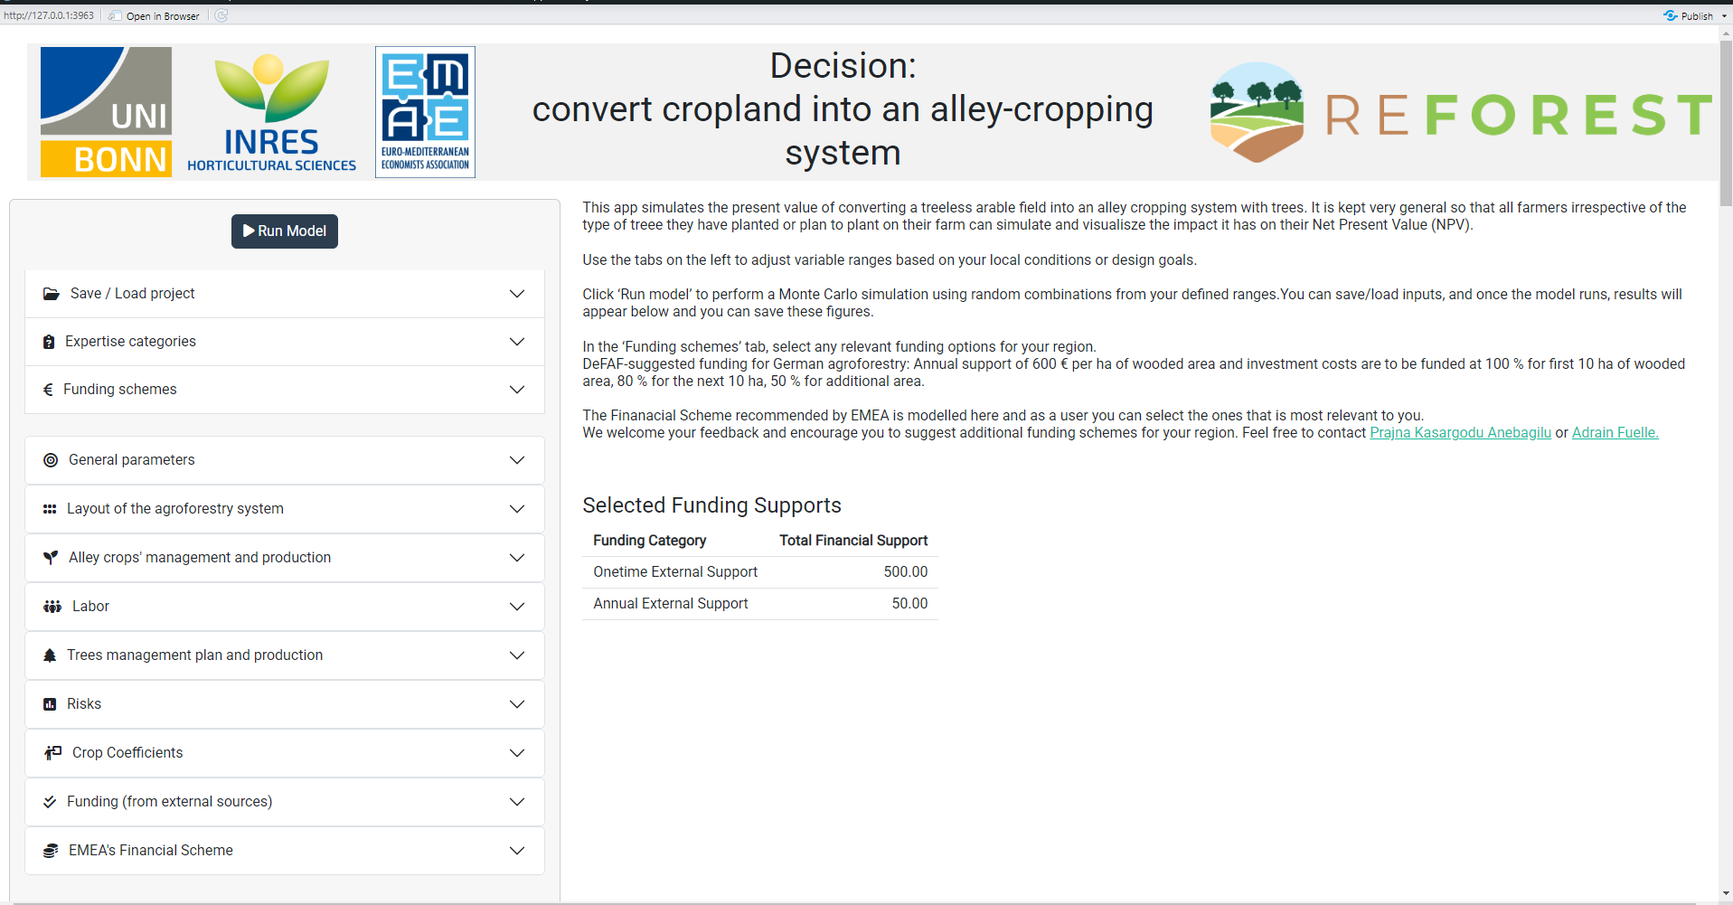
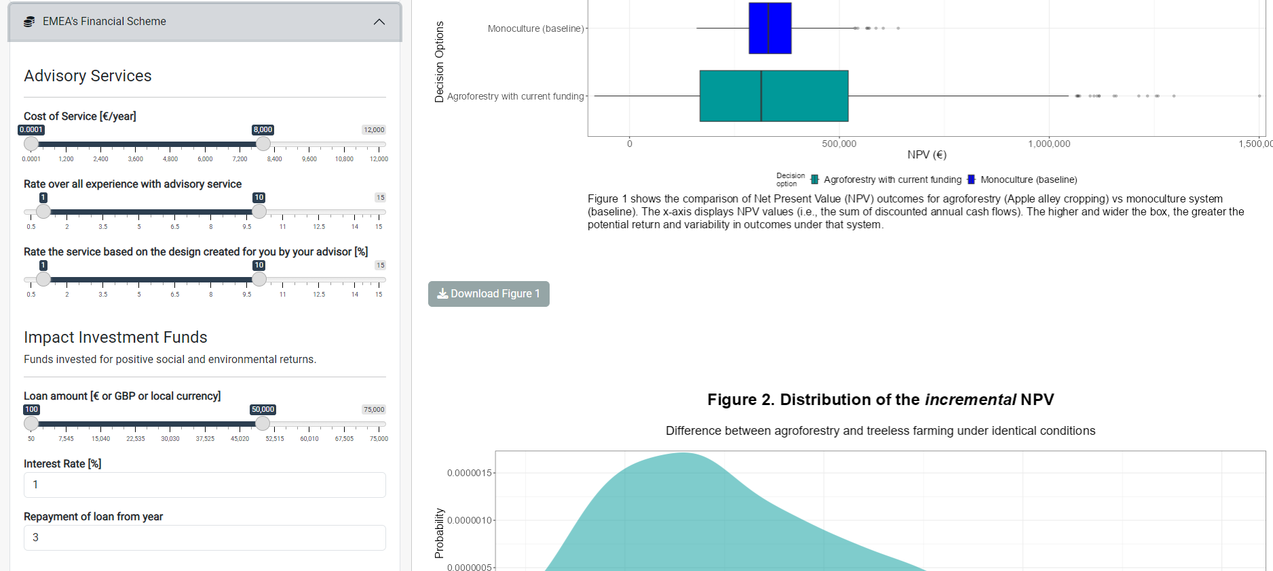
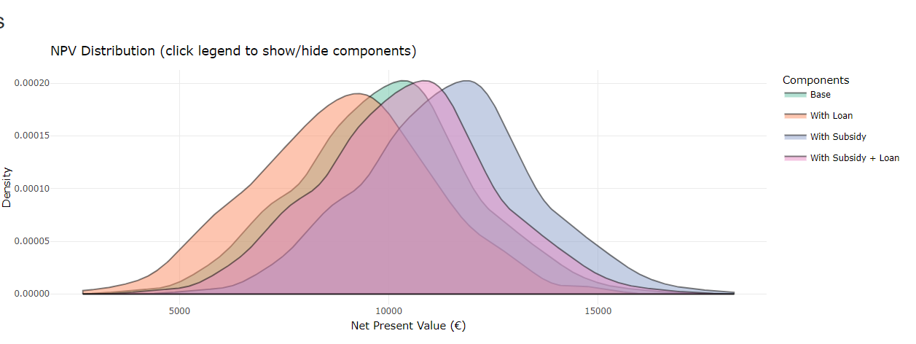
Decision Model Interface – Sensitive Analysis Scenario Comparison

