Slide 1


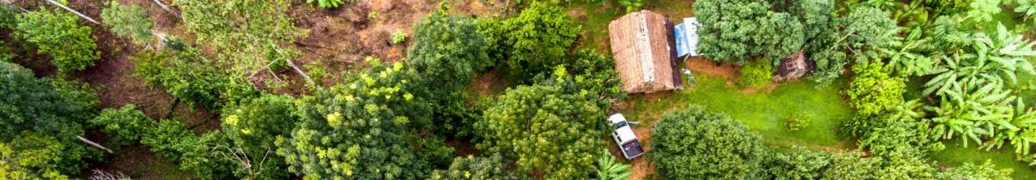
FarmTree Advantage
Practical Use of the Platform to Strengthen Value Chains
Prepared for REFOREST – FarmTree webinar, 23rd October 2025
Presented by:
Mia Beyens mia.beyens@farmtree.earth
Roos van Haeff roos.vanhaeff@farmtree.earth
Betelehem Beyene: betelehem.beyene@farmtree.earth
Frank van Schoubroeck Frank.vanSchoubroeck@FarmTree.earth
Notes:
FarmTree is a social enterprise that aims to make Agroforestry investable through a SaaS service

Slide 2
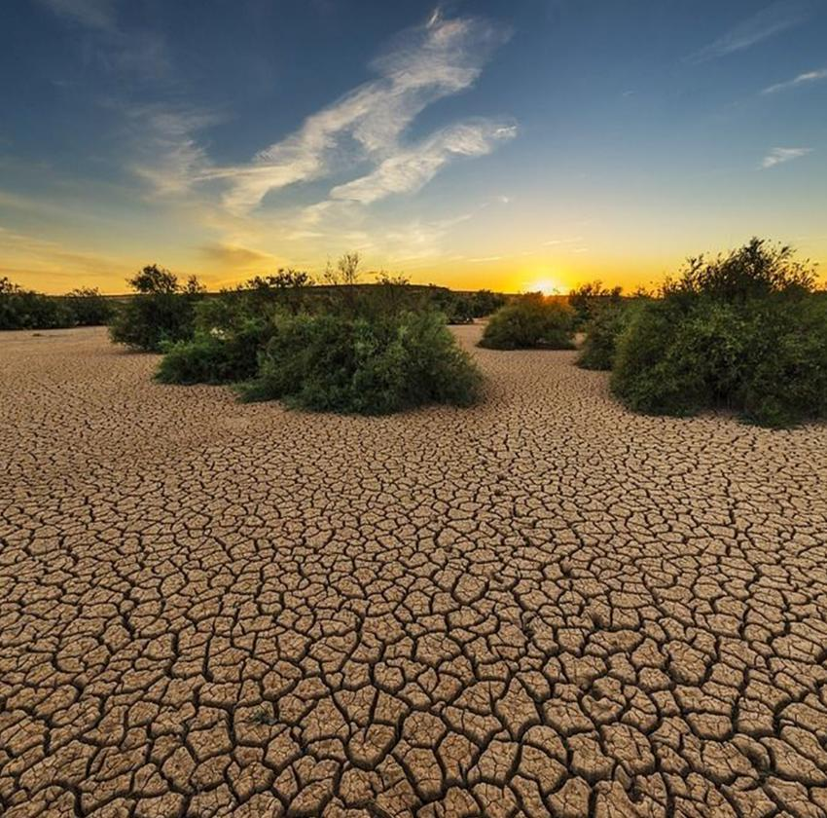
FarmTree Platform Introduction
Who we are
FarmTree is a social enterprise offering data and a digital platform that quantifies the impact of landscape restoration.
Through the FarmTree Platform, users can model and project yield, carbon, water, financial, and environmental returns from agroforestry systems.
We operate as a Software-as-a-Service (SaaS) solution and also provide consulting services for financial, farm, and landscape analyses.
No reliable data
No predictable returns
No investments in restoration

Slide 3
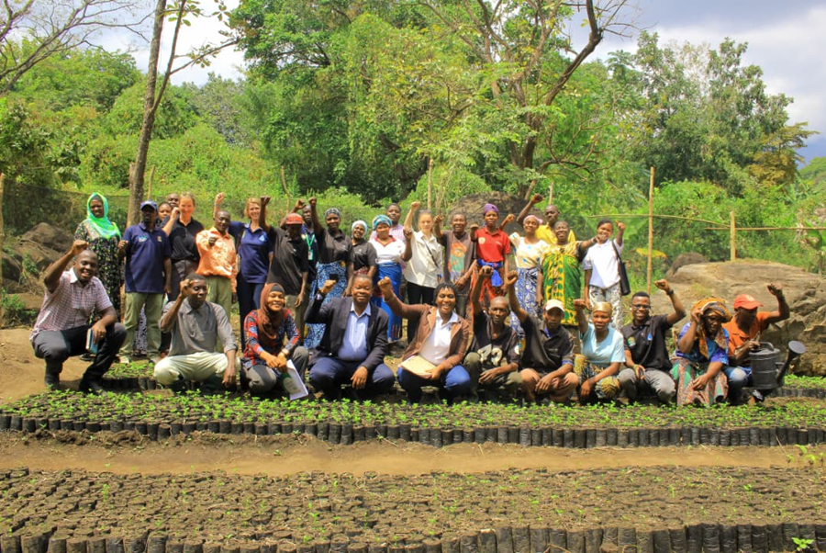
The FarmTree Platform Introduction
“Turning agroforestry into a predictable, profitable and scalable investment – for every decisionmaker – worldwide.”
WHY THIS MATTERS
From Farm to Landscape to Finance
Producers seek profitable agroforestry; investors seek verified financial, social, and ecological outcomes.
Data = Investment Potential
Unlocking validated, science-based tree and crop data to empower global experts and de-risk investment decisions.
Accelerating Restoration
Verified farm and forest plans accelerate smart and sustainable restoration at scale.

Slide 4
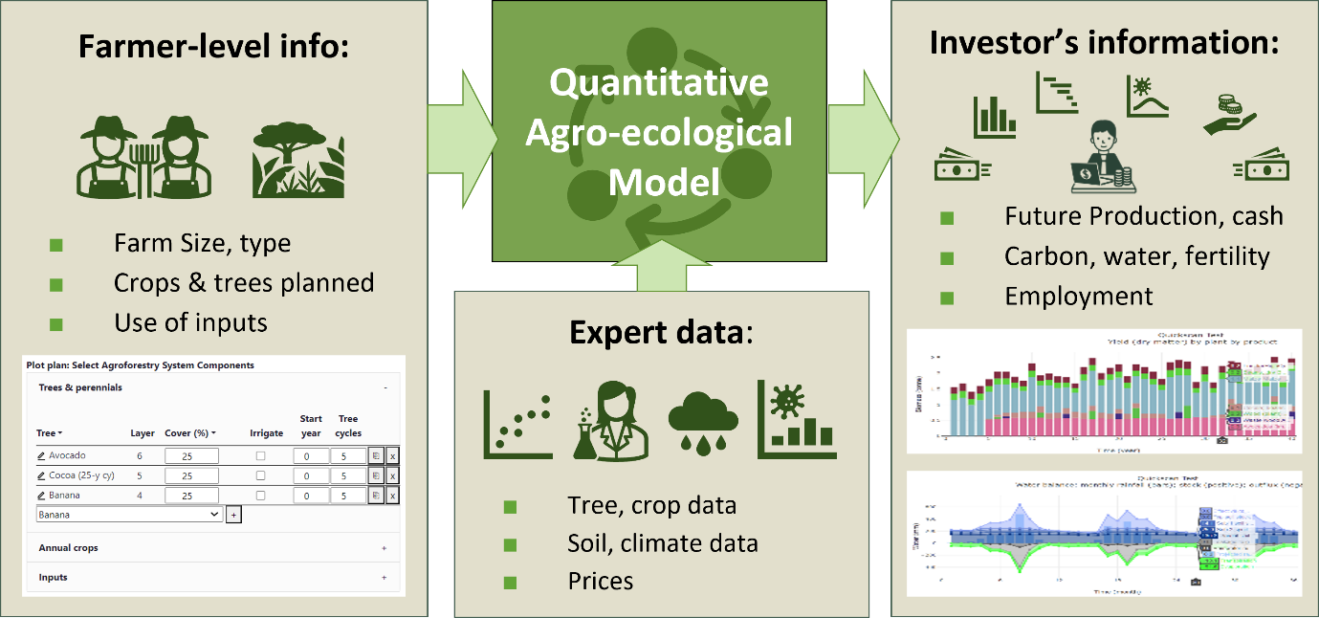
FarmTree Platform Innovation
How we develop
We are an enterprise so we constantly adapt to market needs
The platform has a growing user base of project developers globally → driving innovation
We use your feedback to implement the innovations
→ Let us know what you need! We appreciate your feedback

Slide 5







FarmTree turns uncertainty into clarity through data-driven forecasting
Climate Projections
Platform
Projected metrics
Livelihoods
Environment
Cash Flows
Reporting
Farm Plan
Project Plan
Plot Plan
Science-Based Models
Soil & Topography
Species data
Prices
Ground Truthing
Notes:
FarmTree has developed a platform that can project the 'people, planet, profit' impact of Agroforestry interventions all over the world. With a simple plot location and plot cover plan, FarmTree takes into account:
Climate, Soil, Topography
Annual and Perennial characteristics, including management options and pricing
Interaction between unlimited tree-crop mixtures
And turns that into multiple-KPI Farm Forecasts.

Slide 6
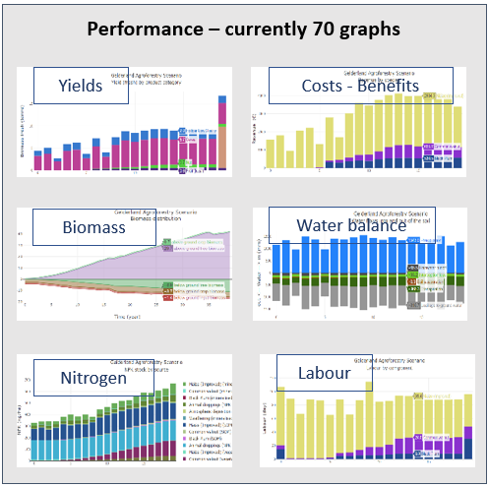
People across the value chain need access to Data
Production & Growth Data Expected yield over time and under different scenarios
Input Data Use and costs of inputs under each scenario
Economic & Financial Data Production costs at the primary production level
Harvesting Data Expected harvest (per year and per month)
Traceability Data Geospatial information (e.g., polygons for production areas)
Risk Data Yield variability and diversification under different scenarios (e.g. climate)
Environmental Co-benefits CRU & CRU revenue, biodiversity, water retention, soil organic matter (SOM)

Slide 7
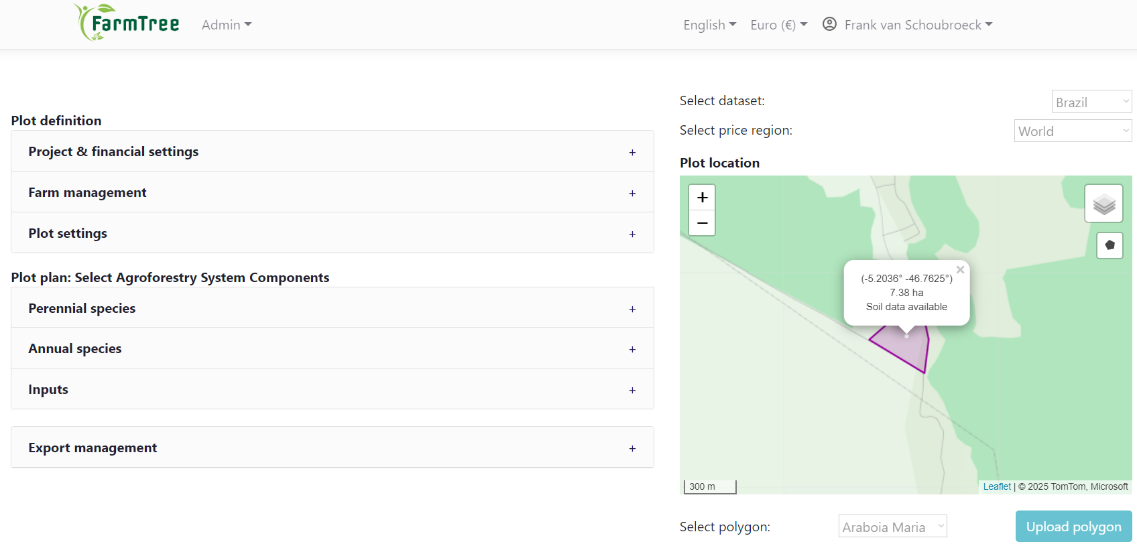
FarmTree Demo: What does it mean in the context of value chains?

Slide 8
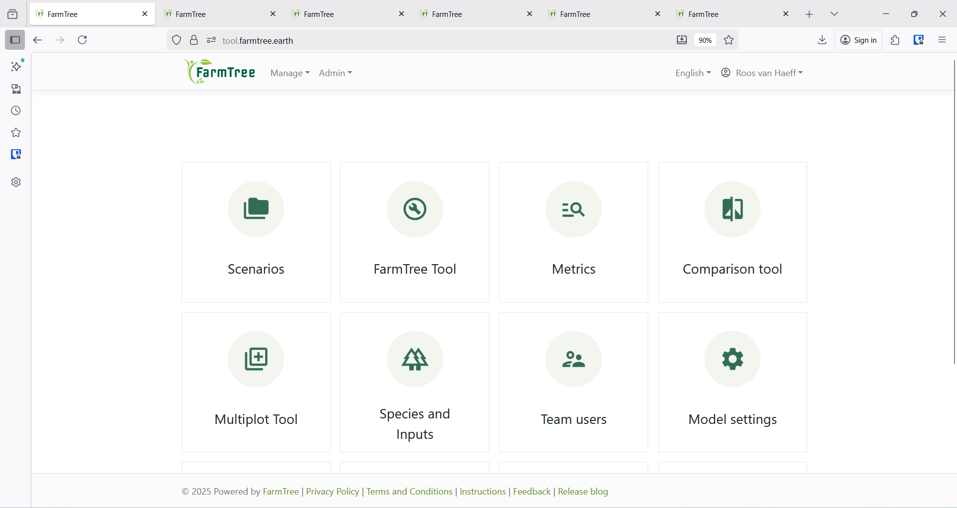
What does it mean in the context of value chains?
FARMTREE PLATFORM

Slide 9
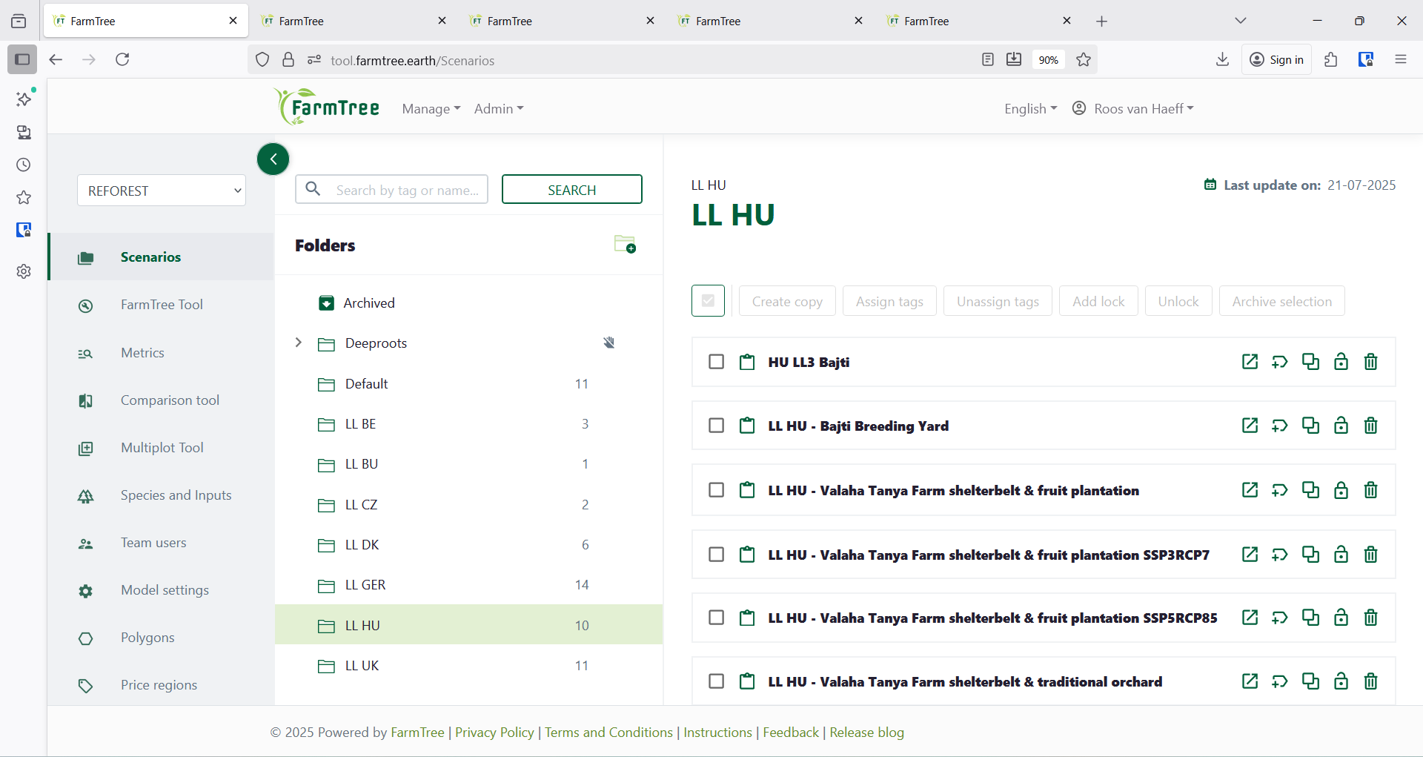
What does it mean in the context of value chains?
FARMTREE PLATFORM – SCENARIO STORAGE

Slide 10
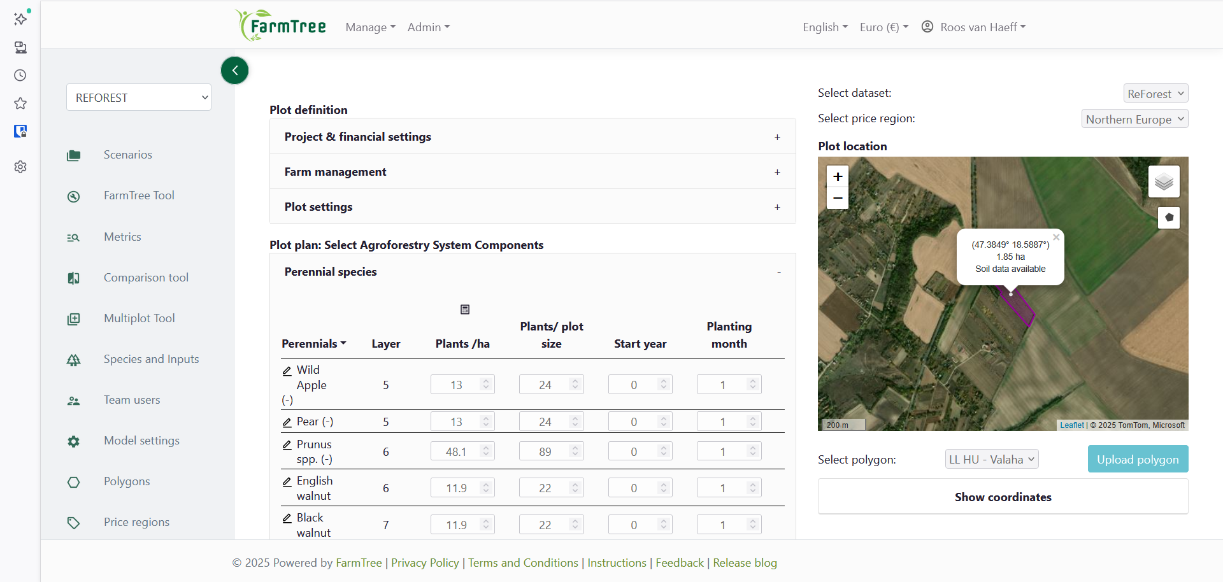
What does it mean in the context of value chains?
FARMTREE PLATFORM – SCENARIO DESIGN

Slide 11
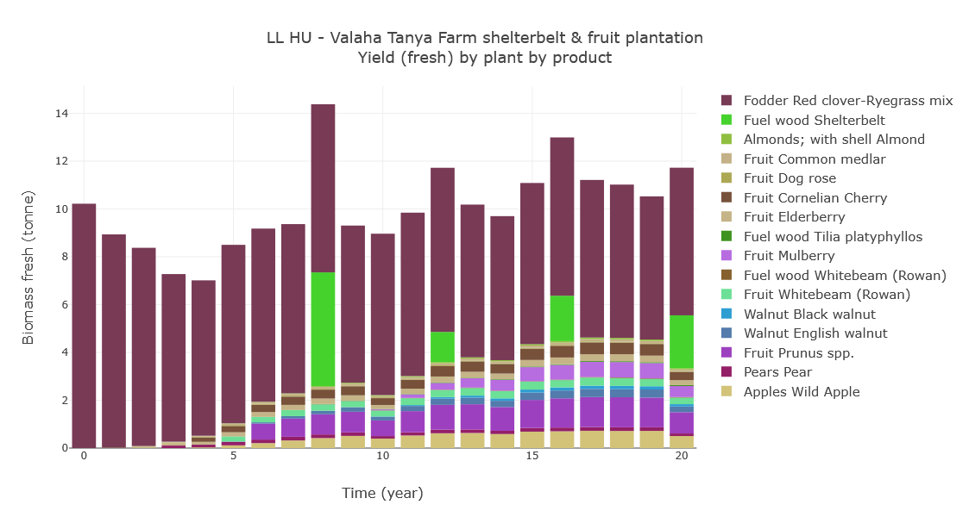
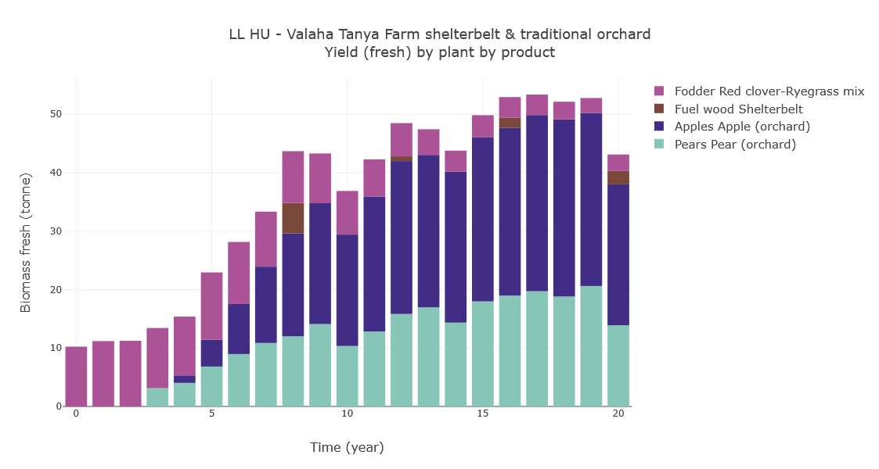
What does it mean in the context of value chains?
YIELDS

Slide 12
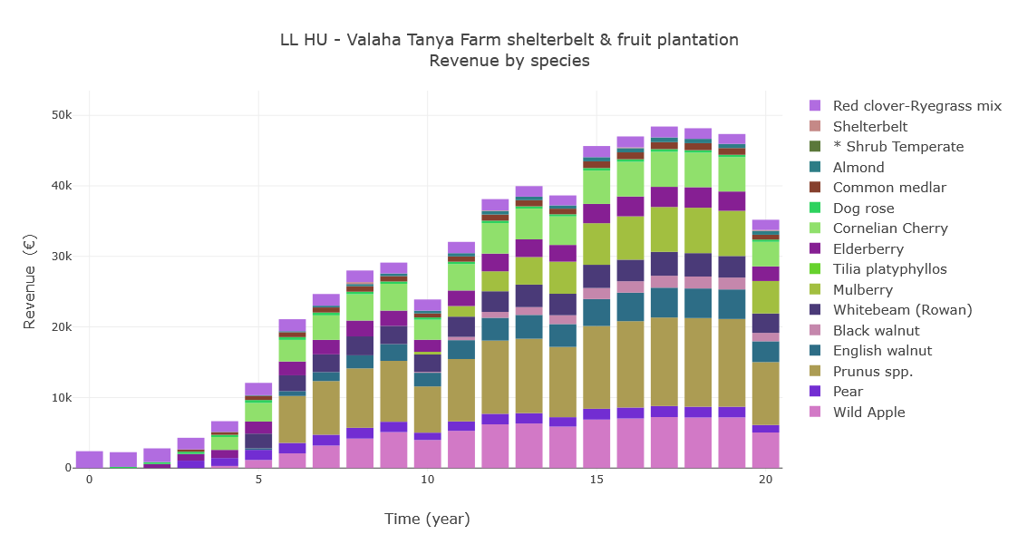
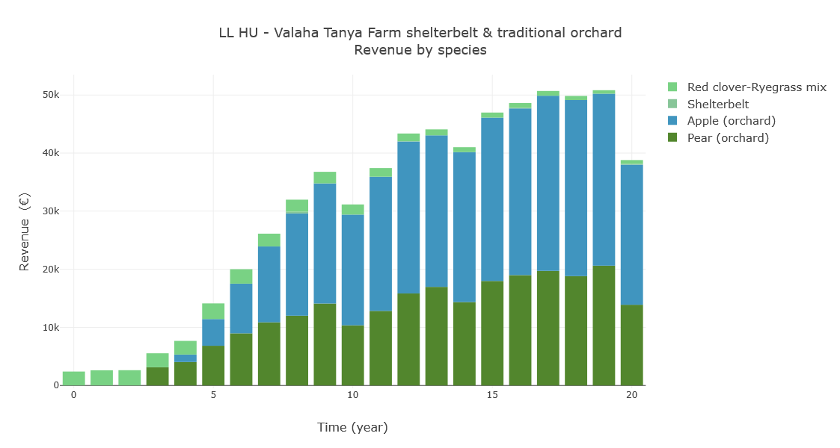
What does it mean in the context of value chains?
REVENUES

Slide 13
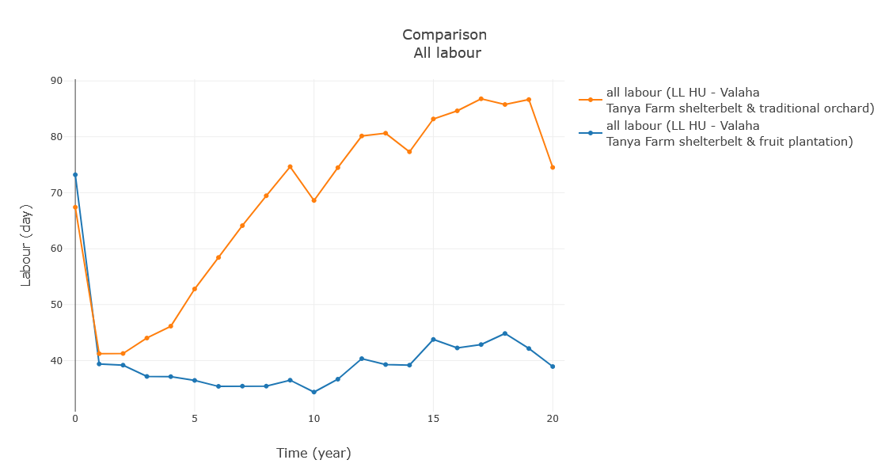
What does it mean in the context of value chains?
LABOUR

Slide 14
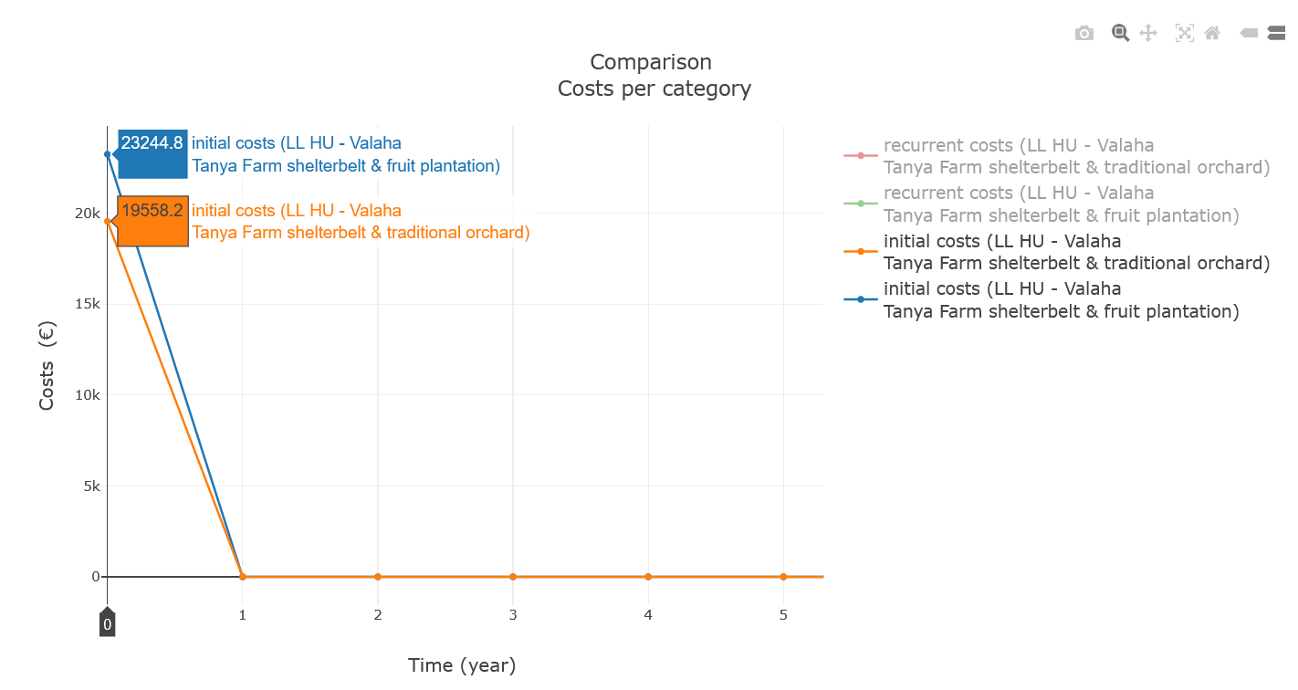
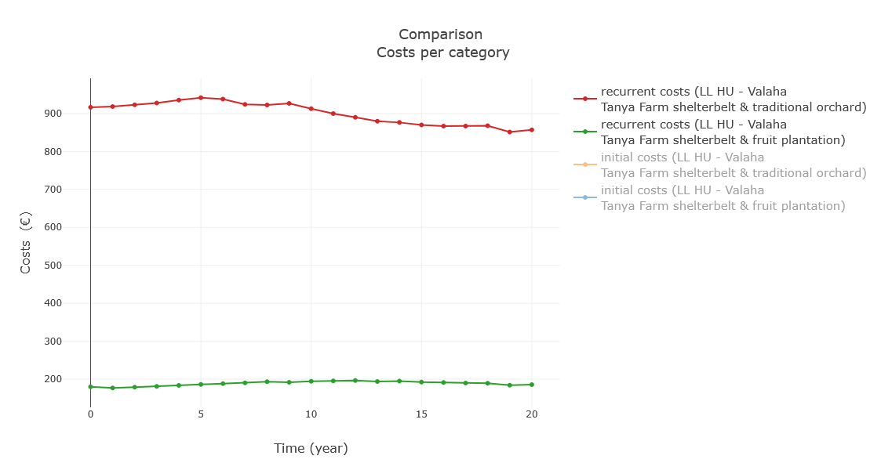

What does it mean in the context of value chains?
COSTS PER TYPE

Slide 15
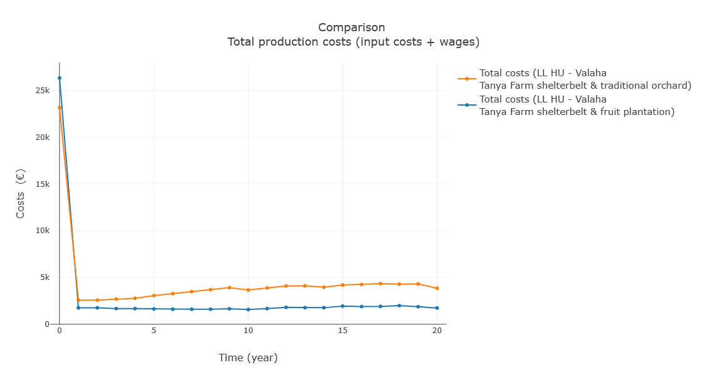
What does it mean in the context of value chains?
TOTAL COSTS

Slide 16
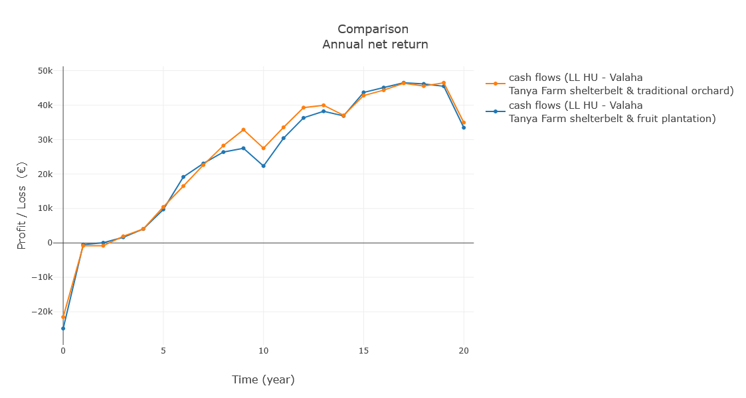
What does it mean in the context of value chains?
ANNUAL NET RESULT

Slide 17
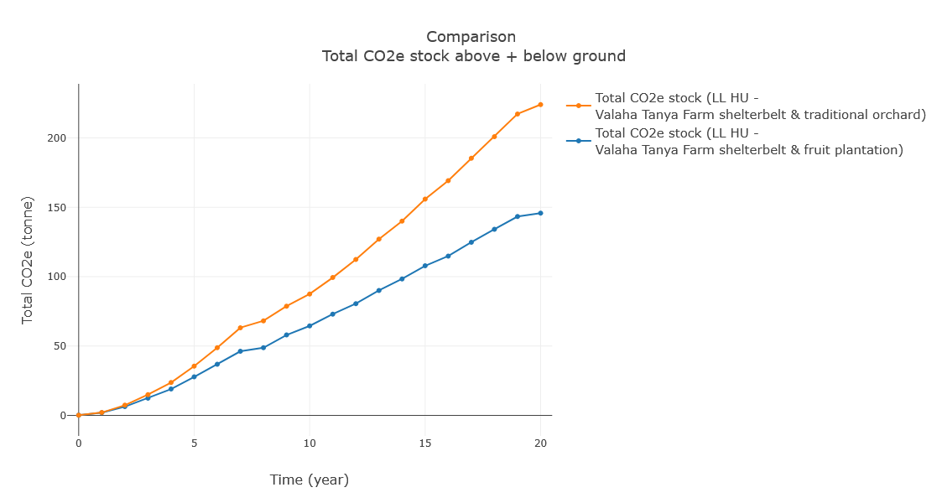
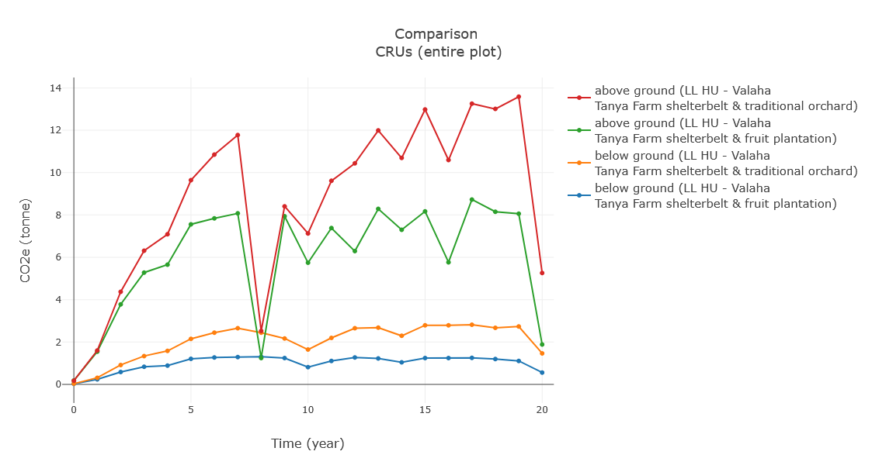
What does it mean in the context of value chains?
CARBON & CARBON REMOVAL UNITS

Slide 18
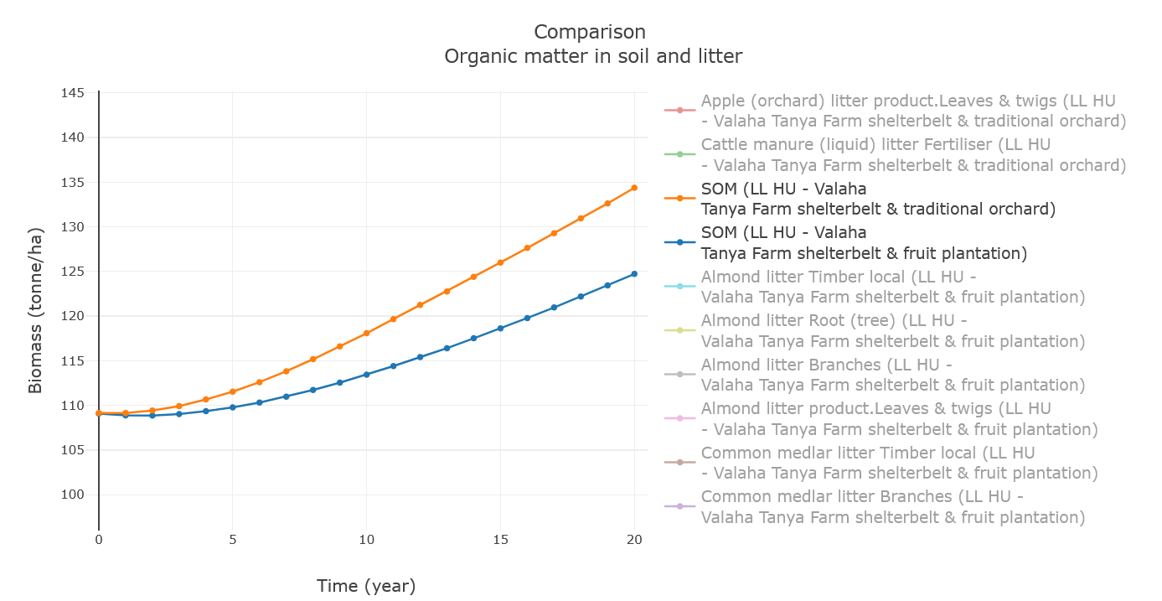
What does it mean in the context of value chains?
SOIL QUALITY

Slide 19
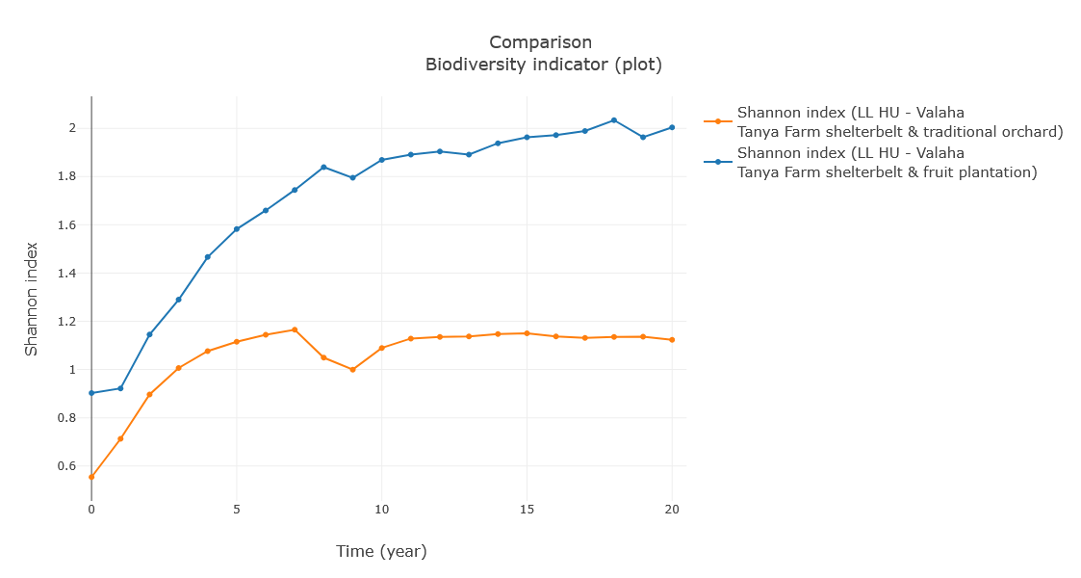
What does it mean in the context of value chains?
BIODIVERSITY

Slide 20
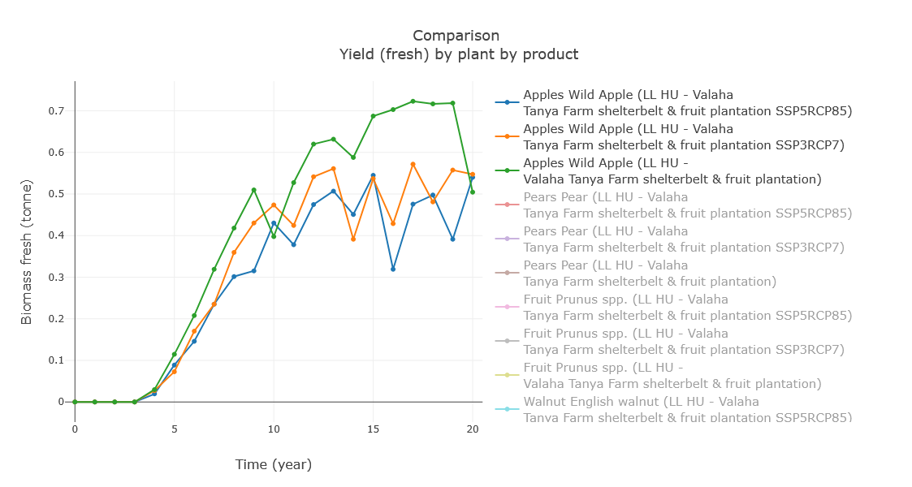
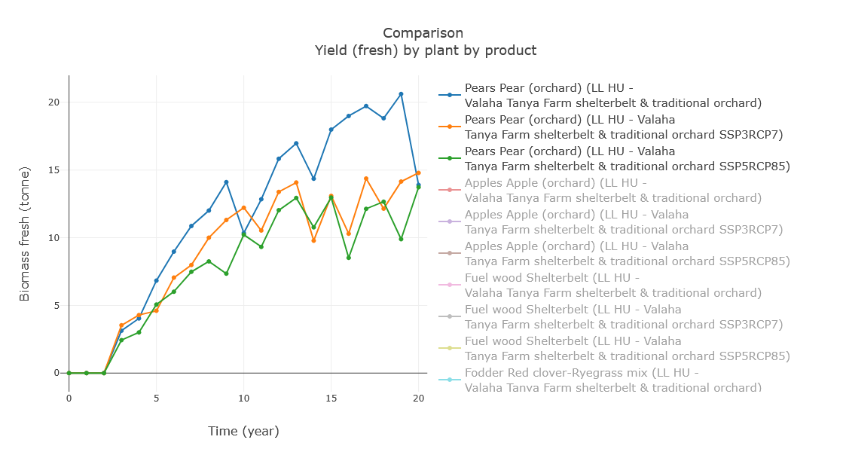
What does it mean in the context of value chains?
DE-RISKING – CLIMATE SCENARIOS

Slide 21
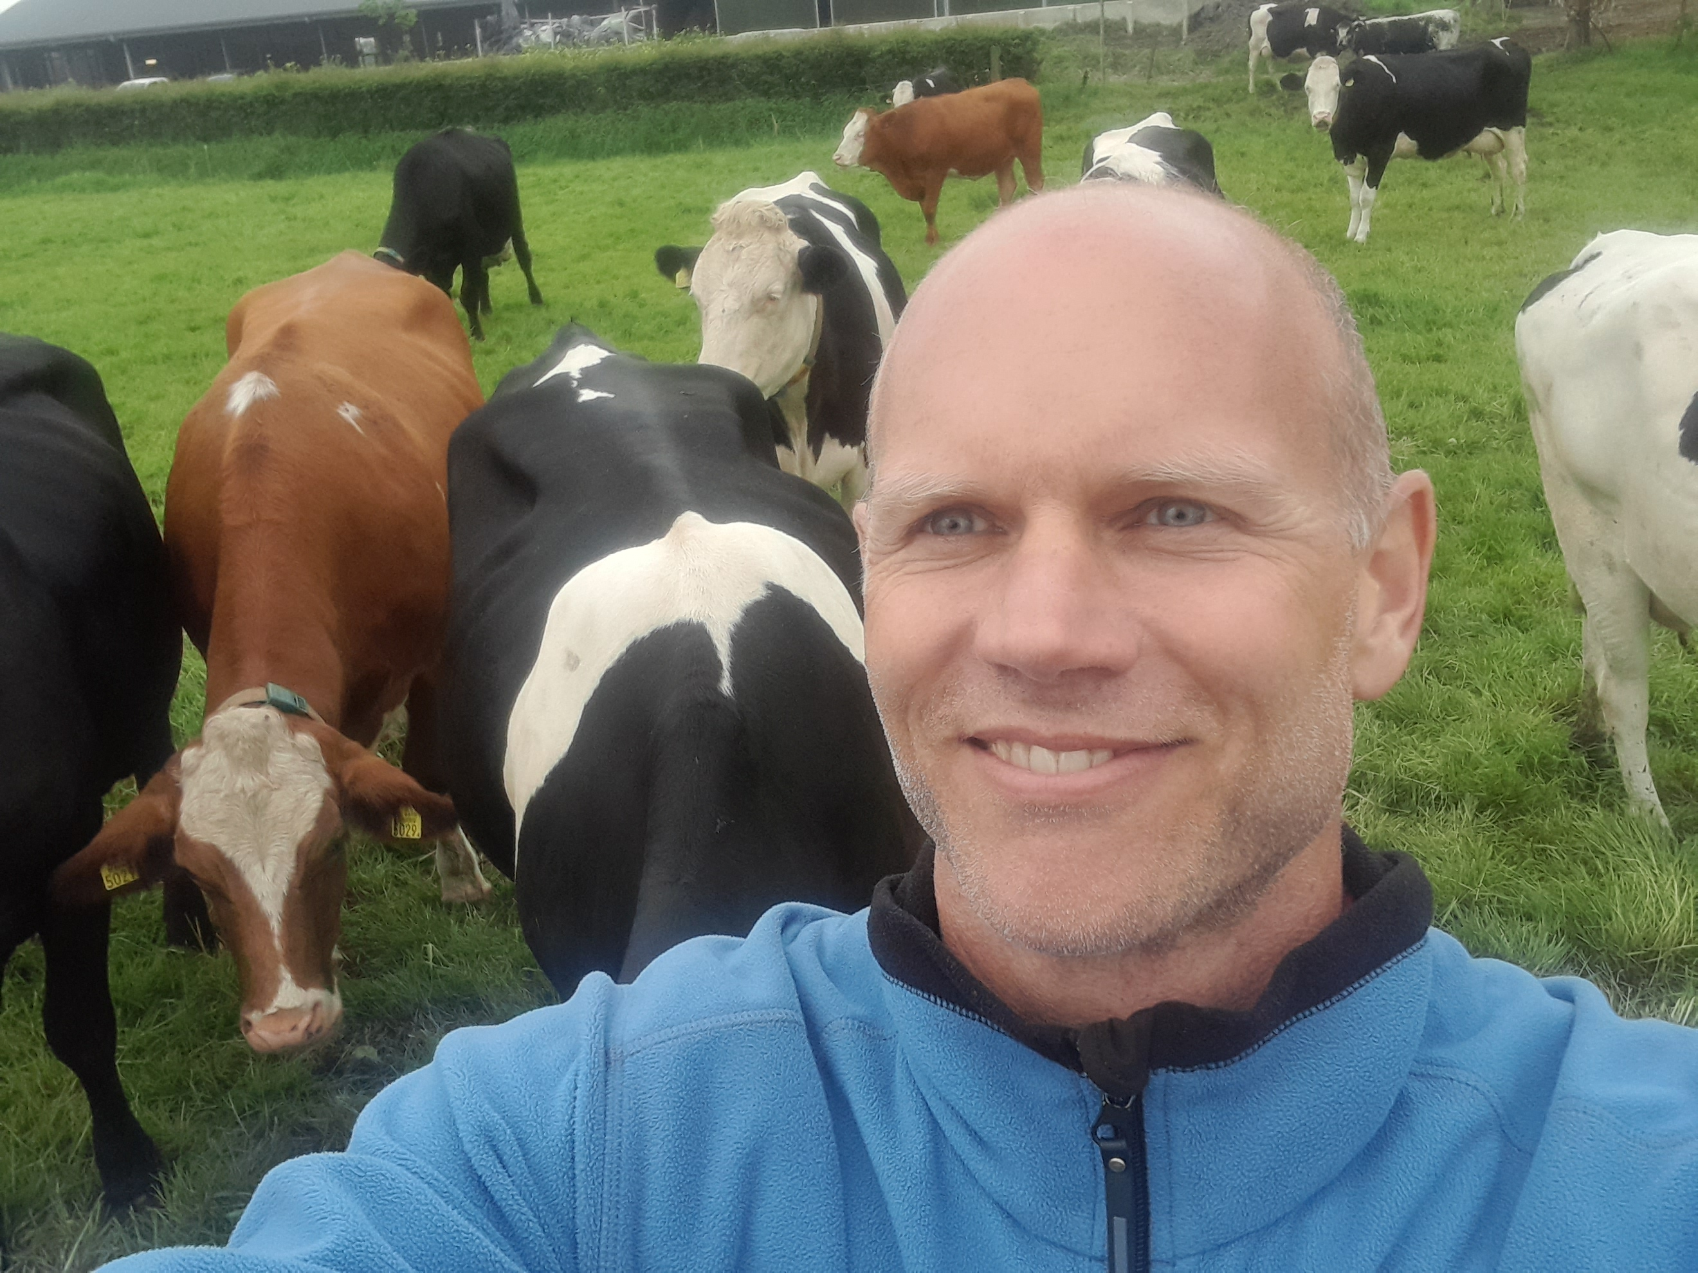
Reflection by value chain expert
Pieter Goudswaard
Agroforestry Netwerk Nederland
Sustainable market developer at MVO
Bringing agroforestry products to the (Dutch) markets
Short supply chains, but also cooperatives
Based on what you’ve seen in the demo, what are your first impressions?
Could you clarify which actors in which parts of the value chain need what data, and for what purposes?
Who would be responsible for preparing the scenarios, who would interpret the results, and who would ultimately use those results

Slide 22

Test your agroforestry designs for their potential production
Try the FarmTree Platform for free
More information on our website:
https://www.farmtree.earth/home
Do you have a question?
Contact us via email: support@farmtree.earth

Slide 23
Available resources
Overall introduction to FarmTree: www.farmtree.earth
Some specialised instruction videos can be found at: https://www.farmtree.earth/instructions
Documentation and justification of the FarmTree Model: https://drive.google.com/file/d/1YA-25htrIk_8t8I5i-ZHbPw-u85JI__W/view
Registration for a Demo or Client Account: https://tool.farmtree.earth/Identity/Account/Register

Slide 24
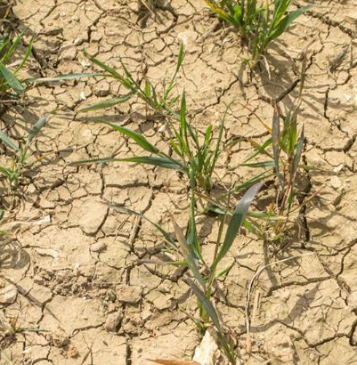
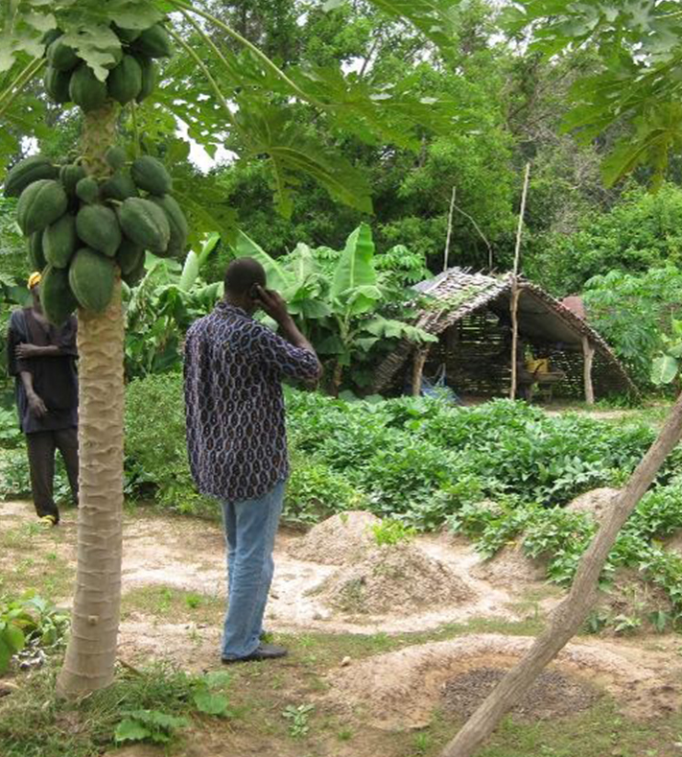






The ‘Black Box’ Problem
Agricultural intensification is one of the major drivers of land degradation globally
Well-planned agroforestry has the capacity to turn degraded land into resilient systems by:
Restoring soils
Storing carbon
Increasing biodiversity
Retaining water
Stabilising yields
Stabilising income

Slide 25

The ‘Black Box’ Problem
Agricultural intensification is one of the major drivers of land degradation globally
Well-planned agroforestry has the capacity to turn degraded land into resilient systems by:
Restoring soils
But outcomes remain unpredictable, a 'black box' for:
Investors needing data
Farmers needing proof
Storing carbon
Increase biodiversity
Retaining water
Stabilising yields
Stabilising income
Notes:
This hampers investments both by farmers and external investors

