Slide 1
REFOREST North of England Living Lab
What?
Network of 50 farmers, researchers, advisors and other stakeholders sharing knowledge and experience of agroforestry to help implement successful agroforestry systems in their region
Insights and ideas on the challenges and opportunities of implementing agroforestry
Co-design of digital decision-support tools to help design and implement agroforestry relevant to geographical context with a particular focus on food production, carbon capture, and biodiversity
How?
Workshops, farm visits, webinars, e-newsletter

Slide 2
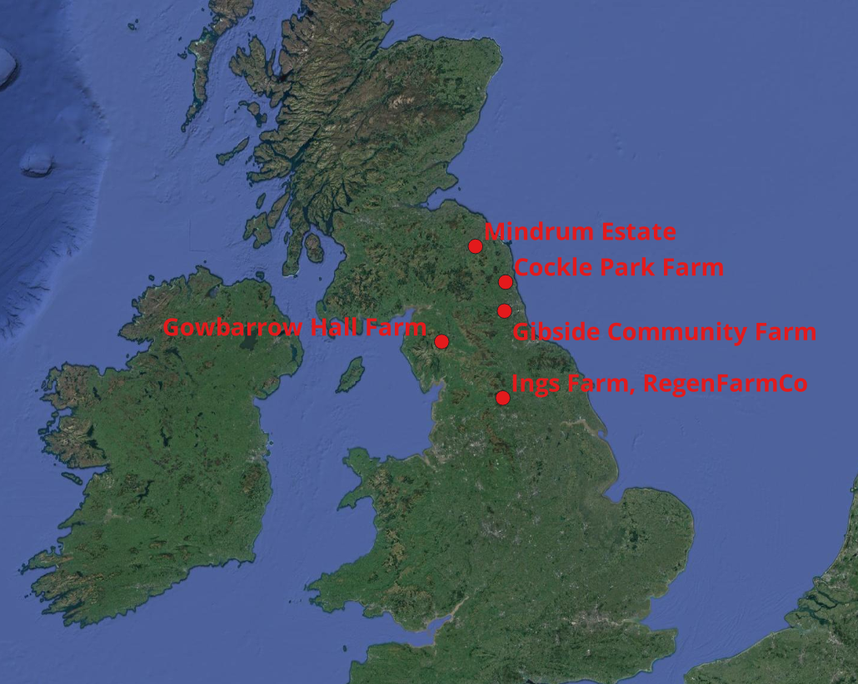
Case study farms of the REFOREST North of England Agroforestry Living Lab
Check out information on them and other European living labs on the REFOREST website: https://agroreforest.eu/living-labs/
Notes:
19 May 2023, first in person meeting of the UK living lab, University of Newcastle, Cockle Park Farm
Workshopping established major issues facing agroforestry in the North particularly in relation to tree establishment and restrictions on woodland grazing

