Slide 1
Agroforestry at the forefront of farming sustainability
Martin Lukac, lukacm@fld.czu.cz
And a whole team of excellent people who do the actual work

Slide 2
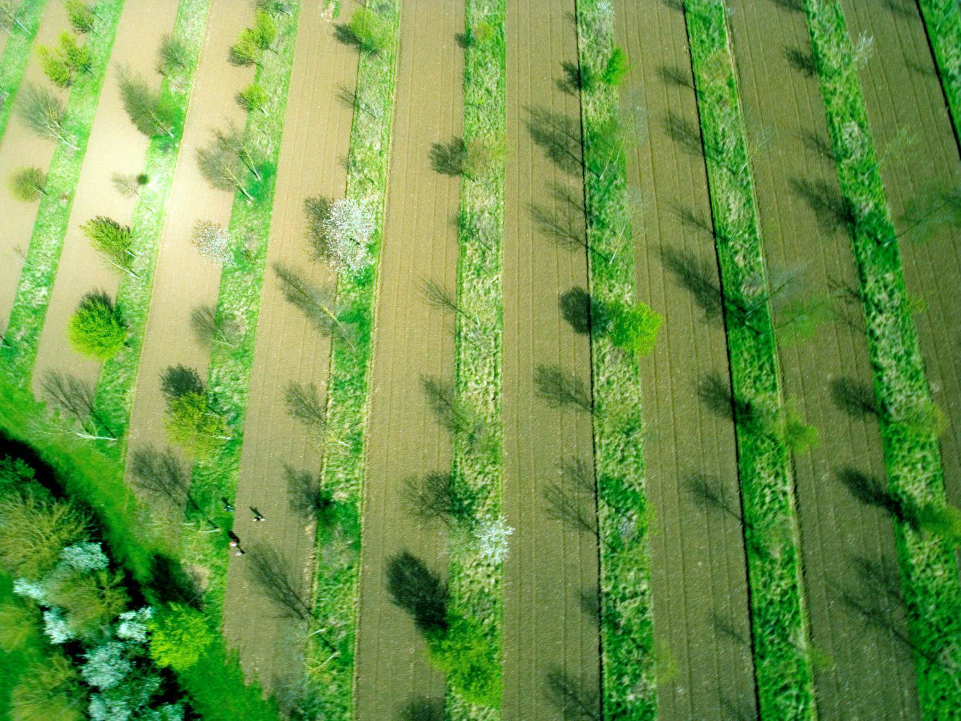
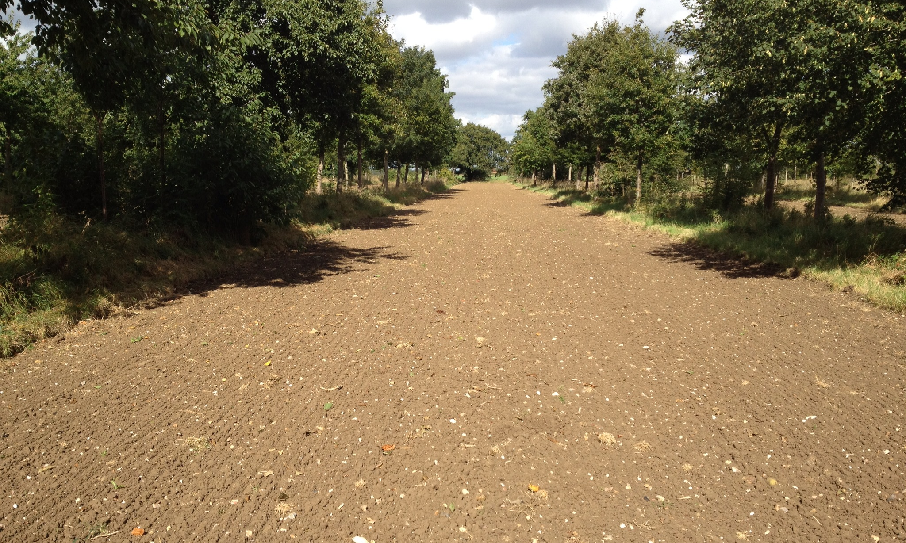
ReForest aims to enhance
understanding of AF systems by actors
innovation and development of AF systems
monitoring and verification capability acceptable to key stakeholders
financial models specific to AF

Slide 3
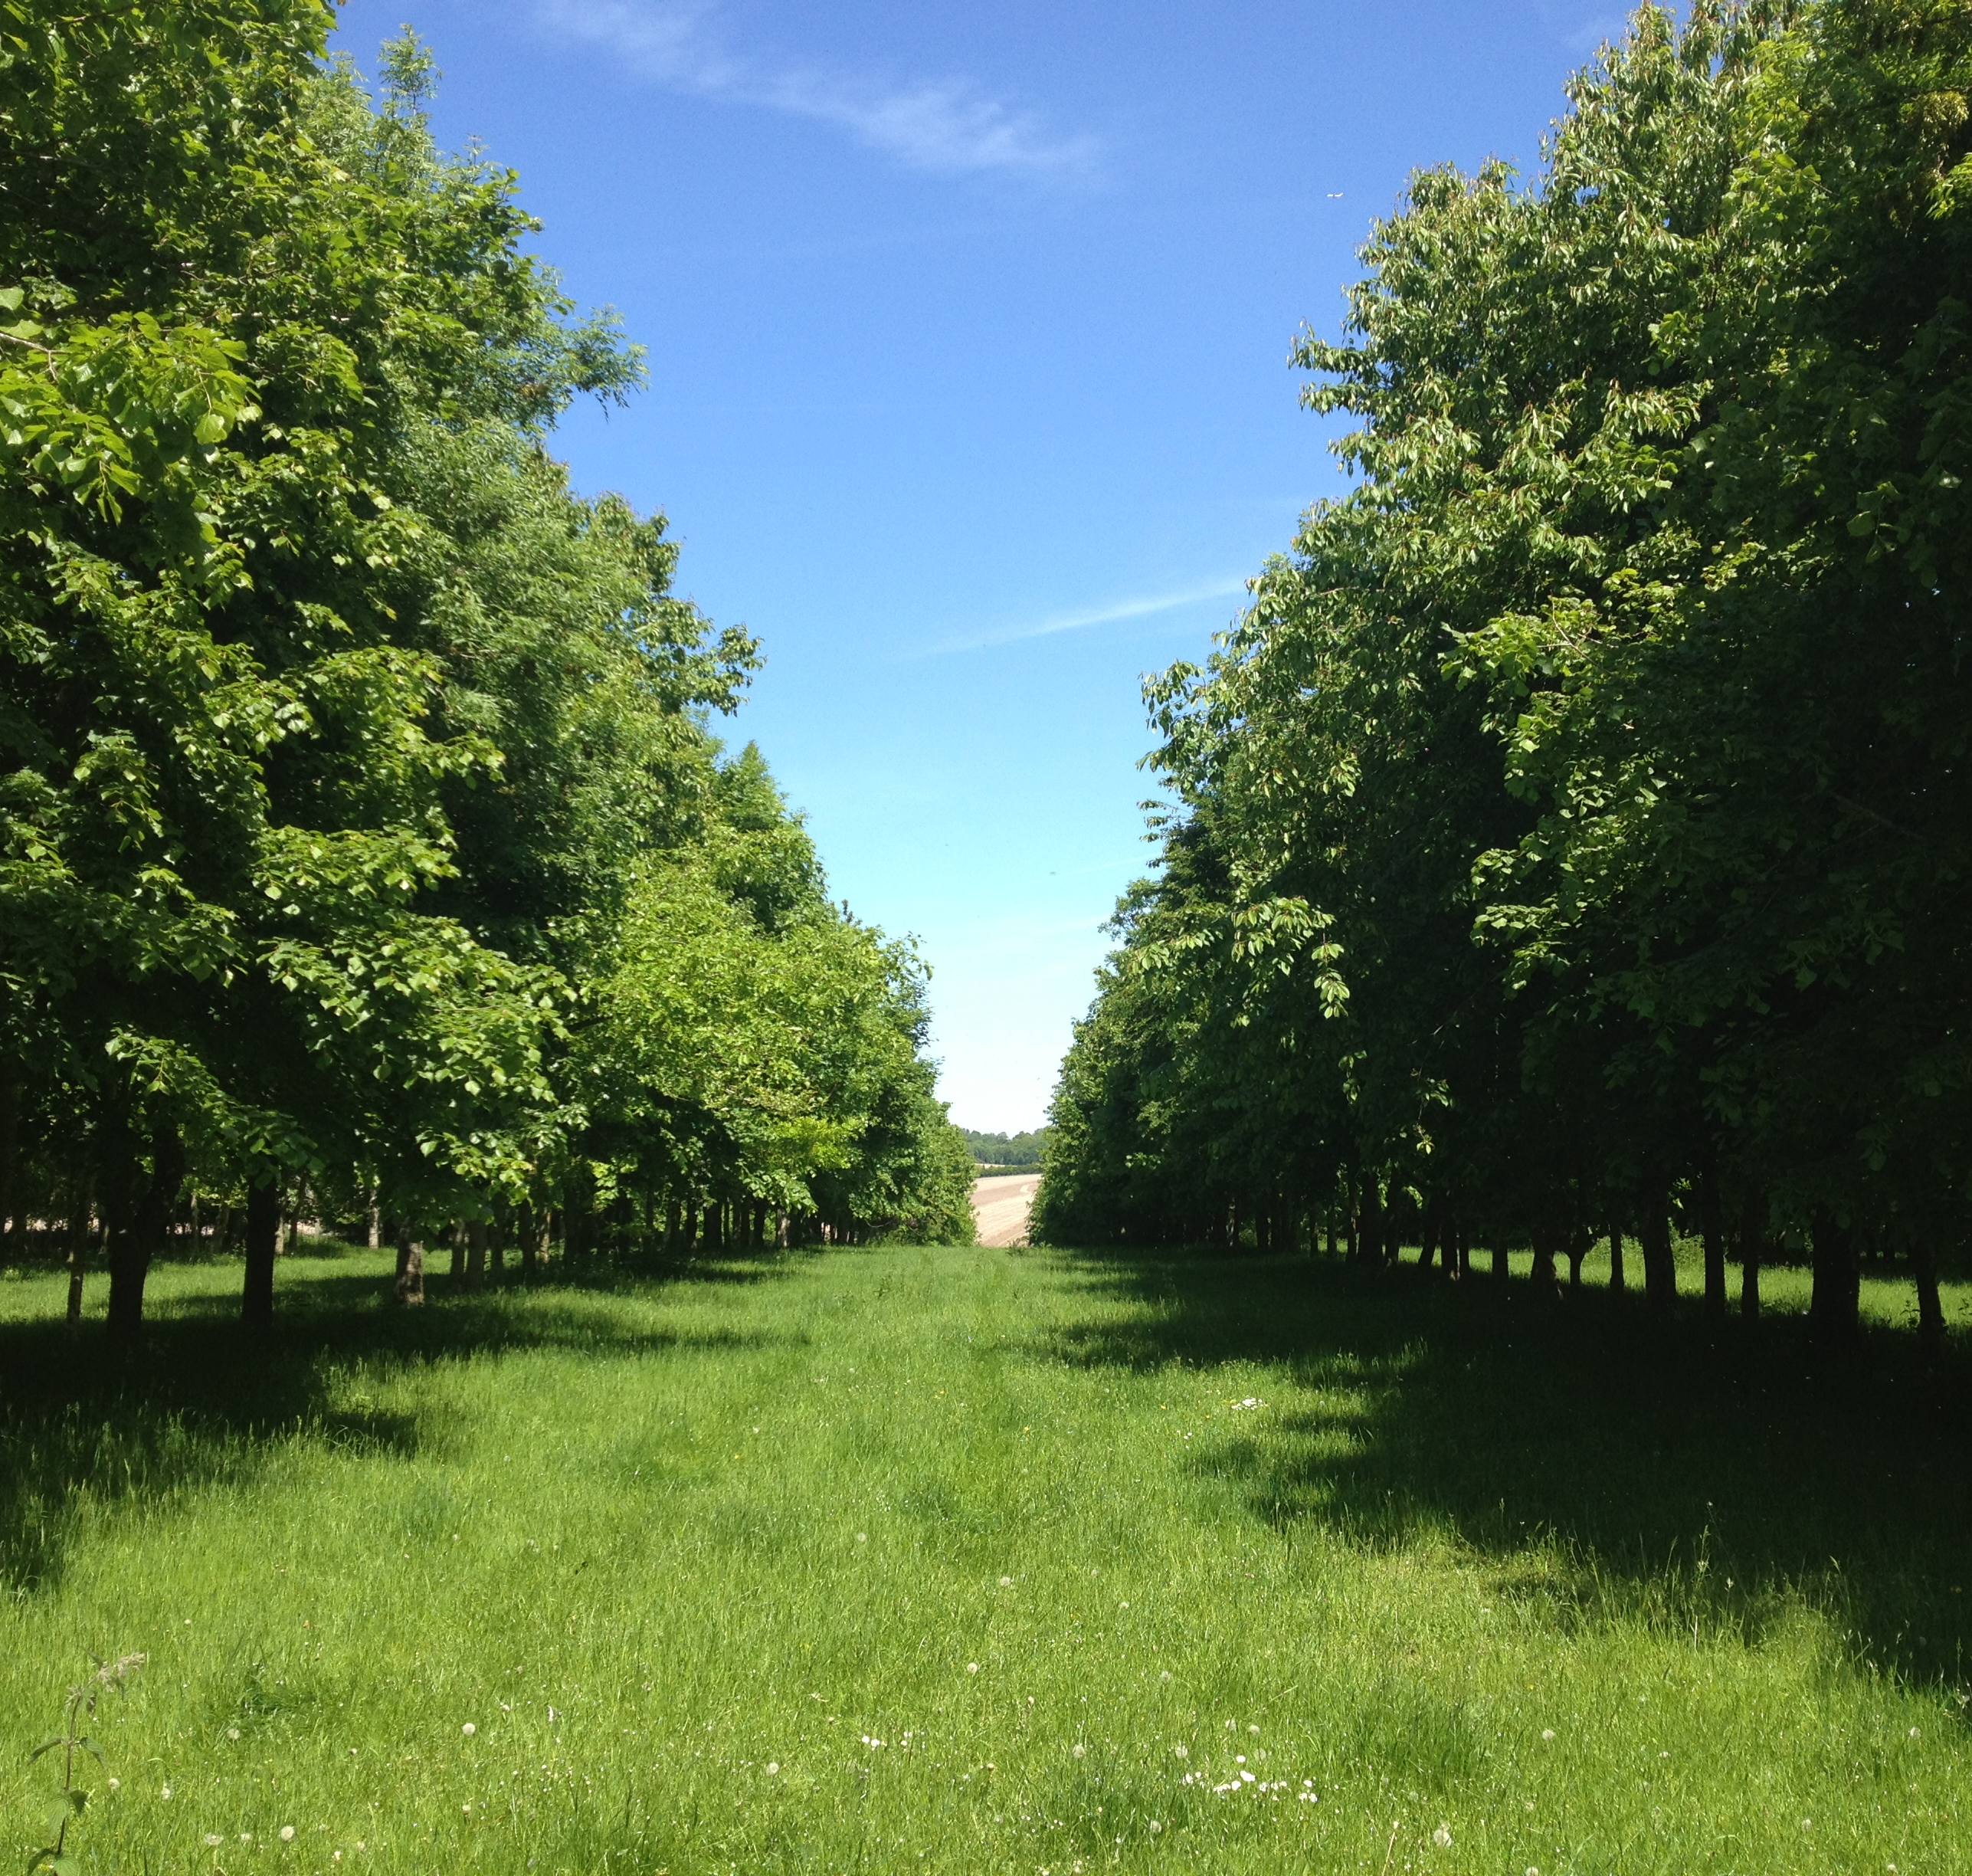
ReForest
The long-term goal is to make AF one of the most attractive land management systems in Europe.
We aim to address barriers and identify enabling interventions.
Ultimately, we need to show how to become an ‘agroforester’.

