Slide 1
Agroforestry at the forefront of farming sustainability
Martin Lukac, lukacm@fld.czu.cz
Notes:
Change the name of the presenter

Slide 2
Agroforestry
Medieval agricultural system, possible older
Integration of woody vegetation with crops and animals
A stable system producing a range of outputs
Made less attractive by industrialisation of agriculture
agroreforest.eu
Notes:
This is not a new system – we have a huge variety of traditional AF systems in Europe + the biggest area is in the tropics
Woody vegetation + ground vegetation make for a more efficient system, better able to utilize the resources of the location – so AF typically produces more that ground vegetation or trees alone
Trees get in the way of big machines = we got rid of the trees
Now we realise that this is not a good idea, so have to put the trees back in somehow.

Slide 3
ReForest
We aim to make agroforestry one of the more attractive agricultural systems in Europe.
Agroforestry delivers food, and many other environmental outcomes on top – so why is everybody not doing it?
agroreforest.eu
Notes:
Alongside food production, AF is better at soil protection, biodiversity habitat creation, water filtration, climate regulation, carbon seq than modern agriculture – given all these benefits, all farmers should be gung-ho about AF
This is clearly not the case, there are issues with adoption and management of AF system.
The core challenge is to marry the food production (private benefit as farm profit) with all other ecosystem services (public benefit as environmental improvement).
This is where ReForest comes in – we look to co-create solutions to known barriers to AF

Slide 4
Barriers
Lack of understanding of AF systems by actors
Lack of innovation and development of AF systems
Few financial models specific to AF
agroreforest.eu
Notes:
Speaking of which, there are some known barriers and clearly there will be some unknown or local to hyper-local. Those that we know relate to the viability of AF asa business, system complexity, lack of tree skills and long-term investment horizons.
So, we focus on the €€€€€ - we look to foster innovation, analyse financial models, and target knowledge and information availabity

Slide 5
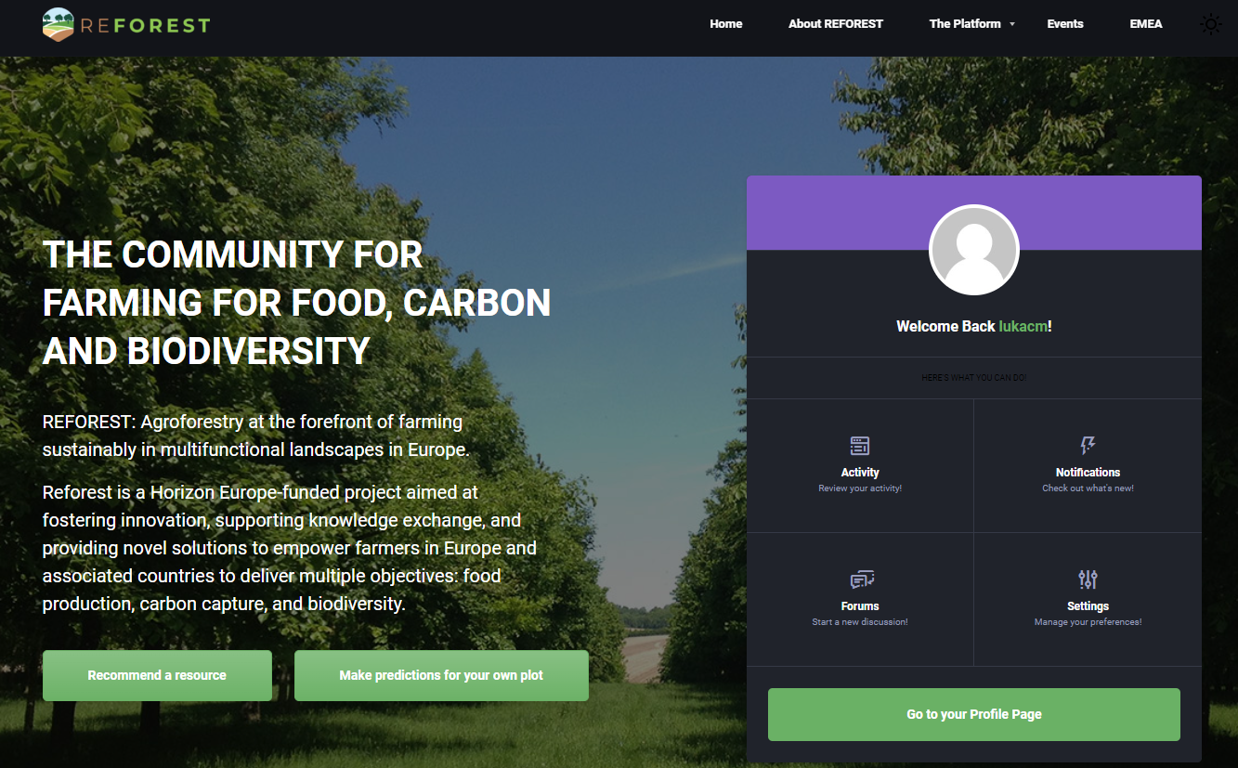
ReForest platform
agroreforest.eu
Notes:
Which brings us to the ReForest platform – the front of all AF knowledge. We have integrated out own Knowledge Hub into it + we are looking at making knowledge created by other projects accessible via our platform. We work with EURAF to make this long-term and accessible to stakeholders.
We want to create a community of people interested in and practicing AF, across borders – the platform is multilingual.

Slide 6
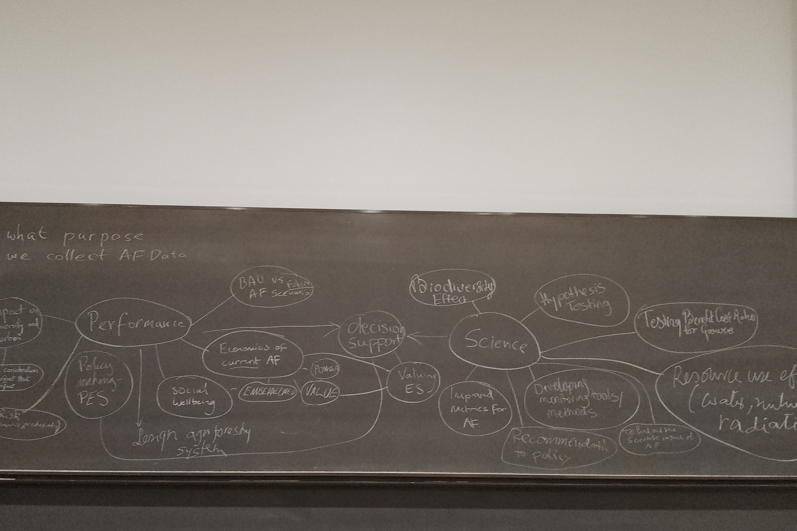
Data-driven solutions
We use latest data gathering technology to describe the social and the sociological performance of AF systems
agroreforest.eu
Notes:
AF must work for the farmers, otherwise it is not going to happen. This means we need to understand and be able to predicts the performance of AF as a farming business proposition.
Key difference with ‘normal’ agriculture is time. Conventional farming usually works on annual on bi-annual budgeting, the woody component in AF works over decades = need to predict for long term.
Our challenge is to integrate the data streams describing the productive and environmental performance AND socio-economic performance over 10+ years time horizon AND make this accessible to the farmer or investor.

Slide 7
ReForest
Aims to promote agroforestry in Europe in order to:
Improve sustainability of agriculture
Make European landscapes more attractive
Support traditional land-use types and their cultural values
agroreforest.eu
Notes:
Ultimately, the project will be a success if we manage to change the behaviour and decision making of farmers and landowners. Several ways to do it, we are exploring some of those. AF can deliver several positive outcomes to farmers and society, our challenge s to align incentives and market forces to make the system more attractive than it currently is.

