Slide 2
FarmTree Tool A digital solution to design, compare and report impact of agroforestry systems
Farms. Trees. Impact. Quantified!
Steffie Rijpkema, MSc - Coordinator Innovation Team steffie.rijpkema@farmtree.earth
www.farmtree.earth

Slide 3
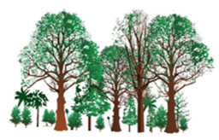
The problem with estimating agroforestry impact
Agroforestry intervention
Multiple long-term benefits and trade-offs difficult to predict and quantify
Yields
Financials
Soil health
Biodiversity
Nutrition
Water
Agroforestry investment targets rarely reached
Labour
Carbon
Complex surveys
Incomplete data

Slide 4
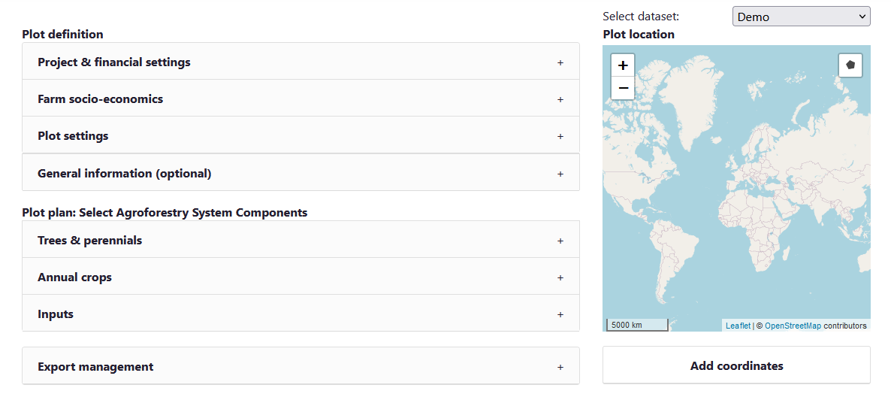
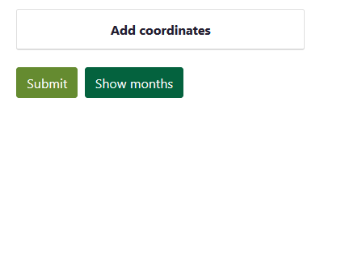
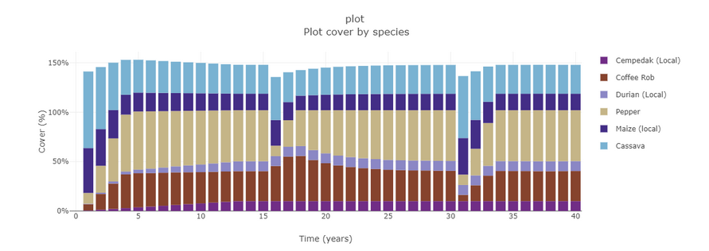
FarmTree Tool Solution
Agroforestry impact quantified for different actors
Agroforestry intervention
Education
Training
Model & Tool
Farmer
Cash-Flow
Co-op Planning
FarmTree
Platform
Project PM&E
Government Development
Trader Supply
Bank
De-Risking
Simple data input
Projected KPIs
FarmTree Database
Open Source:
Soil Data
Climate Forecast

Slide 5
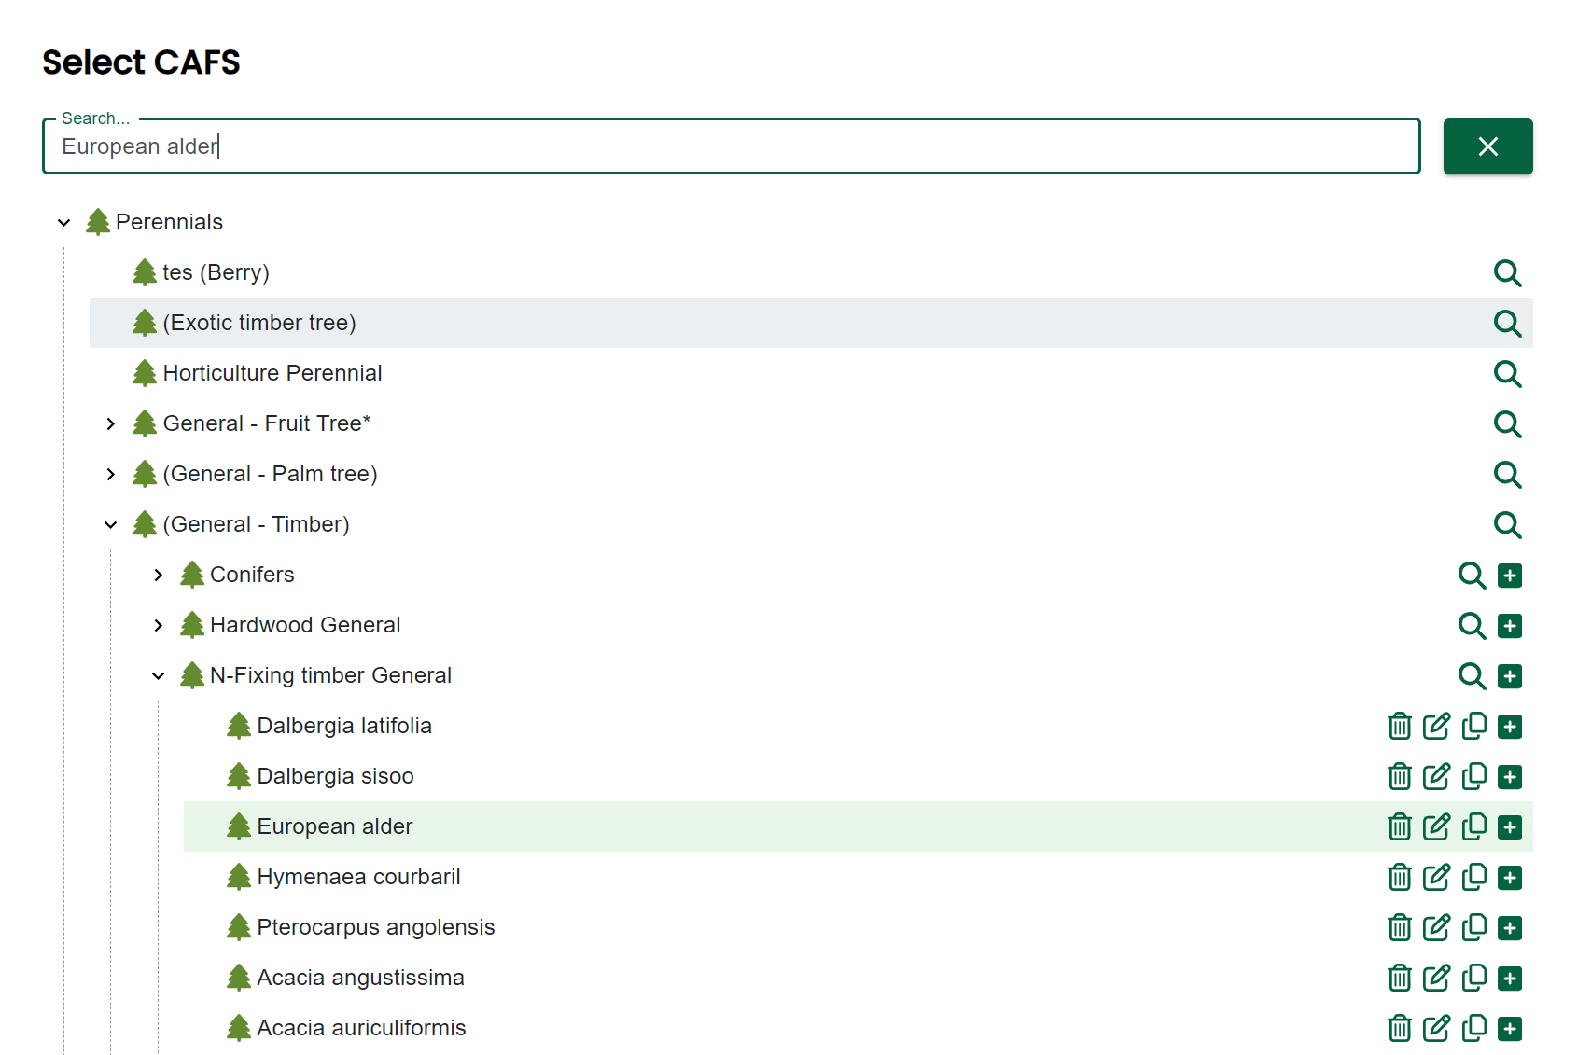
FarmTree Database
Online database
+400 relevant agroforestry species defined
Calibrated for different geo-regions

Slide 6
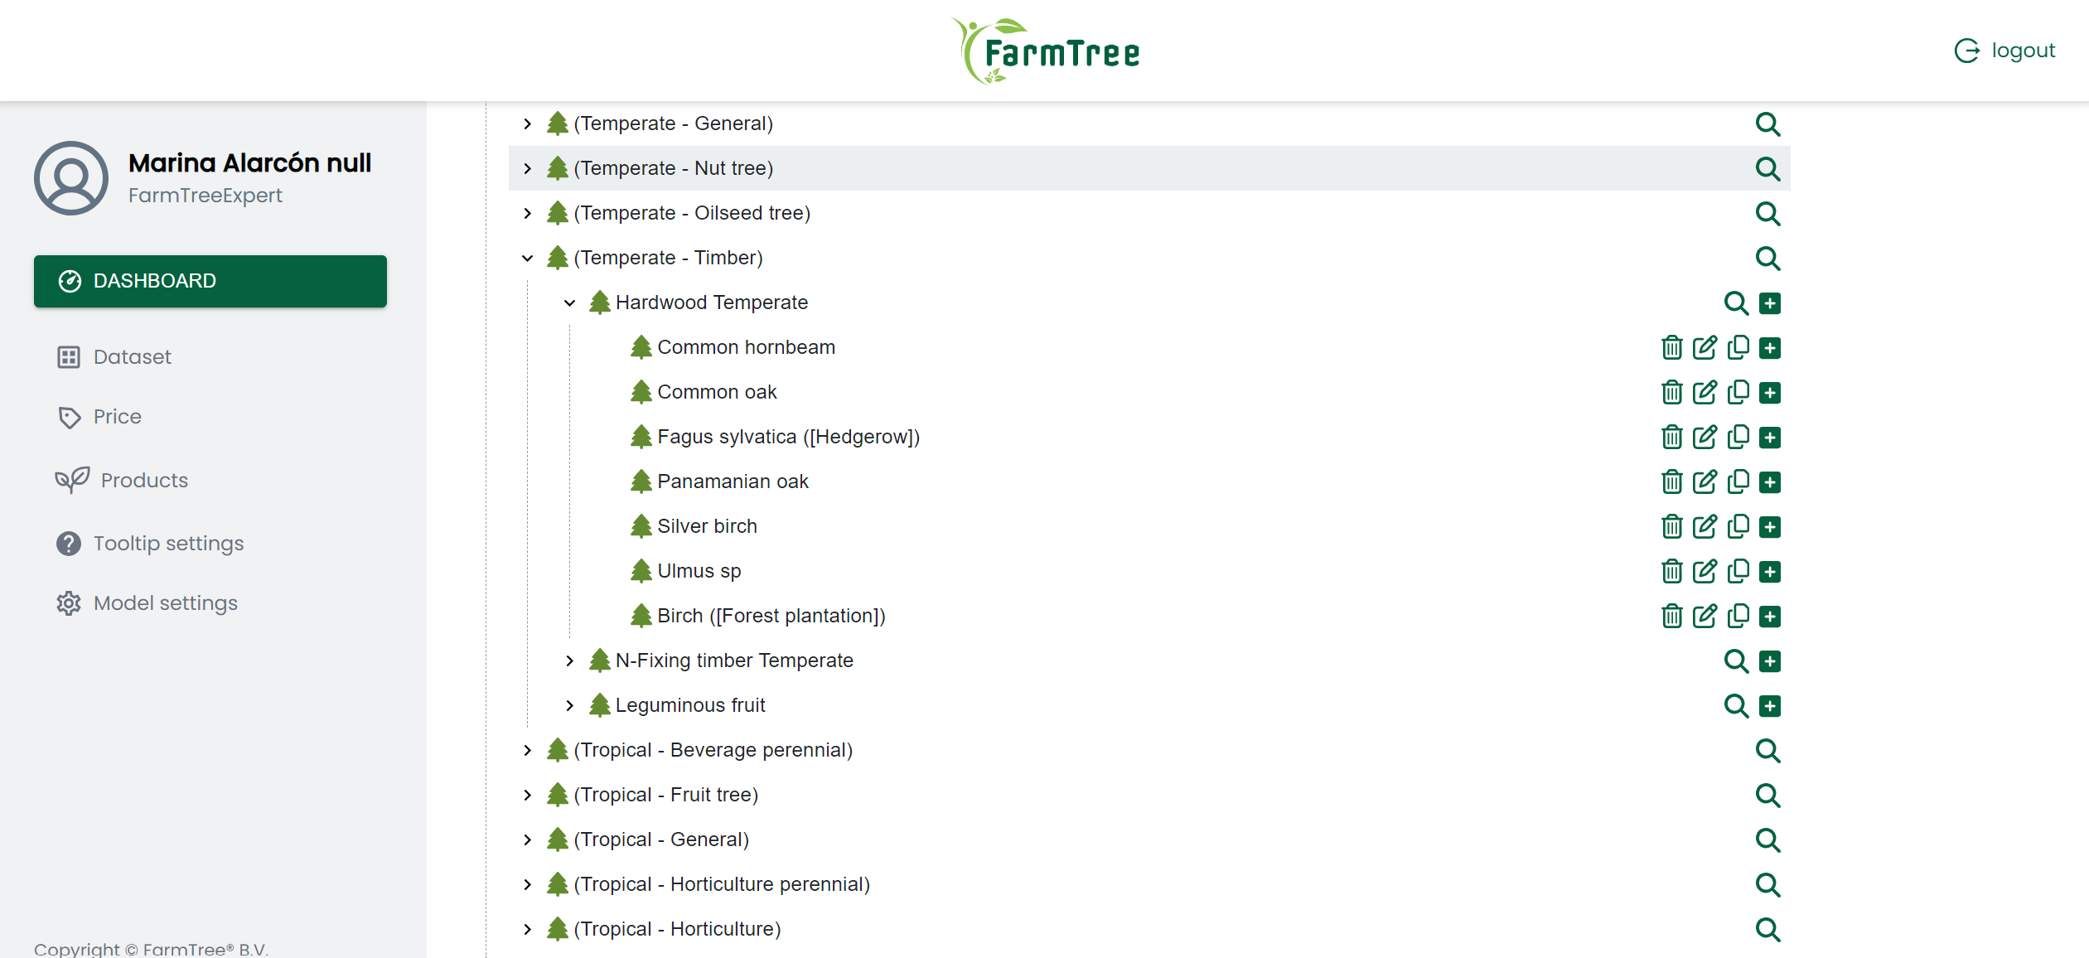
FarmTree Database
Online database
+400 relevant agroforestry species defined
Calibrated for different geo-regions

Slide 7
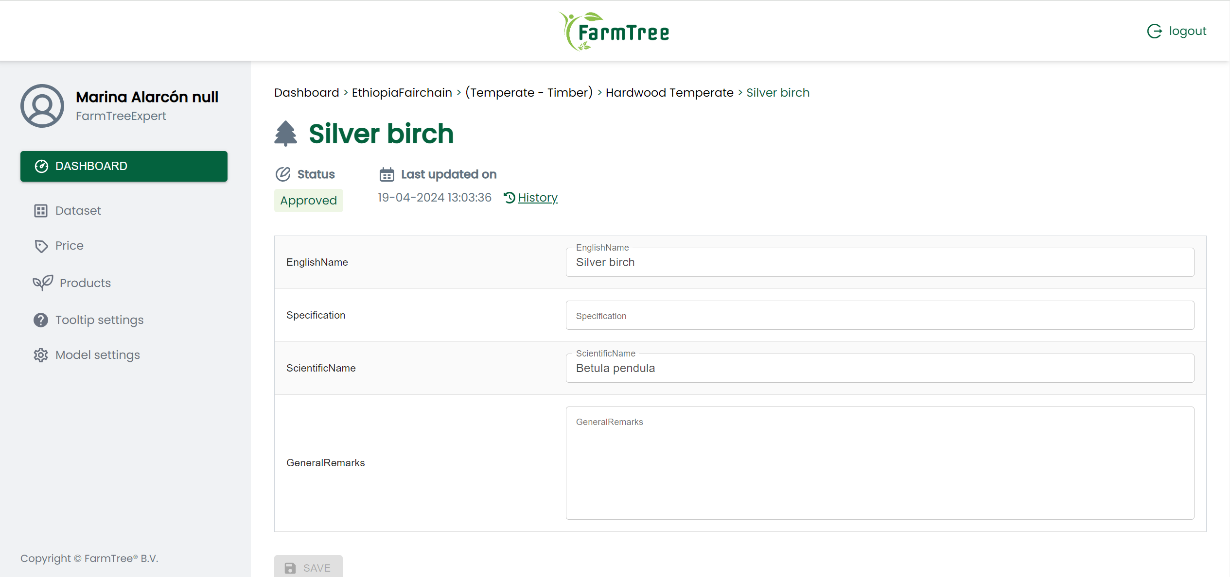
FarmTree Database
Online database
+400 relevant agroforestry species defined
Calibrated for different geo-regions

Slide 8
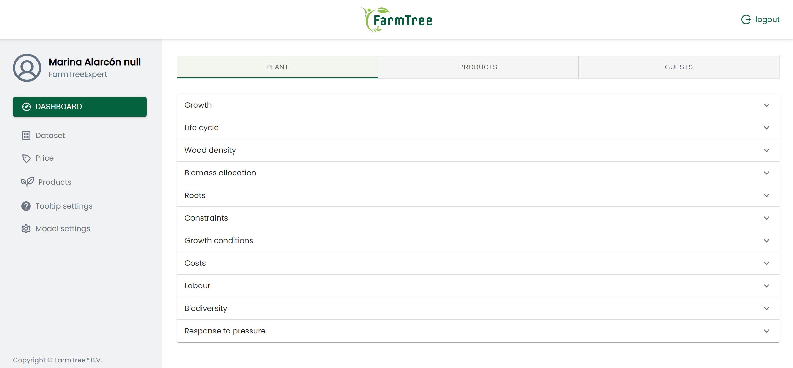
FarmTree Database
Online database
+400 relevant agroforestry species defined
Calibrated for different geo-regions

Slide 9
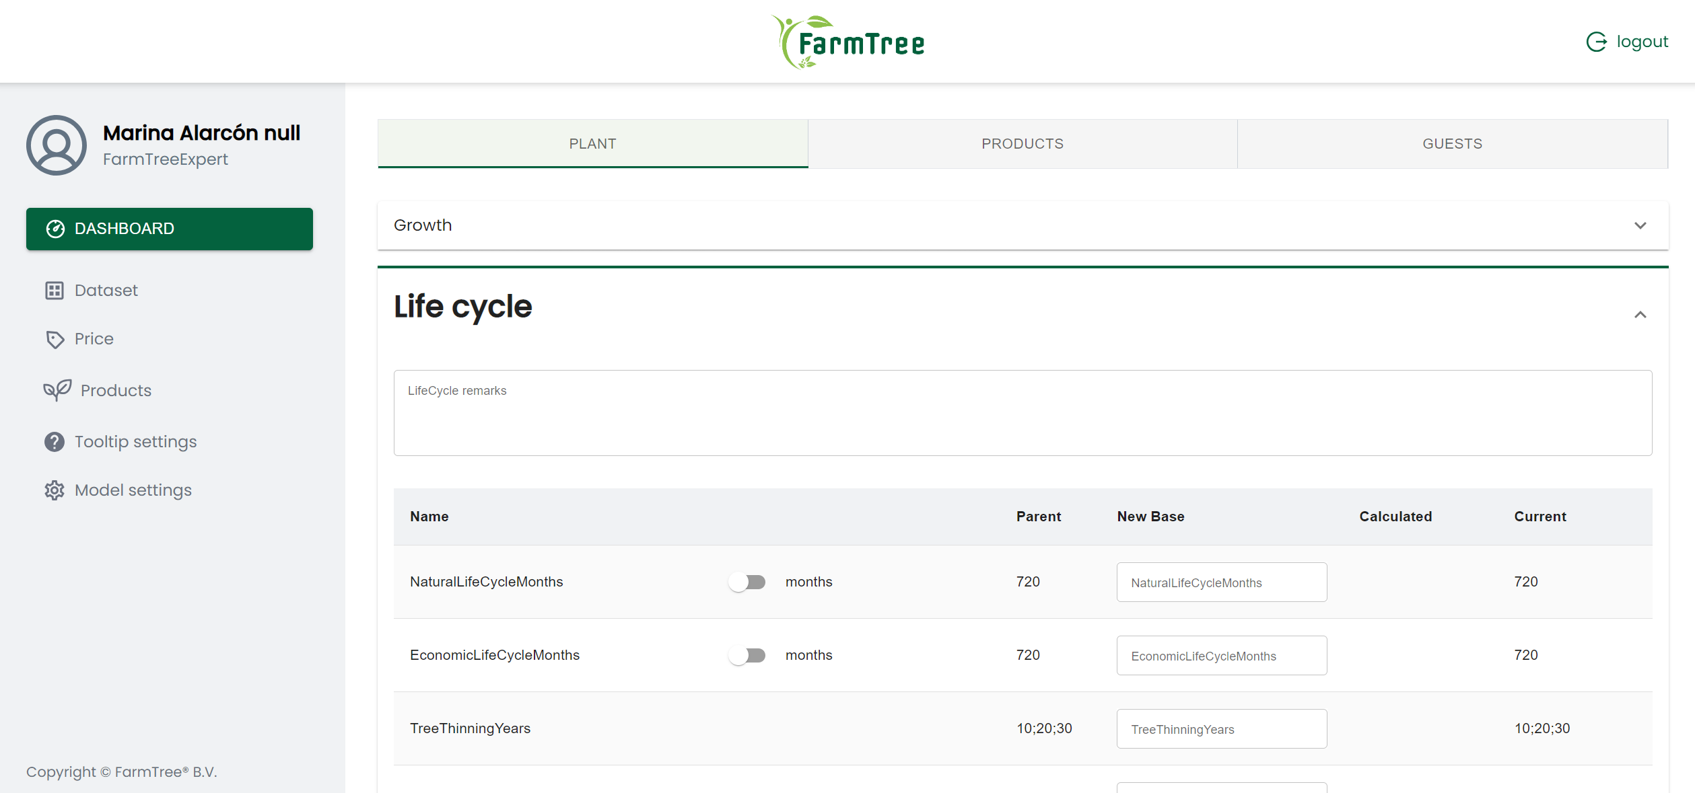
FarmTree Database
Online database
+400 relevant agroforestry species defined
Calibrated for different geo-regions

Slide 10
FarmTree Tool
A software-based agroforestry model + interactive online interface
https://tool.farmtree.earth/

Slide 11
FarmTree Tool Demo
https://tool.farmtree.earth/

Slide 12
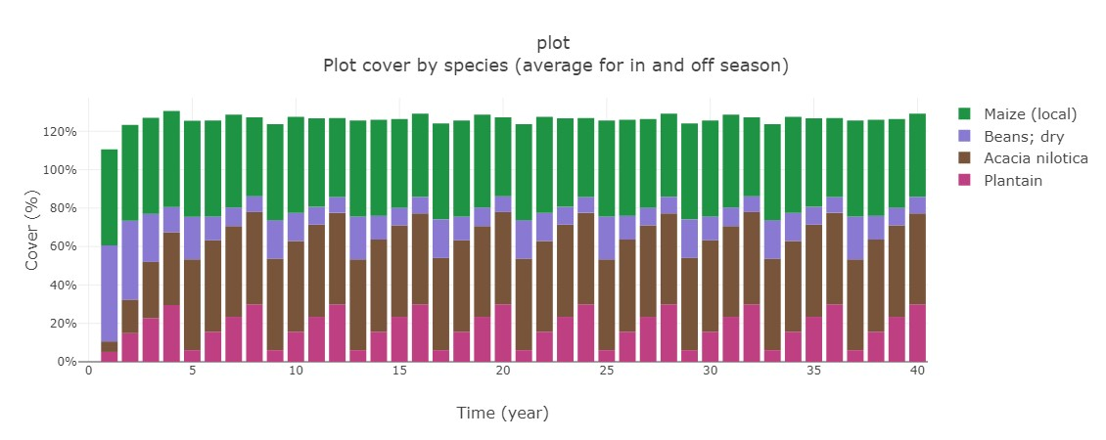
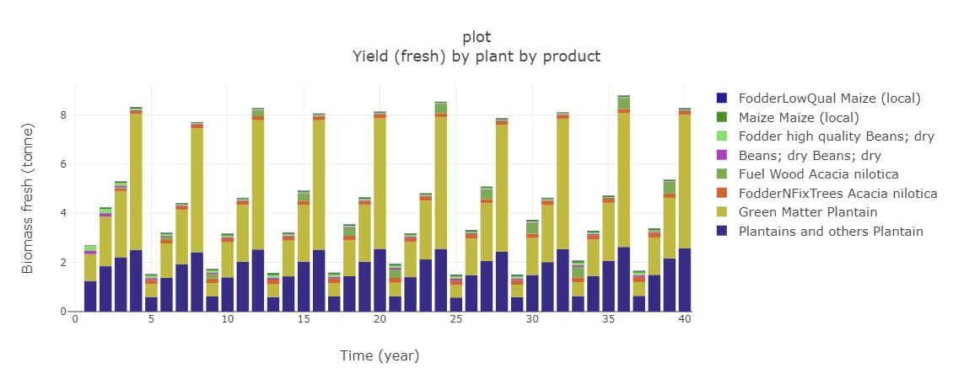
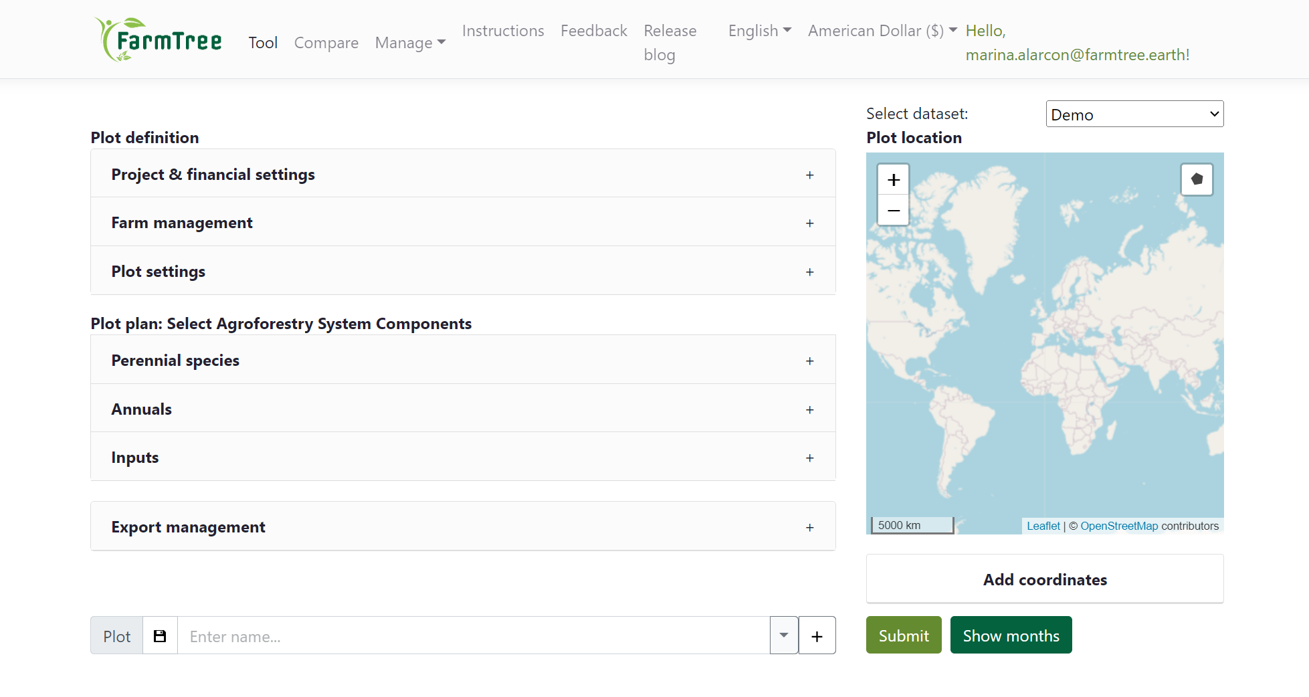
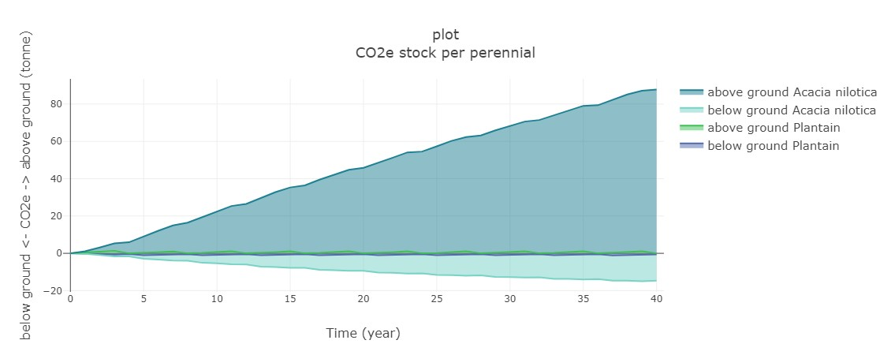
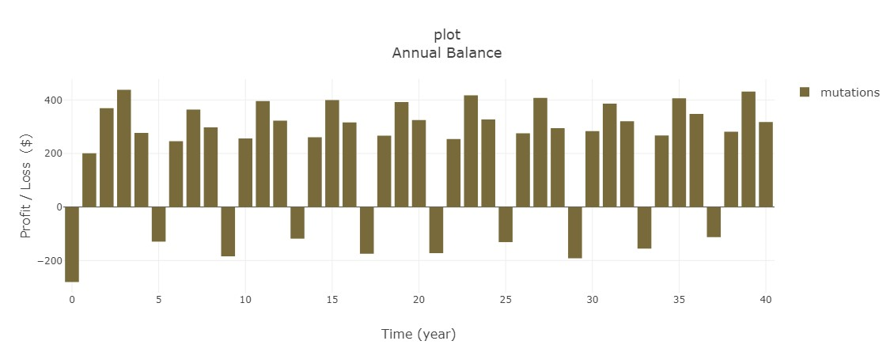
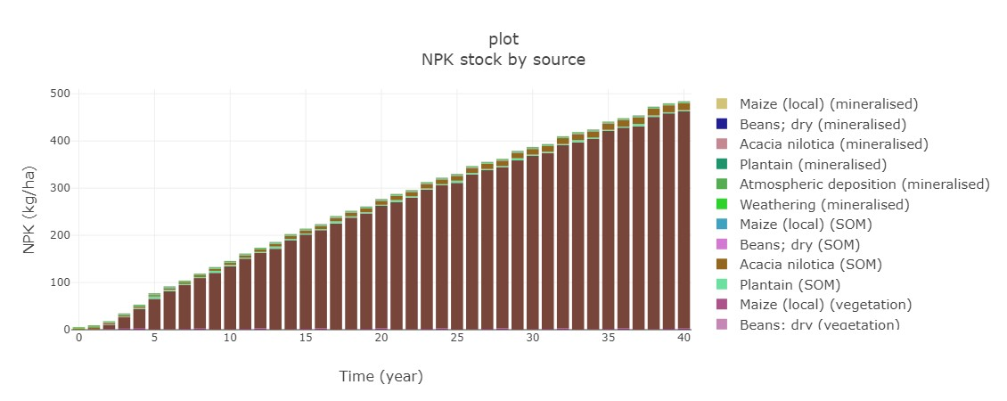
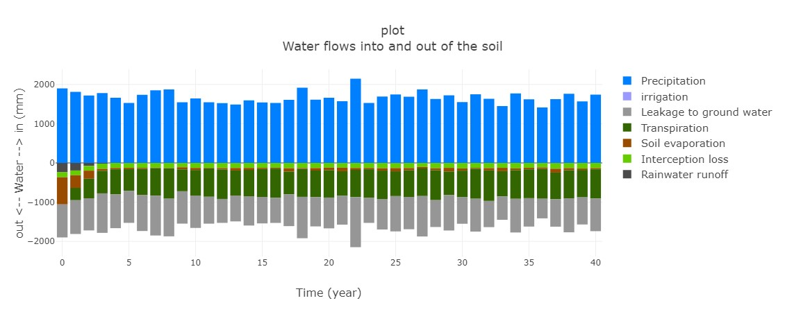
FarmTree Tool
Links local farm data, with climate and soil scientific databases, and an internal database with +400 species
Allows flexible design of agroforestry systems and estimating their long-term financial, environmental and social impact
Vegetation cover
Yields
CO2e stock
Annual balance
NPK stock
Water flows
https://tool.farmtree.earth/

Slide 13
FarmTree Tool Output
Vegetation cover
Yields
The FarmTree Tool facilitates forecasting the impact and performance of agroforestry systems:
Fast – accessible and few data required
Flexible – default data adjustable
Holistic – reports on SDGs
Credible – science-based
CO2e stock
Cashflow
NPK stock
Water flows

Slide 15
Applications of the FarmTree Tool Temperate Agroforestry Systems from ReForest Living Labs
Farms. Trees. Impact. Quantified!
Marina Alarcón, MSc - Agroforestry Impact Quantification Expert marina.alarcon@farmtree.earth
www.farmtree.earth

Slide 16
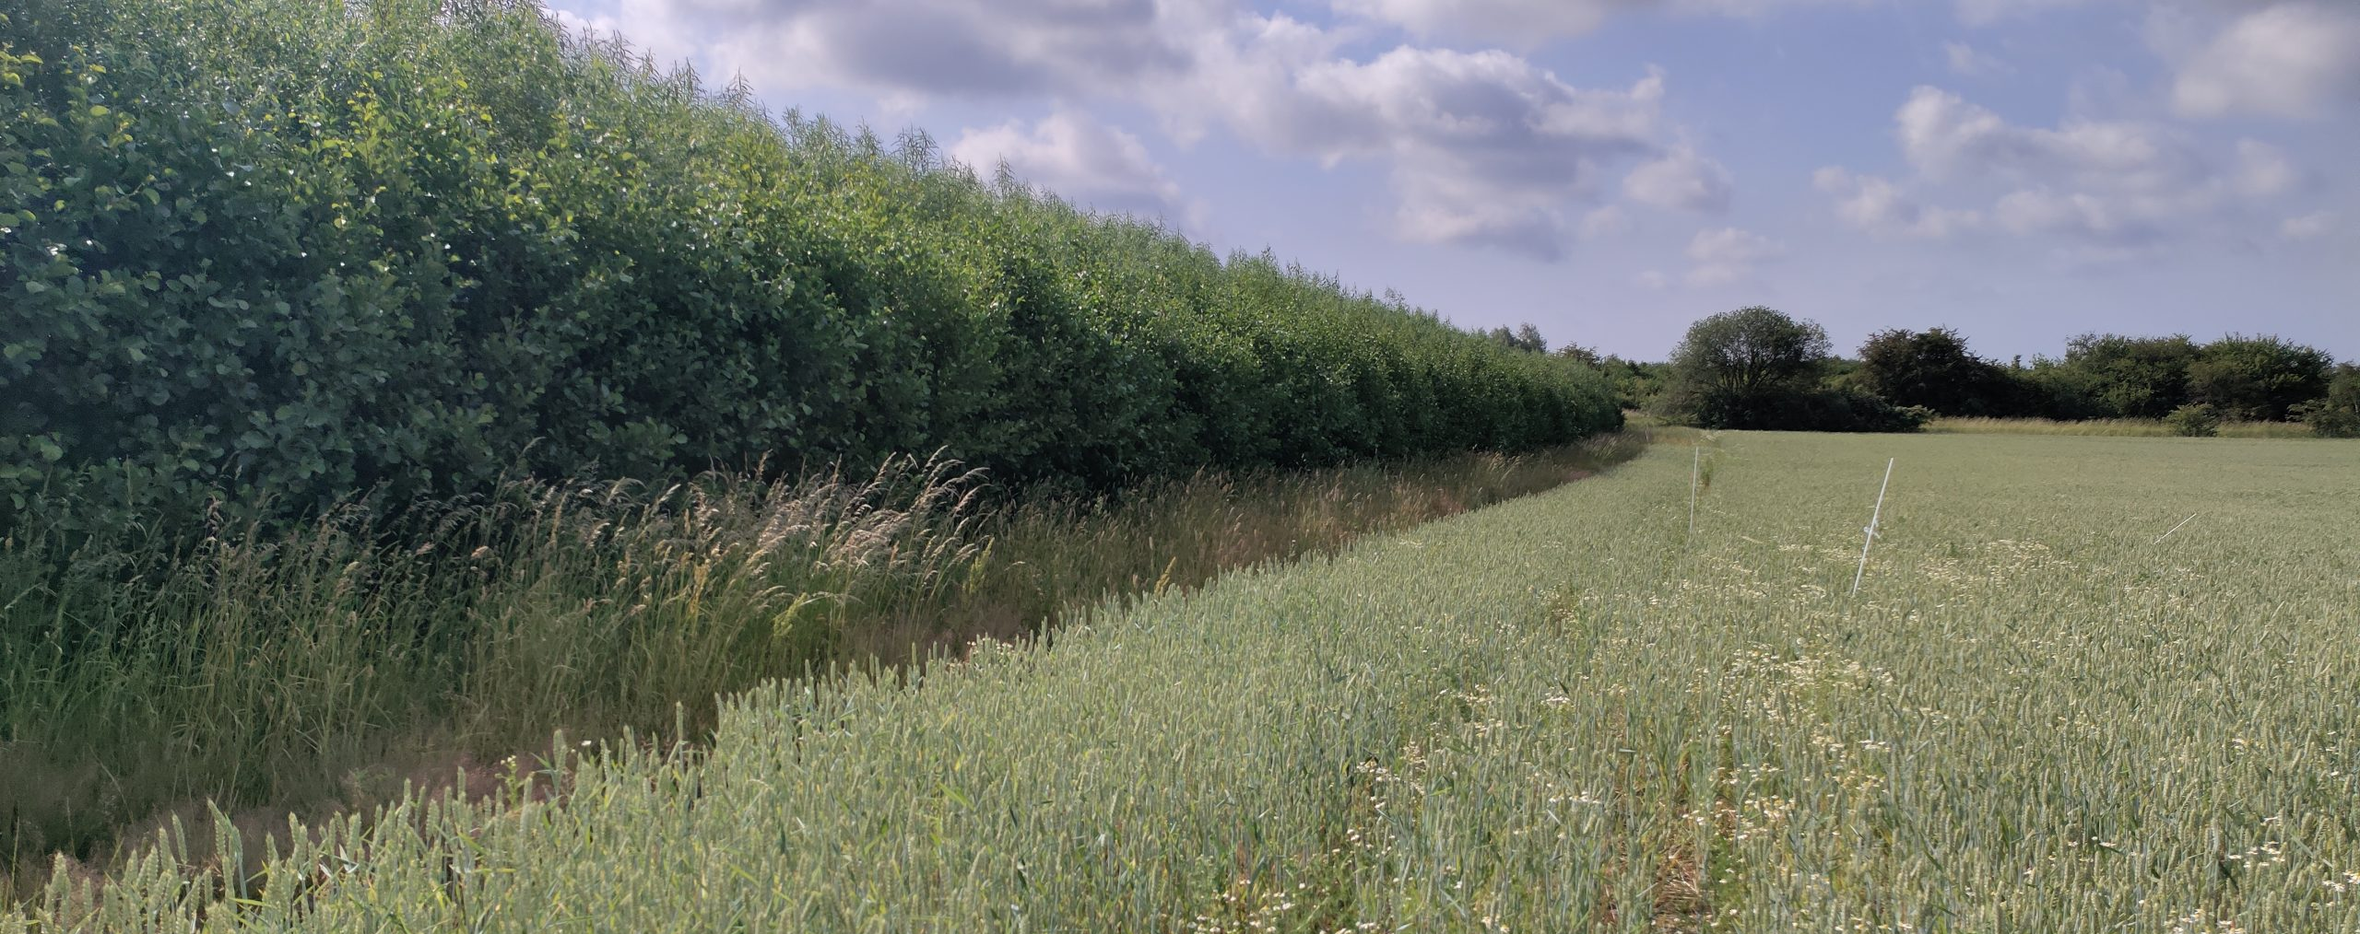
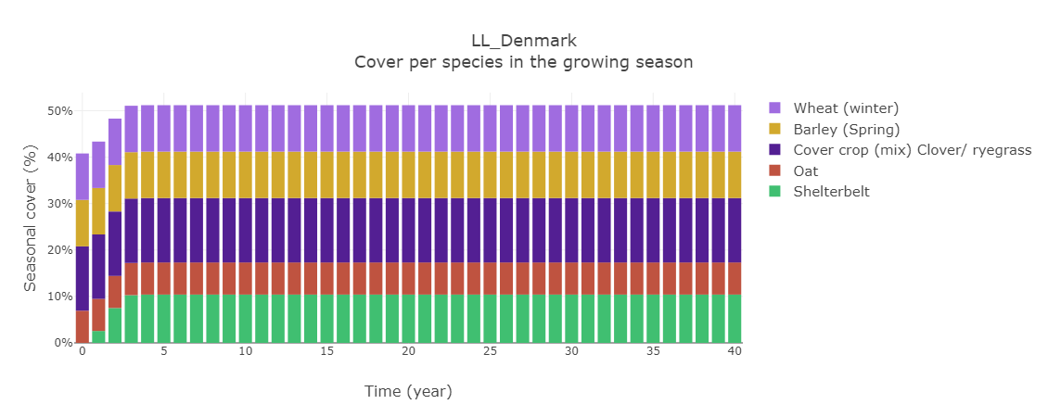
FarmTree Tool for European Agroforestry support
FarmTree is a REFOREST project partner, contributing to agroforestry scaling with digital tooling support
+80 temperate species added to FarmTree Database, calibrated with field and literature data
Seasonality modelling developed
8 European languages now supported in the tool
Living Lab agroforestry systems captured (Digital Twins)
Living Lab Denmark
Living Lab 4: Hungary

Slide 17
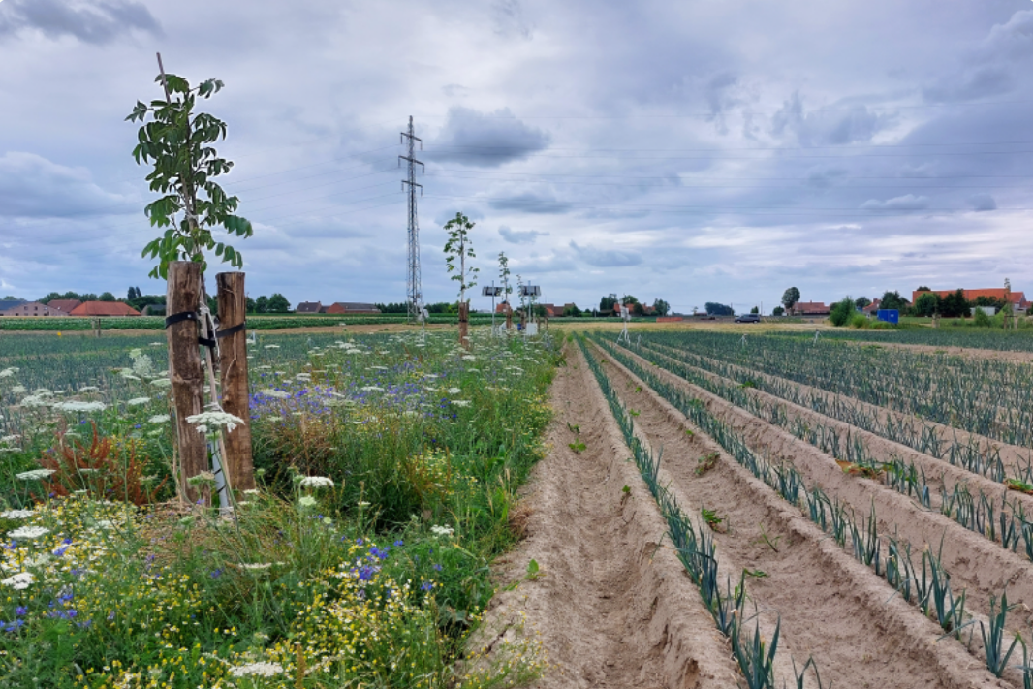
LL Belgium – Inagro research field
Long-term agroforestry research & demo site, Flanders
Walnut trees + Arable crops + Flower strips
1.4 ha – established in 2023
Conventional
Managed by Inagro (trees) + Farmers (crops)
Objectives:
Example system for Flanders
Provide science-based figures on profitability, soil, water, biodiversity
Knowledge communication to farmers, researchers, advisory, policymakers

Slide 18
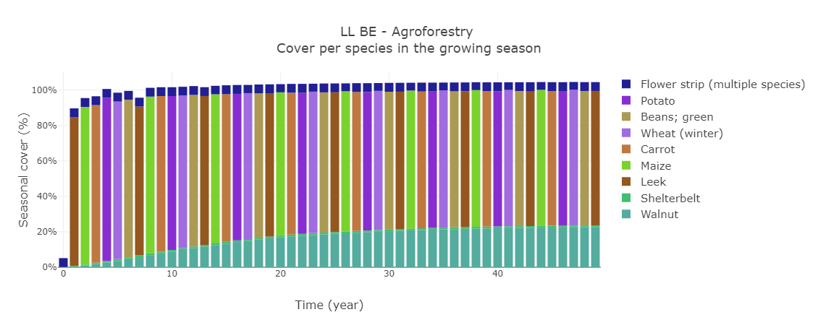
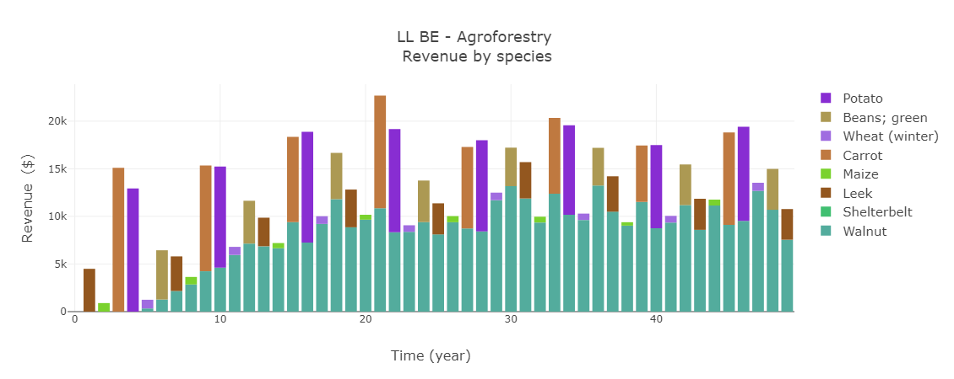
LL Belgium – Inagro research field
Yearly revenue differs considerably depending on arable crop that year
Walnut yields fluctuate 1.2-2 t/ha (management, temperature and nutrients)

Slide 19
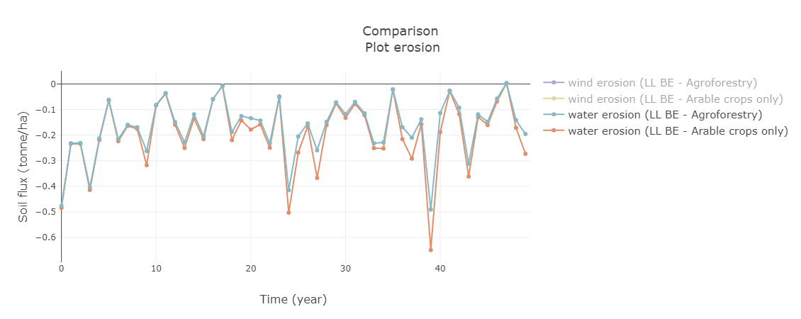
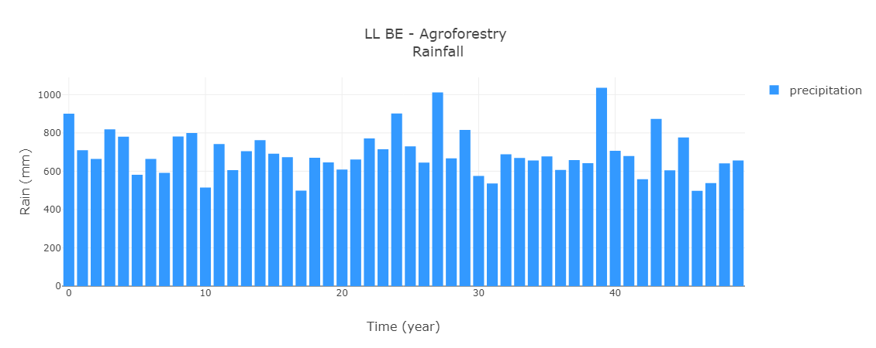
LL Belgium – Inagro research field
Trees in agroforestry system help mitigate water erosion in the long-term

Slide 20
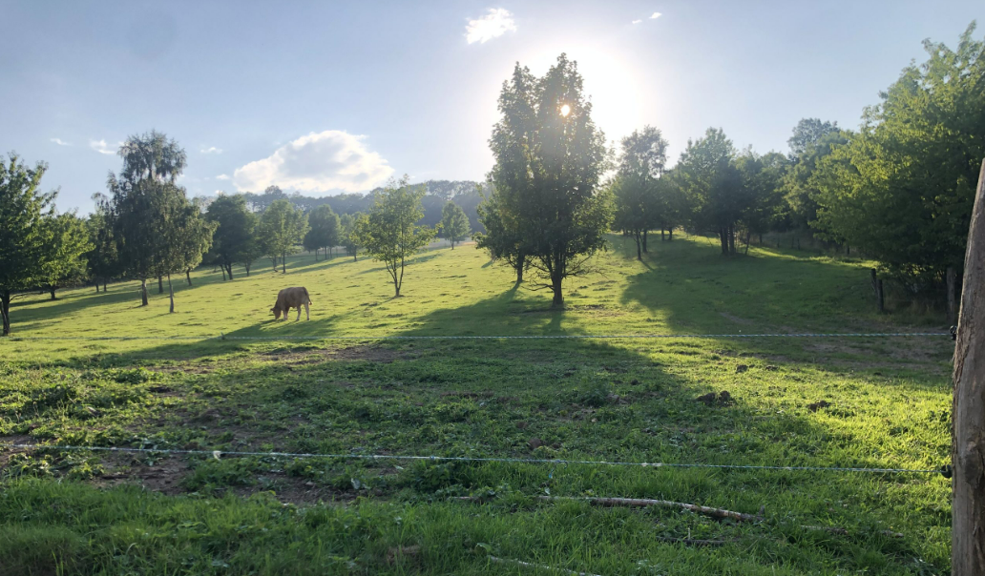
LL Czech Republic – Organic farm
Northwestern Bohemia
Silvoarable (sheep, cows) + Diverse orchards (fruit trees)
600 ha
Organic
Established in 2021
Managed by Daniel Pitek
Objectives:
Self-sustaining system
Synergy biodiversity + commercial goals
Marketing of organic products

Slide 21
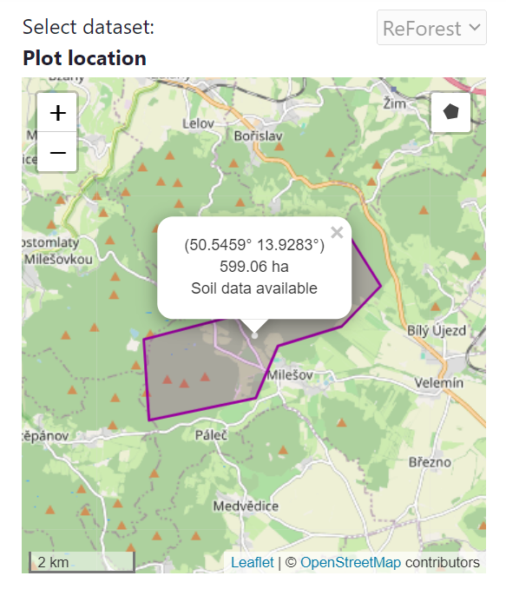
LL Czech Republic – Organic farm

Slide 22
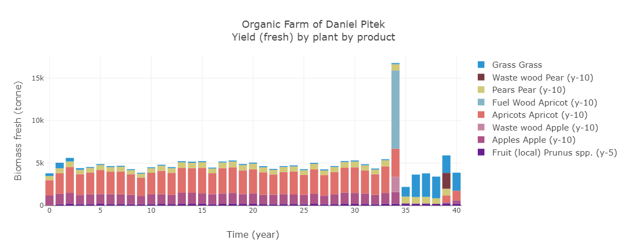
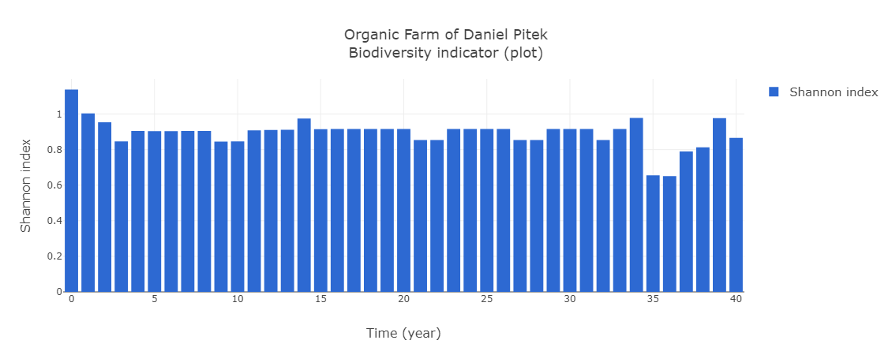
LL Czech Republic – Organic farm
When planting densities are scaled to the whole farm area (600ha) you can estimate total system yields, and yearly fluctuations
Biodiversity (Shannon index) fluctuates depending on biomass production, pruning, tree removal at the end of economic lifecycle

Slide 23
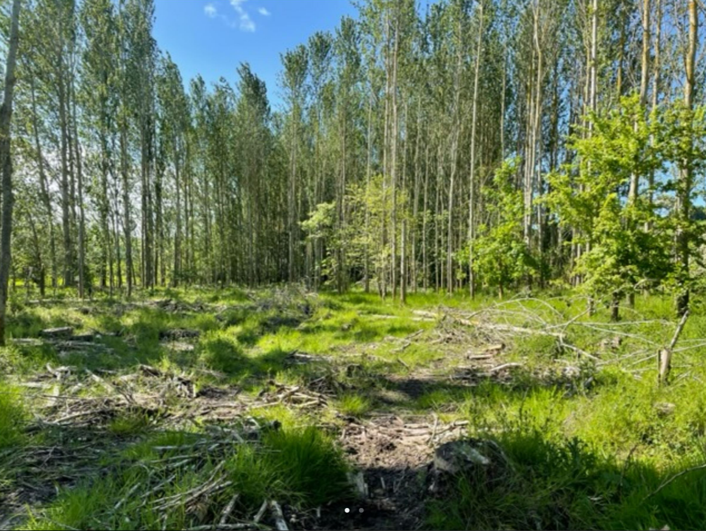
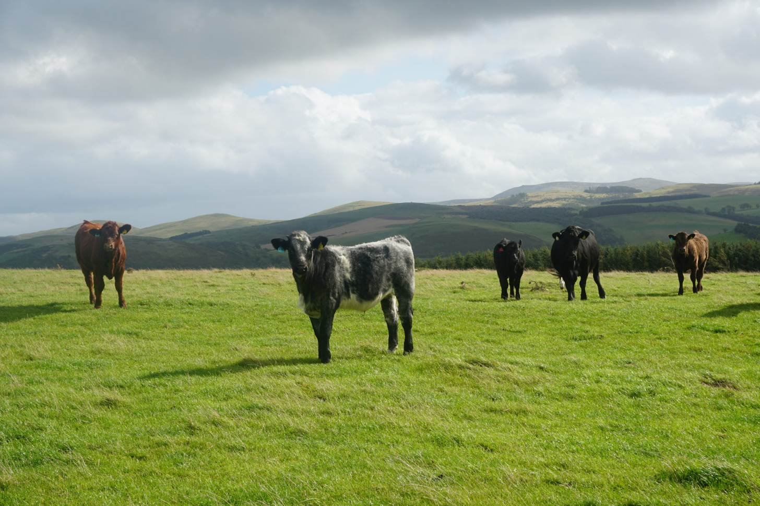
LL UK - Mindrum Farm
Northumberland foothills
Mixed system (sheep, cattle, cereals + grass)
49 ha shelterbelts
2 ha grazed woodland (60 trees/ha)
Organic since 2022
Managed by Tom Fairfax
Objectives:
Livestock as ecosystem engineers
Complete tree integration (permanent and temporary grazing, woodland, margin planting)
Agroforestry for tree browse, soil nutrients, biodiversity, emissions mitigation from livestock
Challenges:
Tree establishment to survive browsing in permanent pastures

Slide 24
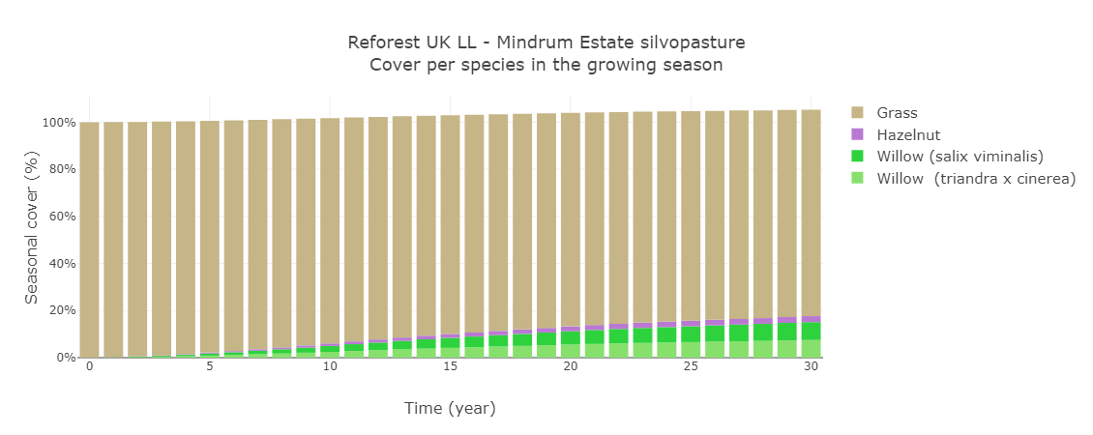
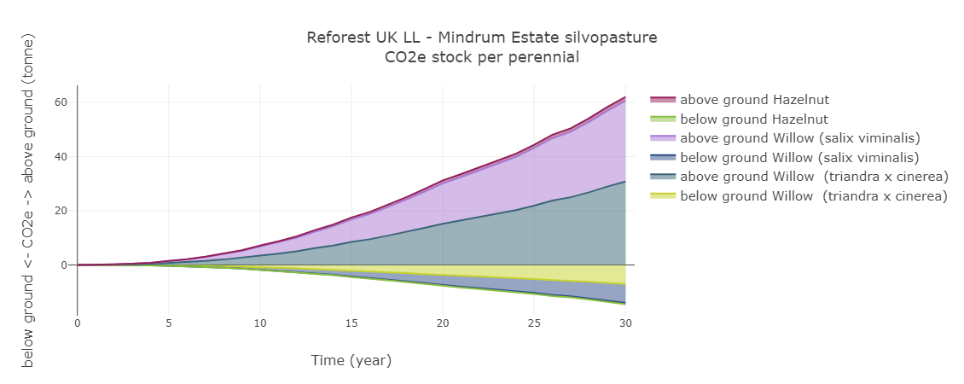
LL UK - Mindrum Farm
Tree density in grazed woodland is low
CO2e sequestration potential of up to 70 tonnes/ha in 30 years (above + belowground)

Slide 25
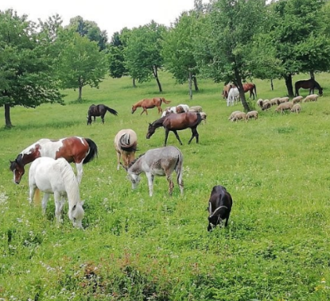
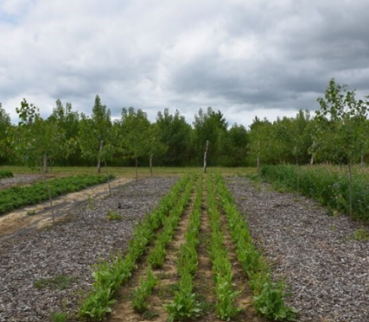
ReForest Living Labs: lessons learned
Modelling allows the exploration of long-term trade-offs between different KPIs in diverse agroforestry systems
Projections facilitate knowledge communication with different stakeholders and decision-making at different levels (farm, regional)
Ongoing field data collection, calibration and validation is essential for context-specific projections (more accurate and useful to stakeholders)
Learn more about all Living Labs @
https://agroreforest.eu/living-labs/

Slide 26
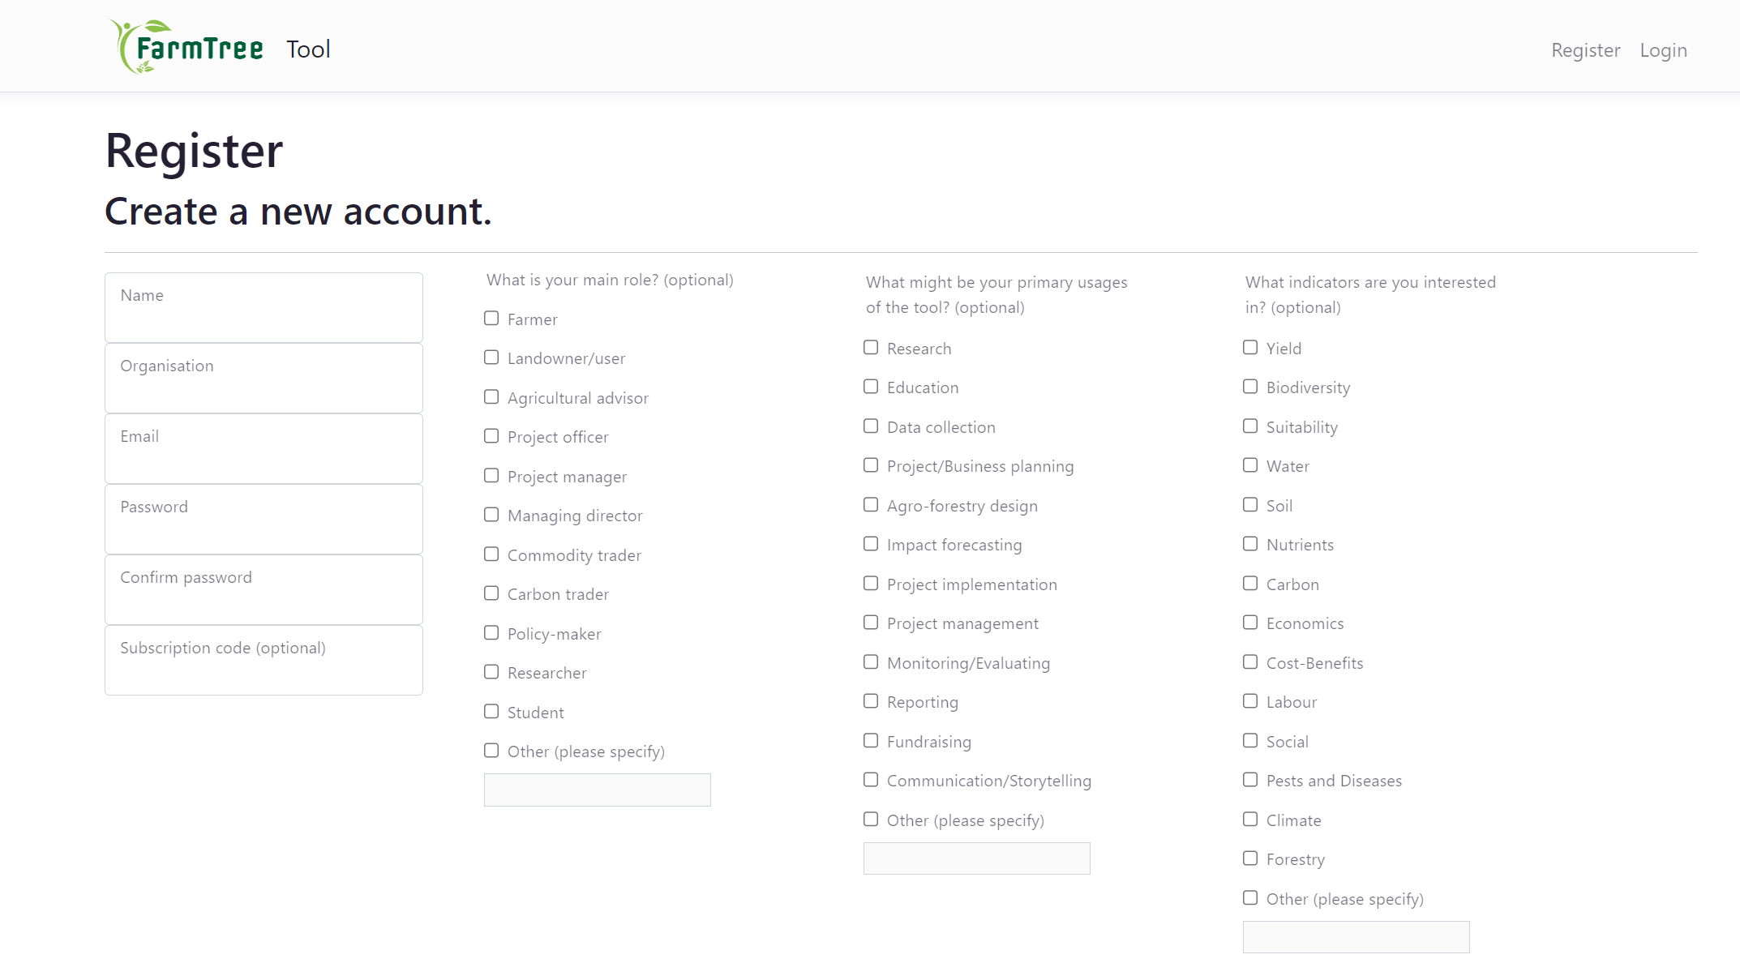
Promotion: Demo Temperate dataset
1-month FREE access to 15 temperate agroforestry species with Demo Temperate code
+ contact us for discounted access until Dec 2024!
What key temperate species would you like to see in this Demo Temperate dataset?
Type them in the chat!
Demo Temperate
Go to https://tool.farmtree.earth/Identity/Account/Register and register your FREE DEMO TEMPERATE account

Slide 27
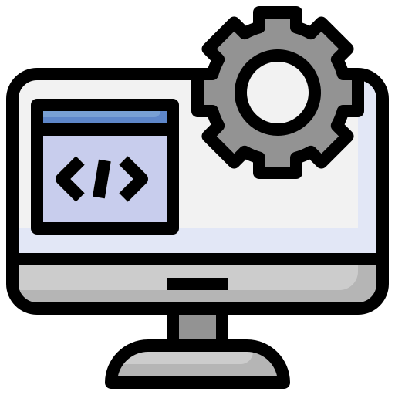
Contact us
https://tool.farmtree.earth
Register and try the FarmTree Demo Temperate Tool for FREE!
https://www.farmtree.earth
https://www.linkedin.com/company/farmtree-b-v
info@farmtree.earth
marina.alarcon@farmtree.earth
steffie.rijpkema@farmtree.earth

Slide 29
Digital Tools in European Agroforestry What do diverse agroforestry practitioners need?
Farms. Trees. Impact. Quantified!
Marina Alarcón, MSc - Agroforestry Impact Quantification Expert marina.alarcon@farmtree.earth
www.farmtree.earth

Slide 30
Please download and install the Slido app on all computers you use
Join at slido.com #1400991
ⓘ Start presenting to display the joining instructions on this slide.

Slide 31
Please download and install the Slido app on all computers you use
What is your main role within your organisation?
ⓘ Start presenting to display the poll results on this slide.

Slide 32
Please download and install the Slido app on all computers you use
What would you mainly need an agroforestry tool for?
ⓘ Start presenting to display the poll results on this slide.

Slide 33
Please download and install the Slido app on all computers you use
What indicators would you need in an agroforestry tool?
ⓘ Start presenting to display the poll results on this slide.

Slide 34
Open questions:
What would you mainly use an agroforestry tool for?
What specific features are you looking for in a tool?
online access
user-friendliness
flexibility
data quality
etc
Type your answers in the slido Q&A chat!

Slide 35
Thank you for your participation
We would love to hear your questions!

