Slide 1
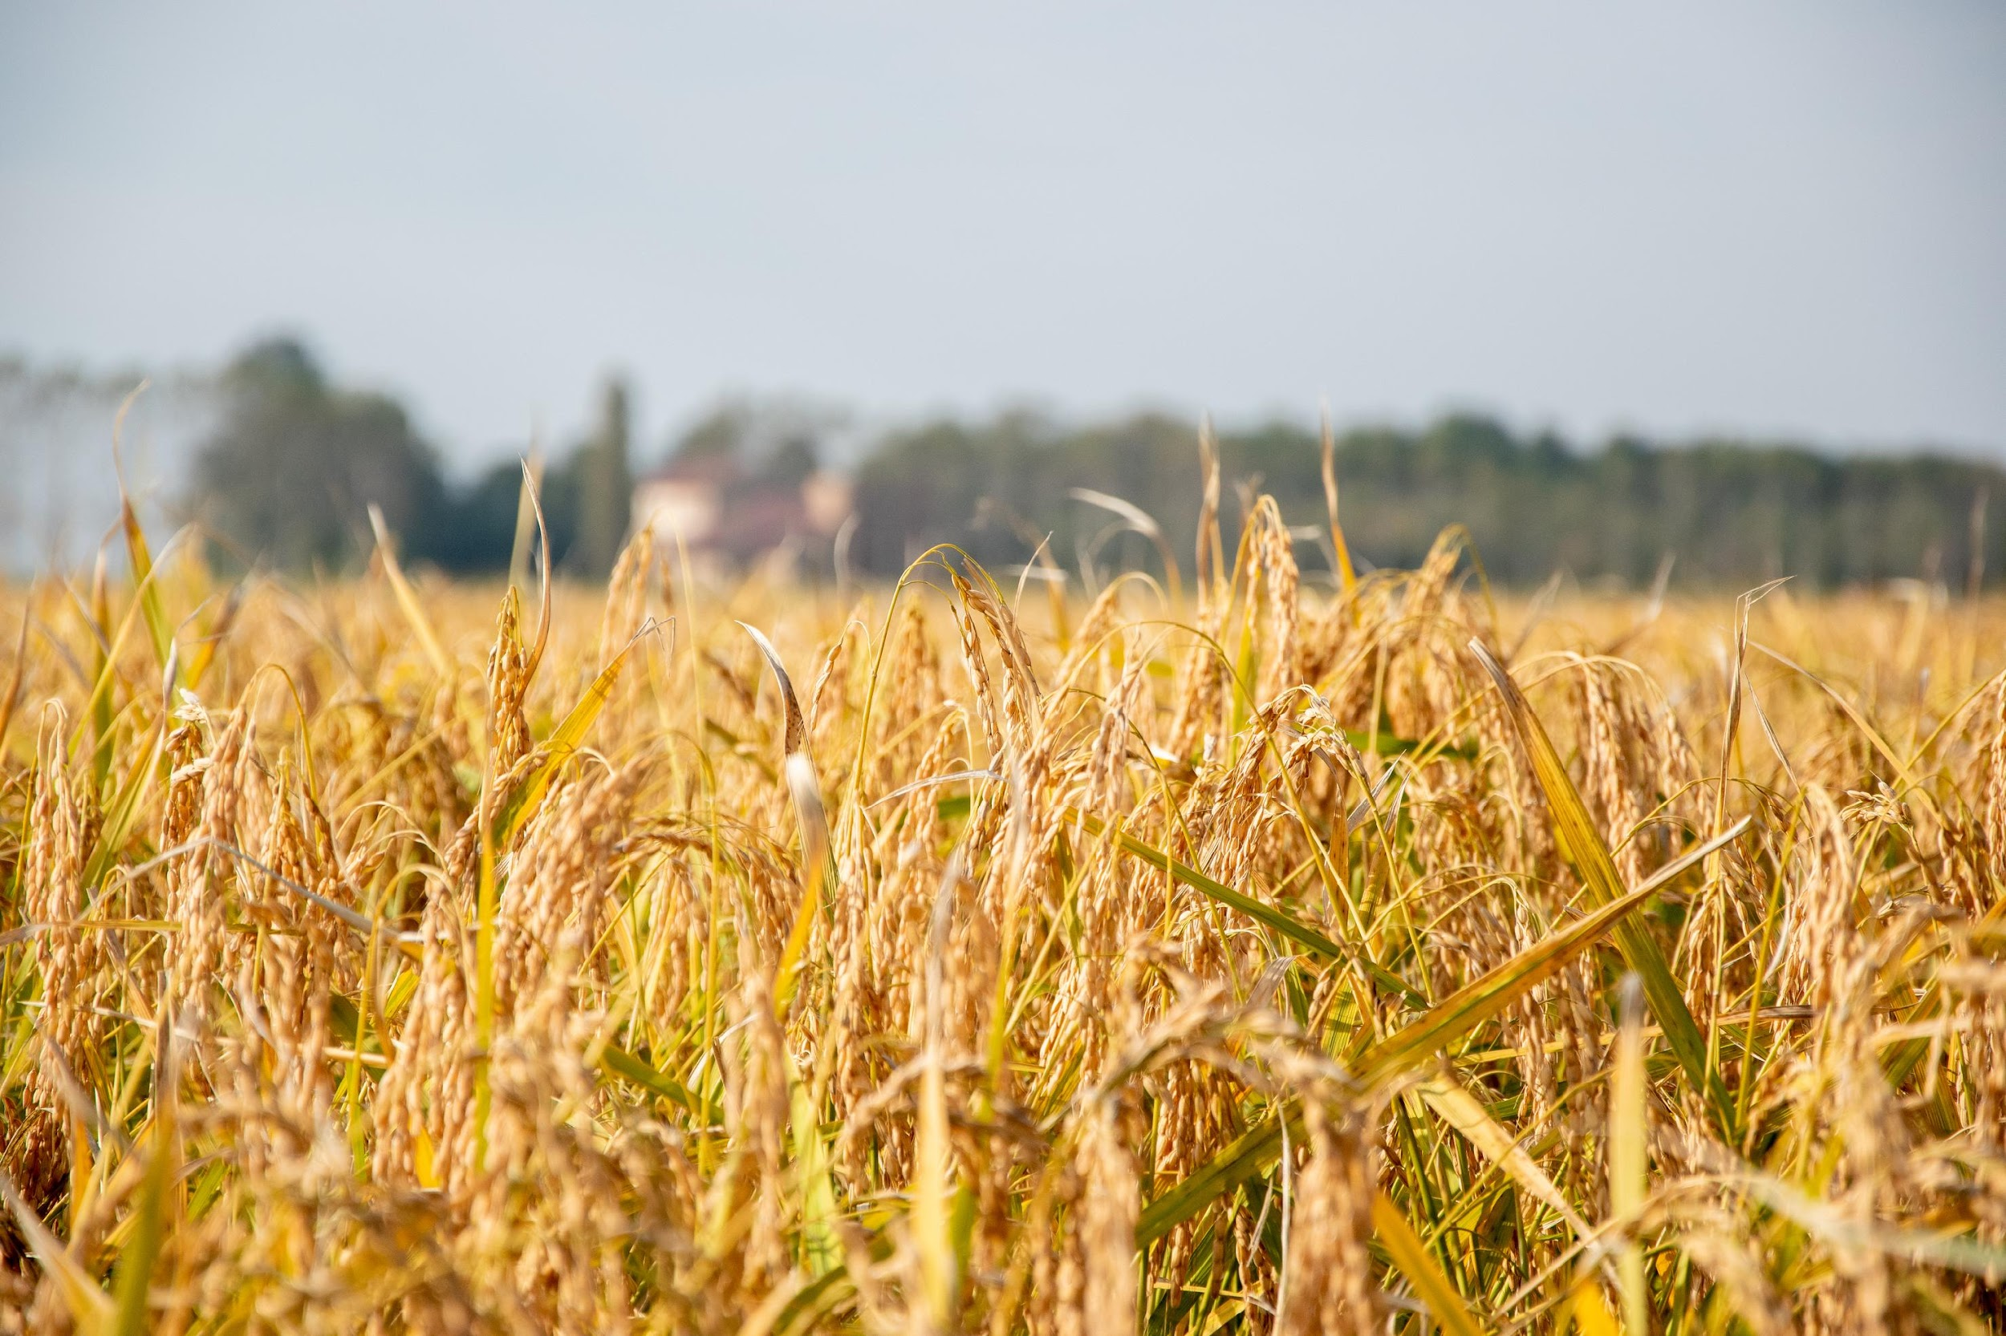












Assessment of carbon farming practices in Poland
Alina Syp
Robert Borek
Paweł Radzikowski

Slide 2
2023
 | JRC value [kg/ha/year] | Area in 2023 [1000xha] | Carbon offset in 2023 [1000xtonC] | Payment in 2023 [EUR/ha] | Cost of int. in 2023 [mln EUR]
Mixing straw with soil | 150 | 2155 | 323 | 45 | 98
Winter catch crops or intercrops | 210 | 1059 | 222 | 113 | 120
Mixing manure into soil | 750 | 798 | 599 | 45 | 36
Reduced tillage systems | 240 | 2670 | 641 | 91 | 242
Diversified crop structure | 150 | 1476 | 221 | 68 | 100
Application of natural liquid fertilisers | 120 | 736 | 88 | 68 | 50
Extensive use of permanent grassland | 720 | 154 | 111 | 113 | 17
Water retention in grasslands | 750 | 117 | 88 | 63 | 7,4
Intetegrated plant production | 150 | 164 | 25 | 295 | 48
Development of fertilisation plan | 50 | 1477 | 74 | 23 | 33
Fertilisation plan – option with liming | 135 | 141 | 19 | 68 | 10
Areas with honey plants | 210 | 15 | 3,2 | 272 | 4,1
Land excluded from production | 720 | 0 | 0 | 0 | 0
Organic farming | 450 | 636 | 286 | 448 | 285
Afforestation | 850 | 0,01 | 0,01 | 2270 | 0,02
In-field trees planting | 850 | 0,01 | 0,01 | 2550 | 0,03
Agroforestry systems | 850 | 0,09 | 0,07 | 1080 | 0,09
Sum |  | 11598 | 2700 |  | 1052
Average value | 433 |  |  | 91

Slide 3
2025
 | JRC value [kg/ha/year]
Mixing straw with soil | 150
Winter catch crops or intercrops | 210
Mixing manure into soil | 750
Reduced tillage systems | 240
Diversified crop structure | 150
Application of natural liquid fertilisers | 120
Extensive use of permanent grassland | 720
Water retention in grasslands | 750
Intetegrated plant production | 150
Development of fertilisation plan | 50
Fertilisation plan – option with liming | 135
Areas with honey plants | 210
Land excluded from production | 720
Organic farming | 450
Afforestation | 850
In-field trees planting | 850
Agroforestry systems | 850
Sum
Average value | 433
Area in 2025 [ha] | Carbon offset [1000xMgC] in 2025 | Peyment in 2025 [EUR/ha] | Cost of intervention in 2025 [mlnEUR]
860 | 129 | 20 | 18
1020 | 214 | 102 | 105
752 | 564 | 41 | 31
3827 | 919 | 61 | 235
1928 | 289 | 55 | 105
1535 | 184 | 61 | 94
122 | 88 | 102 | 13
77 | 58 | 63 | 4,9
576 | 86,5 | 215 | 124
1302 | 65,1 | 20 | 27
140 | 18,9 | 61 | 8,6
21 | 4,3 | 254 | 5,2
30 | 22 | 102 | 3,1
700 | 315 | 486 | 340
0,01 | 0,01 | 2461 | 0,02
0,02 | 0,01 | 2764 | 0,04
0,10 | 0,09 | 703 | 0,07
12890 | 2956 |  | 1113
 |  | 86

Slide 4
2023-2025
 | JRC value [kg/ha/year]
Mixing straw with soil | 150
Winter catch crops or intercrops | 210
Mixing manure into soil | 750
Reduced tillage systems | 240
Diversified crop structure | 150
Application of natural liquid fertilisers | 120
Extensive use of permanent grassland | 720
Water retention in grasslands | 750
Intetegrated plant production | 150
Development of fertilisation plan | 50
Fertilisation plan – option with liming | 135
Areas with honey plants | 210
Land excluded from production | 720
Organic farming | 450
Afforestation | 850
In-field trees planting | 850
Agroforestry systems | 850
Sum
Average value | 433
Total carbon offset [1000xtC] | Total cost [mlnEUR] | C cost [EUR/MgC]
731 | 174 | 270
663 | 334 | 673
1775 | 100 | 60
2379 | 678 | 409
824 | 315 | 542
419 | 219 | 867
304 | 45 | 153
191 | 16 | 94
174 | 253 | 2607
228 | 96 | 576
57 | 27 | 656
12,7 | 15 | 1534
44 | 6,1 | 160
912 | 960 | 1302
0,03 | 0,07 | 2967
0,04 | 0,12 | 3348
0,24 | 0,23 | 1013
8715 | 3239 | 17233
 |  | 1014

Slide 5

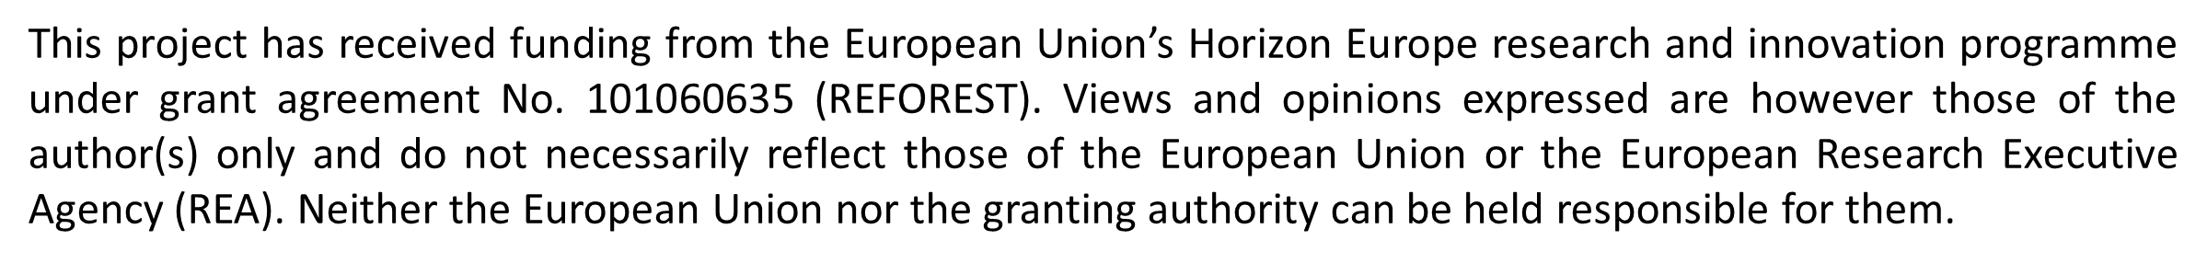
Thank You!

