Slide 1


Assessing the financial performance, uncertainty, and risk in agroforestry systems compared to monoculture under varying climate scenarios
Albert Miquel Colom Bauza
25.06.2026

Slide 2
Context of the study
Economics can help us understand the opportunities and challenges behind agroforestry systems and how to optimise their transition.
1. Agroforestry systems are more complex than monocultures (management, tree-crop interactions, etc.), which require more complex financial assessments.
  They are time-consuming and require large quantities of data, which tend to highly site-specific.
  The more comprehensive a model, the more uncertainty is being introduced through measurement error margins, data resolution, modelling and assumptions…
2. Agroforestry may also deliver (provisioning) benefits, but many are visible only if variability is accounted for.
  AF systems are more resilient than MC:
  Ecologically:
    Enhanced ecosystems withstand climate events better.
    Lower vulnerability to pests and diseases.
  And economically:
    More even profit distribution over the system’s life cycle.
    Multiple income sources can compensate market cycles.
    More local value chains tend to offer greater stability.

Slide 3
Accounting for variability is important
Quantification of variability and risk is necessary in (economic) assessments to account for uncertainty and the robustness of the results.
I identify two main different types of variability.
  Uncertainty: expected variability stemming from regular climatic, ecosystem, market processes.
  Risk: low-probability high-impact events like extreme weather events or economic crisis (war, financial recession).

Slide 4
Objective
Compare the long‑term financial performance of two organic silvoarable (tree-crop) AF systems with that of a conventional monoculture (CMC) after a 30-year period.
  Develop a comprehensive economic model to understand where and when occur the benefits and costs.
  Measure the uncertainty and risk of the outcomes under two climate scenarios (historical and climate change).
  Study how the different systems respond.

Slide 5
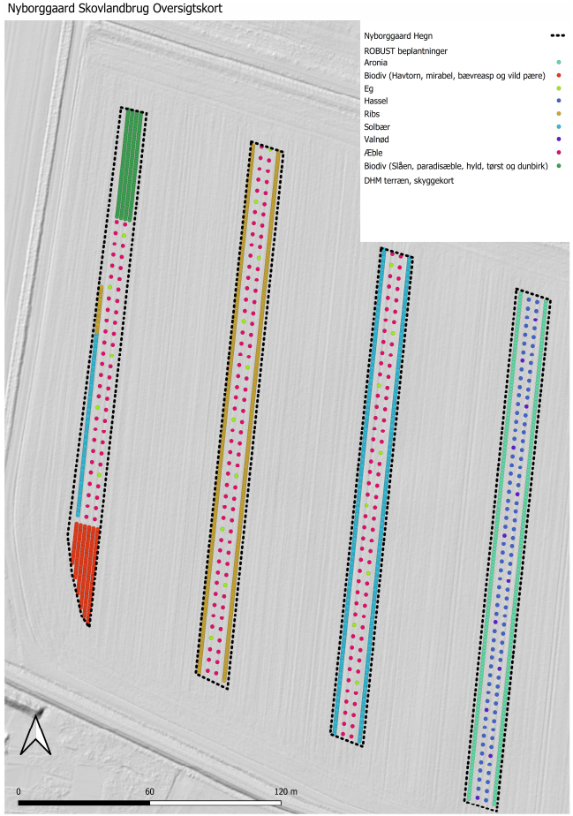
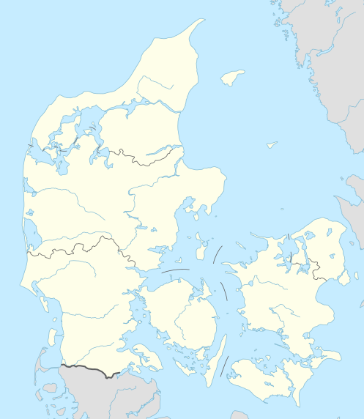
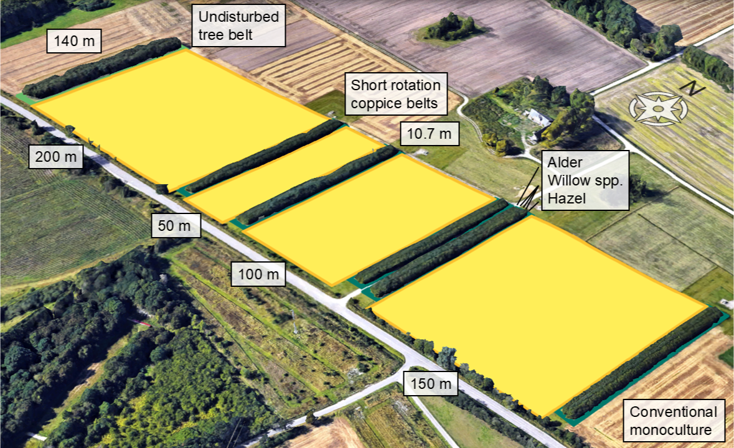
Study sites
(a)
Short-rotation coppice agroforestry and the reference monoculture located in Taastrup, Denmark.
  Crop rotation: spring oat, winter wheat, spring barley, and 2-year grass ley.
  Alley-cropping design: 200-m wide crop alley and 11-m wide tree strip (~ 5 %).
  Short‑rotation coppice agroforestry (SRC AF) system: no-input management with a high-density (18690 trees/hectare) tree strip for woodchip production.
  Conventional monoculture (CMC) managed with synthetic inputs for fertilisation and crop protection.
  Both systems highly mechanised with large-scale machinery.
Apple AF system located in Herning, Denmark.
  Crop rotation: winter rye, spring wheat, spring barley and 3-year grass ley.
  Alley-cropping design: 48-m wide crop alley and 16-m wide tree strip (25 %).
  Extensive apple‑based design (400 trees/ha) with organic management (manure).
  Labour-intensive management of apple trees.
Agronomic data collection: management data (yields, inputs, machinery and labour operations, and prices) were collected through multiple interviews with the land managers.
(b)
Figure 1. Studied agroforestry sites in Denmark.
(a) Apple AF (Halfdan Jørgensen 2023).
(b) SRC AF.

Slide 6
Methods: economic modelling
Excel model to quantify whole life cycle of the systems at the field-scale.
  Cash flows: Inputs, outputs, subsidies, machinery use (consumption, maintenance and depreciation), management operations.
  Complete life cycle: Soil preparation, planting and sowing, input application, pruning, harvesting.
  No fixed establishment costs: machinery costs incurred at use.
Economic data: collected from interviews and from Danish open sources for agricultural management.

Slide 7
Methods: variability assumptions
Internal (expected) uncertainty represents typical minor annual variability associated with normal market and yield fluctuations.
  Normally distributed within the variability ranges (Table).
External (unexpected) risks reflects low‑probability, high‑impact events.
  Represented using a Bernoulli distribution (probability that a risk event occurs).
  In the climate change scenario, we simulated a 33% probability of an extreme weather event reducing yields by 50% in the CMC, while assuming a smaller impact on the organic AF systems (crop: −33%, tree: −17%).
Monte-Carlo modelling approach incorporating both internal (expected) and external (unexpected) uncertainty.
Variability and risk data: sourced from Eurostat (prices) and literature (yields).

Slide 8
Parameter | Quantities (%) | Price (%)
Inputs
Seeds | 0 | 4
Rootstocks | 0 | 4
Organic fertilisers (manure) | 10 | 4
Lime | 10 | 4
Inorganic fertilisers | 10 | 16
Pesticides and adjuvant additives | 10 | 2
Irrigation water | 10 | 4
Diesel |  | 13
Labour |  | 4
Outputs
Cereals | 20 | 19
Legumes | 25 | 11
Perennial crops (grass ley) | 20 | 8
Tree products | 20 | 10
Subsidies | 15
Machinery and implements
Price | 2
Consumption | 10
Maintenance cost | 2
Use | 30
Lifetime | 20
Value loss | 12.5
Scrap value | 18
Management | 15

Slide 9
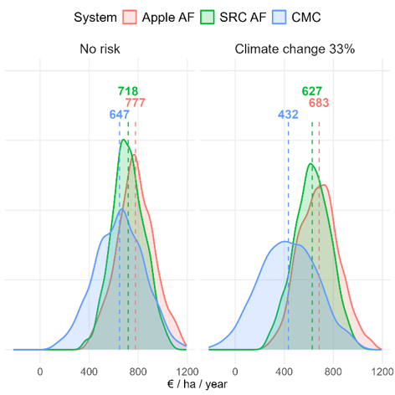
Results
Organic AF systems exceed the CMC’s profitability once CAP subsidies included.
In the absence of climate change risk, the organic AF systems also exhibit lower profit variability.
  A reduced number of external inputs (fossil fuel-based synthetic fertilisers and pesticides) and machinery operations in the AF systems leads to lower uncertainty.
  The use of fewer and locally sourced inputs (e.g., manure) and the greater reliance on labour helped stabilise costs.
  The presence of multiple outputs provides a buffering effect against weather and market shocks, enhancing profit stability over time.
  Tree products further increase stability in localised value chains.
Under the climate change risk scenario, AF systems show higher resilience than CMC, both in terms of profit and uncertainty.
  Profits in the CMC decline by 33%, AF’s decrease by only 12%.
  CMC’s standard deviation increases 17% versus 6% in Apple AF and 11% in SRC AF.
Figure 2. Estimated profit distributions and means under two climate scenarios (N=1000). The results are expressed in a mean annual net present value (2% discount rate), calculated for a 30-year rotation.

Slide 10
Limitations and future improvements
Like any model, the results are as good as the data behind.
  There are many parameters where we do not have a proper quantification of the uncertainty, assumptions need to be taken.
  Price and yield data inconsistent: depends on the study methods and objectives, site-specific context for market growing conditions and climate, future scenarios, etc.
How to quantify and generalise the uncertainty of local value chains and for small-scale systems?

Slide 11

Thank you!
Please, see the Agroforestry Decision-Support Tool: https://agroreforest.eu/tools/
Acknowledgements
We are grateful for the financial support provided by the REFOREST project funded by the European Union’s Horizon Europe Research and Innovation Program under grant agreement number [101060635]. The views and opinions expressed are, however, those of the author(s) only and do not necessarily reflect those of the European Union or the European Research Executive Agency (REA). Neither the European Union nor the granting authority can be held responsible for authors.

