Slide 1

Dynamic Agroforestry Management Tool at the farm level
Dr. Prajna Kasargodu Anebagilu,
INRES Horticultural Sciences, University of Bonn
pkasargo@uni-bonn.de

Slide 2
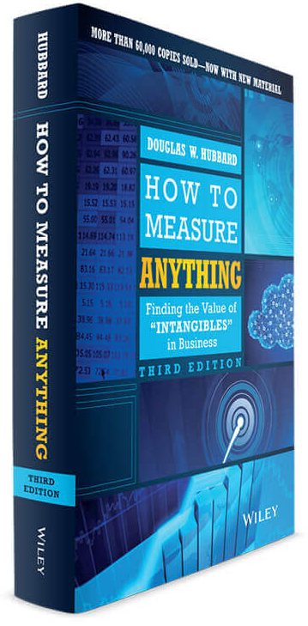
Decision Analysis Approach
Capture what is known and apply this knowledge to generate forecasts of decision outcomes.
From business and economics to agriculture
When to use this approach?
  For systems are too complex to fully understand (with available resources)
  For supporting decisions that must be made without perfect information
  “What’s the best option according to our limited understanding?”
Hubbard, D.W. (2014) How To Measure Anything: Finding the Value of Intangibles in Business. John Wiley & Sons, Hoboken, New Jersey.

Slide 3
Decision Analysis Approach
Key principles:
  Include everything that matters
  Model system using all sources of information, including local and expert knowledge
  Explicitly consider uncertainties about inputs, processes and outputs (probabilistic models)
  Identify key uncertainties for measurement using ‘Value of Information’ analysis
  Update model, when new information becomes available

Slide 4
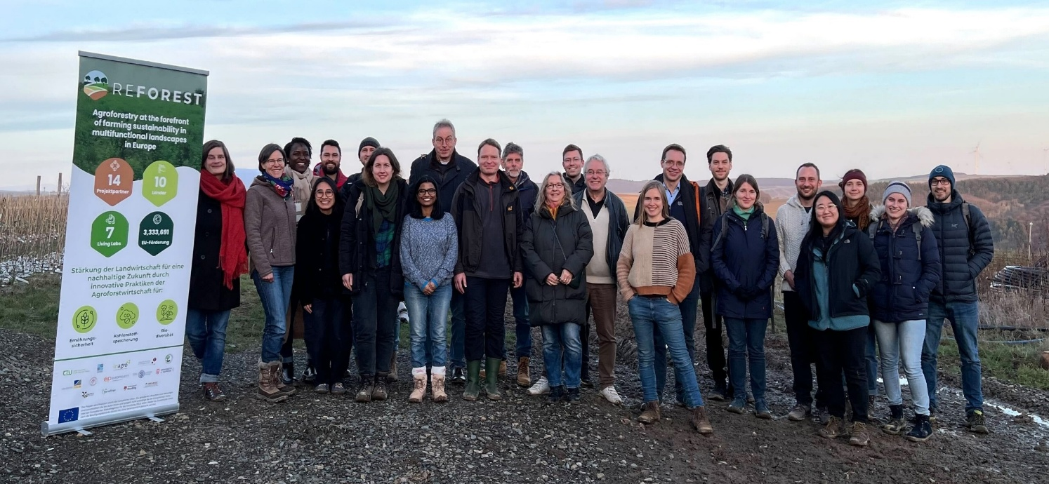
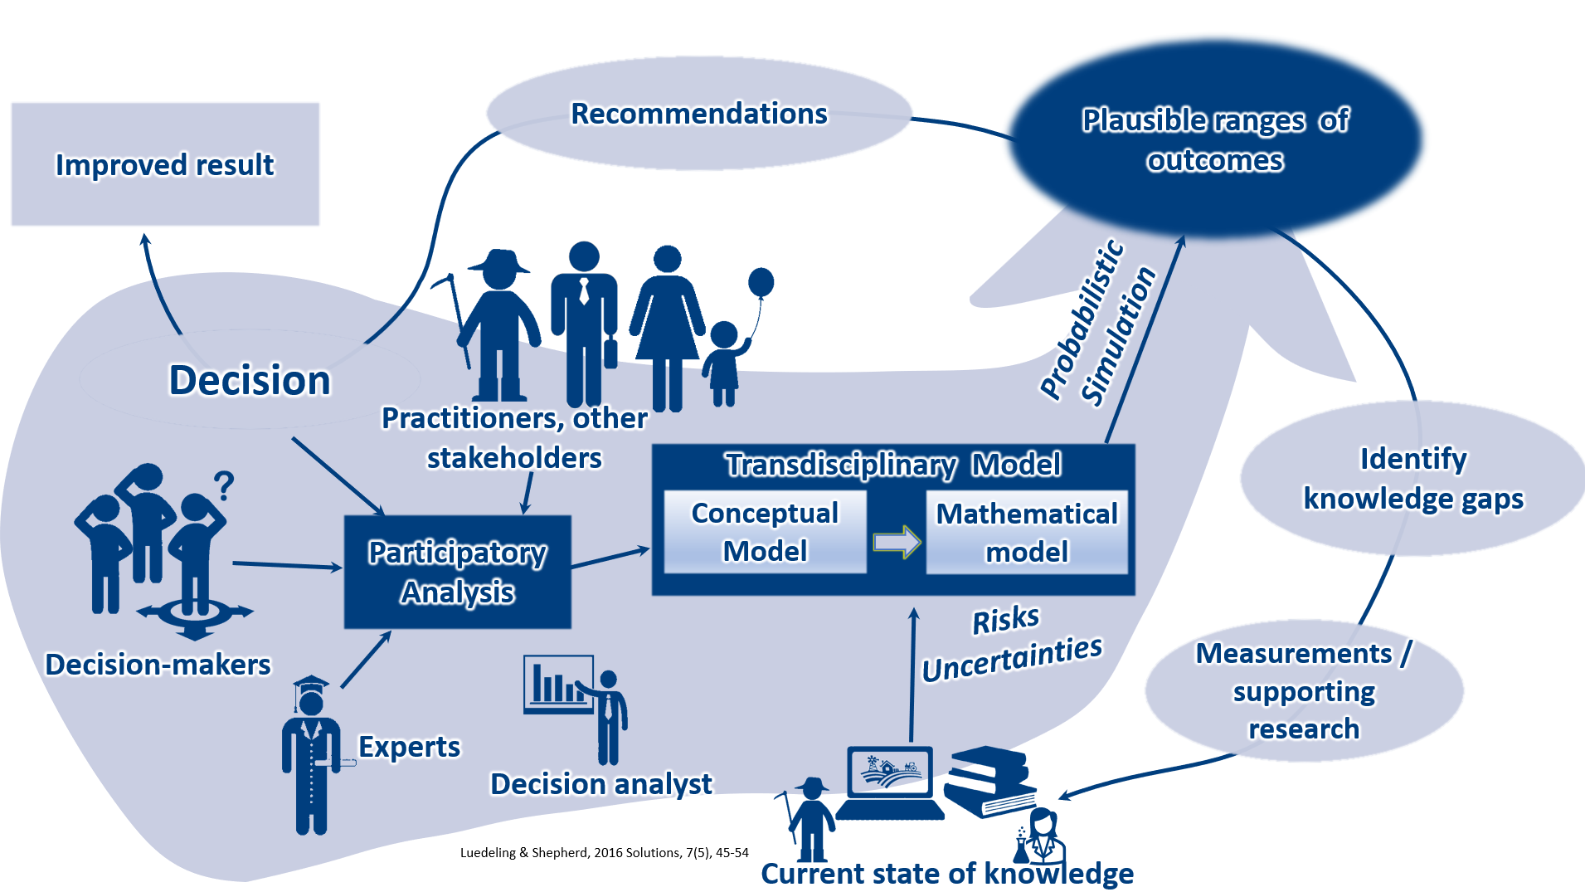
Decision Analysis Approach

Slide 5
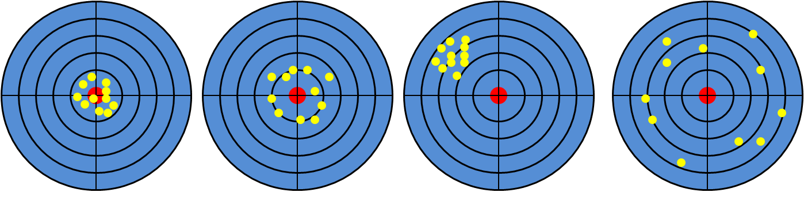
Decision Analysis Approach: using probabilistic value ranges
Input data:
  For many variables, we have no data
  Relying only on our experience is not a good strategy
  Based on what we know, we can estimate the value range
Better to be roughly right than precisely wrong!
Accurate & precise
Accurate & imprecise
Not accurate & precise
Not accurate & imprecise

Slide 6



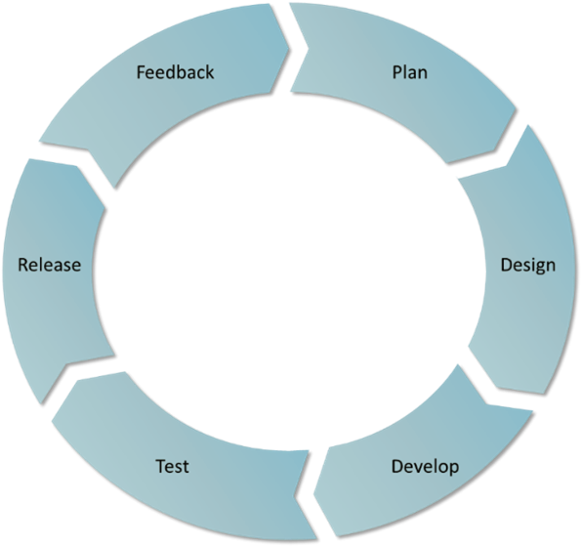
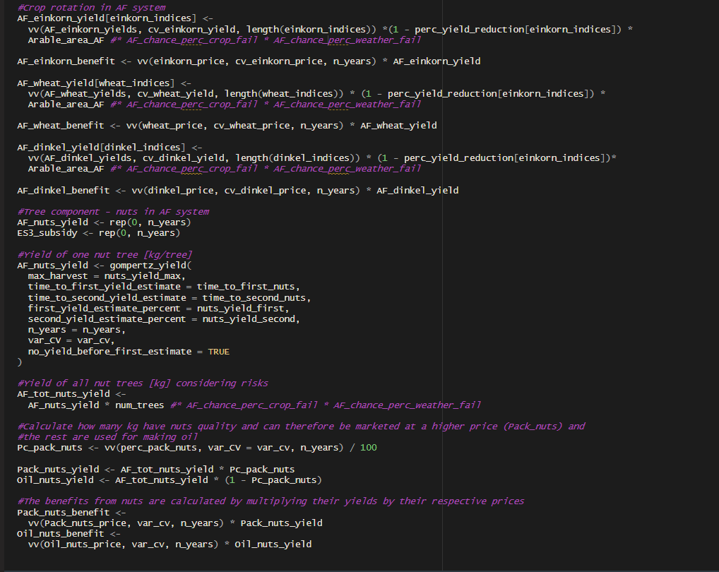
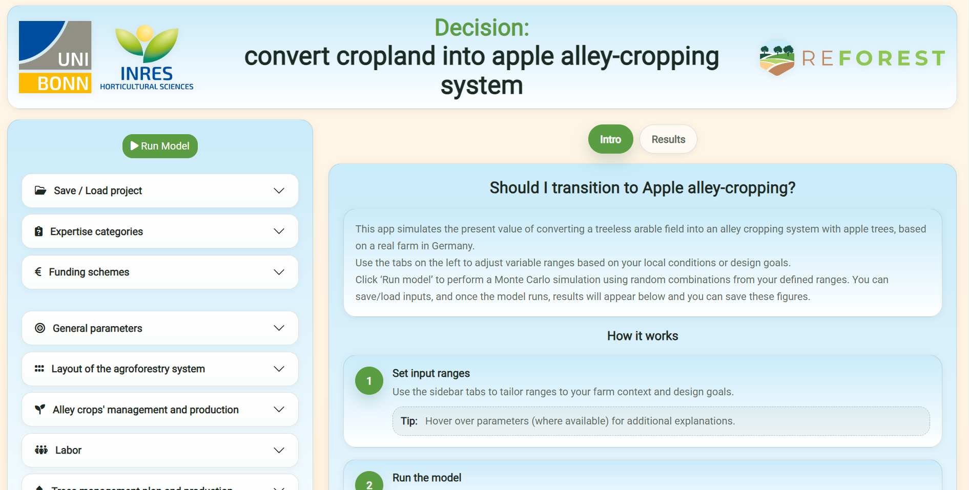
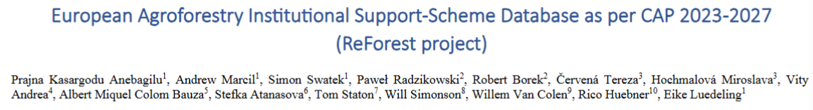
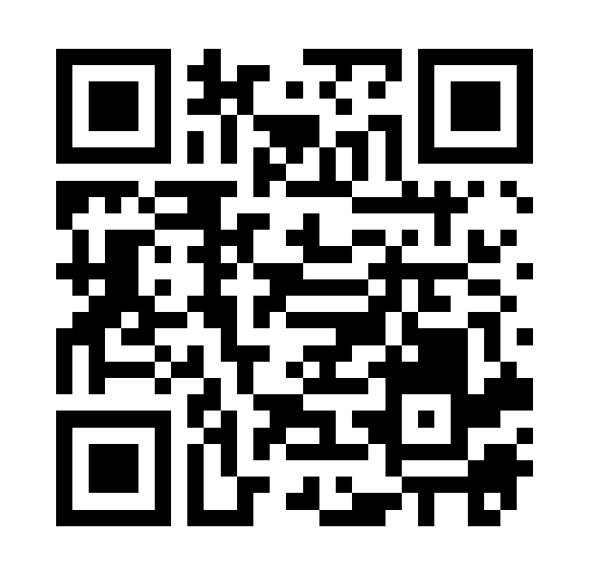
Dynamic Management Tool: Development process
Agile Development Process
6

Slide 7
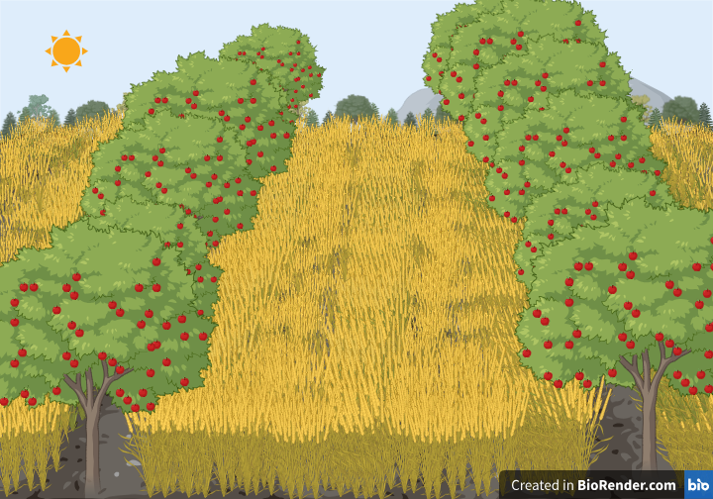
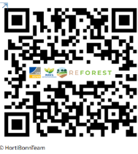
Dynamic Management Tool
App 1: Silvoarable system with apple production, Germany
Comparison of apple agroforestry with the treeless option
https://agtools.app/Apple-Agroforestry/
Notes:
Promising, but risky without support payments
How does support scheme design affect profitability?

Slide 8
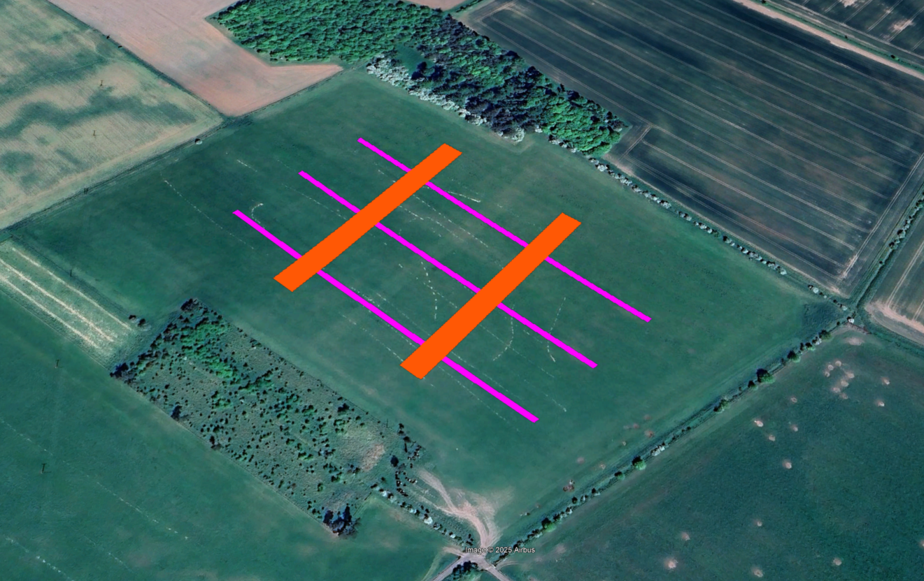
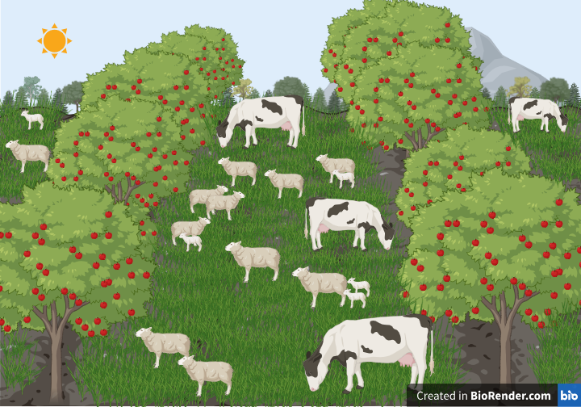
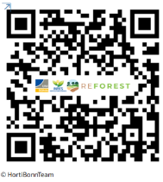
Dynamic Management Tool
App 2: Silvopastoral designs, UK
Comparison of 2 designs
Ecosystem benefits
Major differences in expected outcomes
Design 2
Design 1
https://agtools.app/Silvopastoral-Livestock/
Notes:
In this tool, we also provide the option of 2 types of crop rotation and what % of grazing is allowed between cattle and sheep for each system.
Designs:
Design 1: 3 strips up/down 300 x 5 m stock fenced. Goat willows, mixed natives – stock to be permanently excluded but browse over/through fence. Willow not mechanically harvestable but will overhang fields.
Design 2: 2 Strips across slope – 15 m wide SRC with some mixed natives in tree guards on edge. – stock to be given access for browsing, should be mechanically harvestable.

Slide 9
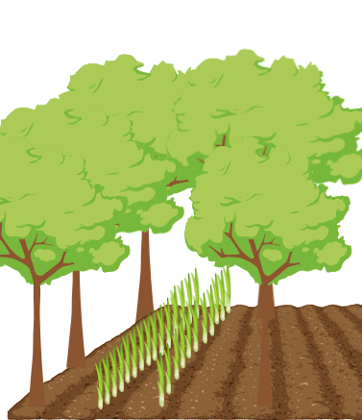
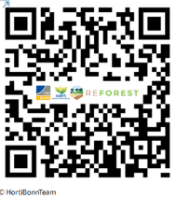
Dynamic Management Tool
App 3: Walnut alley-cropping & hedges, Belgium
With vegetable production
Carbon dynamics and ecosystem services
https://agtools.app/ Walnut-Agroforestry/

Slide 10
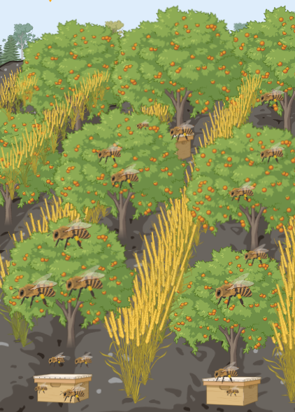
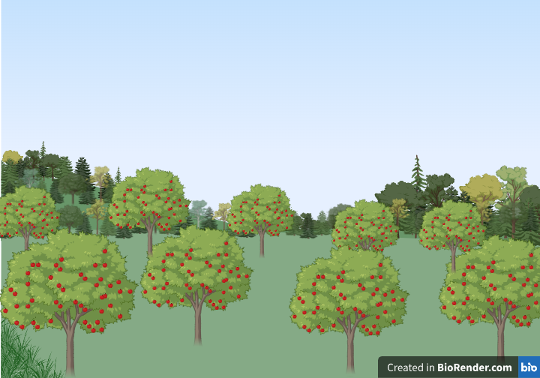
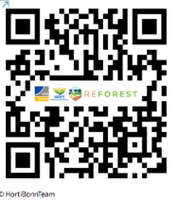
Dynamic Management Tool
App 4: Fruits & honey production + Streuobstwiese, Germany
Fruit trees selected for year-round honey production
Unique design
Much wider range of outcomes than the conventional option
https://agtools.app/Fruit-Honey/
Notes:
traditional orchard meadows

