Slide 1


Evaluating Structured Financing Frameworks for Agroforestry
A Decision Analysis Approach

Slide 2
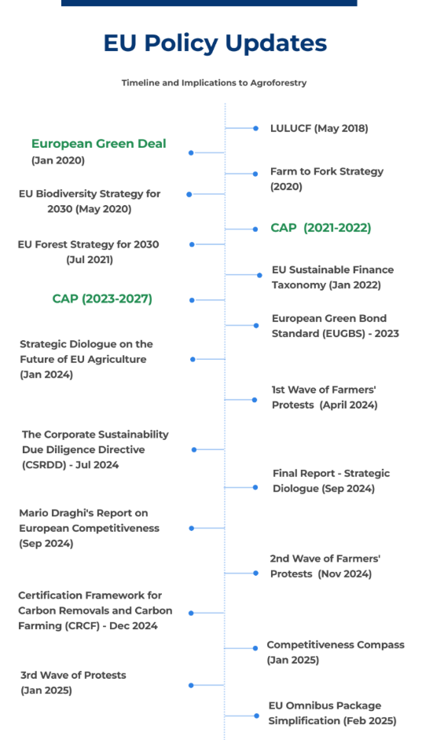
Our Motivation
ReForest Findings and Deliverables
Under ReForest: Policy mapping and barrier assessment
Lit. Review + Living Labs empirics + Digital Tools
Systemic Barriers
Policy / Regulatory Gaps
Funding / Investment Gaps
Knowledge / Data Gaps
See: ReForest-D5.3-Mapping-Report-on-AF-sector-finance-and-policy-3.pdf

Slide 3
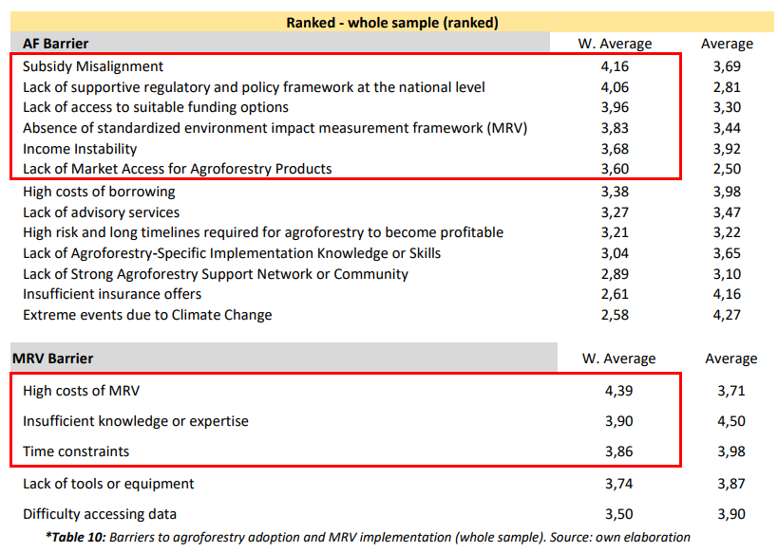
Barrier Assessment from Farmer Survey
See: ReForest-D5.5-Report-of-AF-Financing-Model-Application.pdf
Notes:
Under REFOREST

Slide 4
Proposed Sustainable Financing Scheme for AF
Ex-Ante based payments
Action based payments
Result based payments
Advisory Services
The Sustainable Financing Scheme was co-designed in Deliverable D5.4 (Hadjukovic,2023) through iterative consultations with REFOREST partners and Living Labs.
It integrates findings from WP5 Mapping Reports, Stakeholder Feedback, and Literature Review on blended finance and PES mechanisms to create a hybrid model stress-tested with Living Labs and extended to EU & UK farmers.
Ref.: COWI, Ecological Institute, and IEEP (2021); Den Heder (2017); Guimarães et al., (2023); Hadjukovic (2023); Kay et al (2019); Mc Donald et al (2021); Sheid et al (2023)

Slide 5
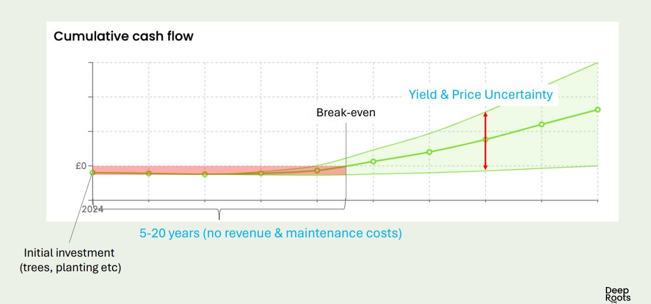
ReForest Financing Scheme
Stylized Typical AF Farmer Financial Projection
De-Risking and Blended Finance mechanisms**
Action Based Payments
Ex-Ante Payment
Hybrid - Results Based Payments
Advisory Service
Pillars of the Scheme over the timeline of a typical agroforestry system

Slide 6
De-Risking and Blended Finance mechanisms**
Standard
Self financed
Advisory Support
Premium
Project Financed through?
Commercial Loan
Digital tools
Living labs
Development bank loan
Cooperatives
Impact Investment
Blended Finance
Consultants
De-risking mechanism support?
Guarantee Fund
Market access & Value Chain?
Price Guarantee
Insurance
Price Premia

Slide 7
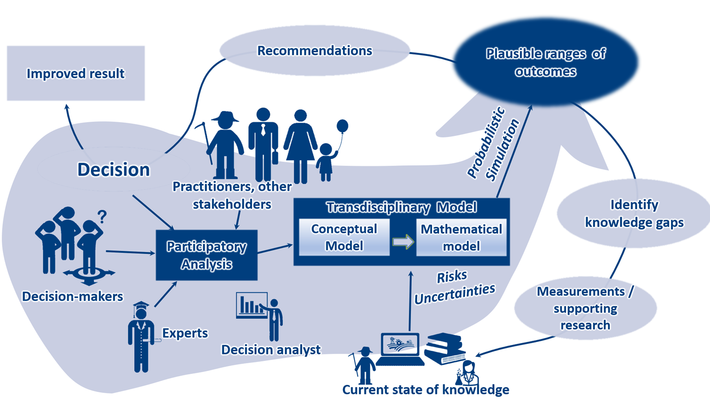
Decision Analysis Approach
Luedeling & Shepherd, 2016 Solutions, 7(5), 45-54

Slide 8
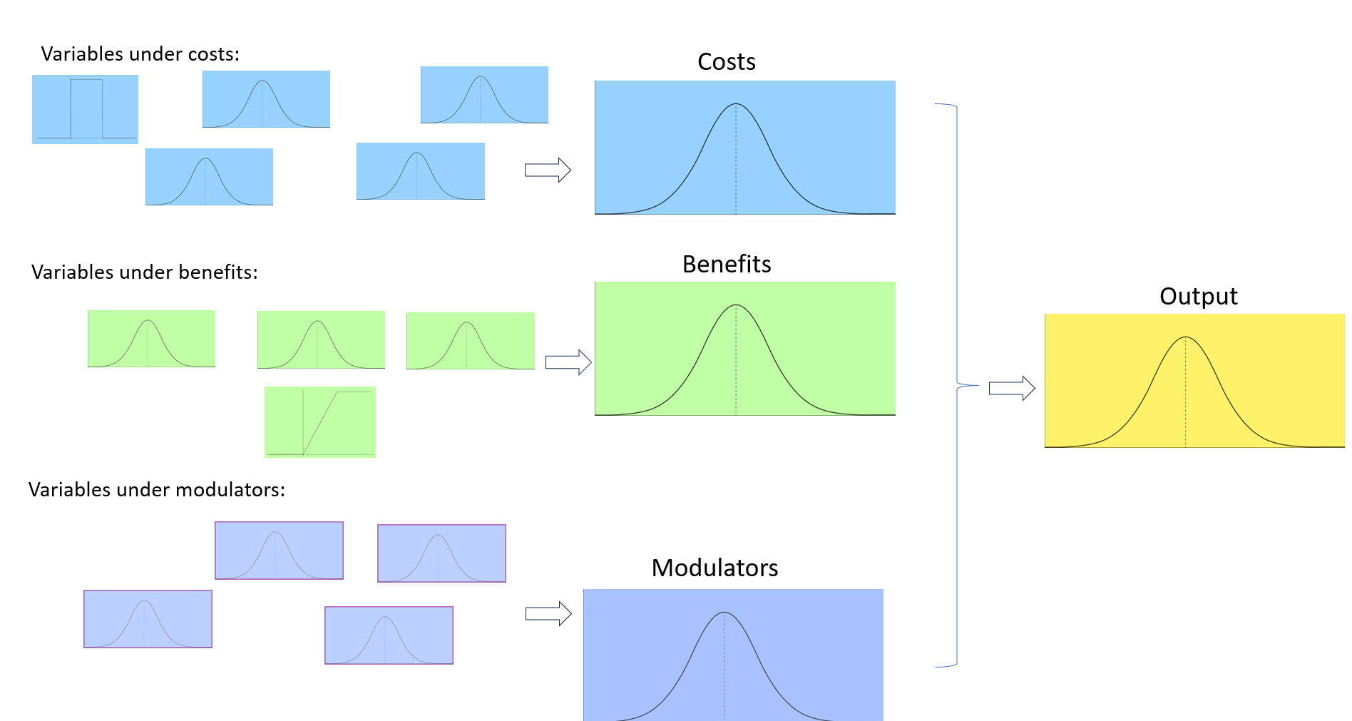
Probabilistic Simulation

Slide 9
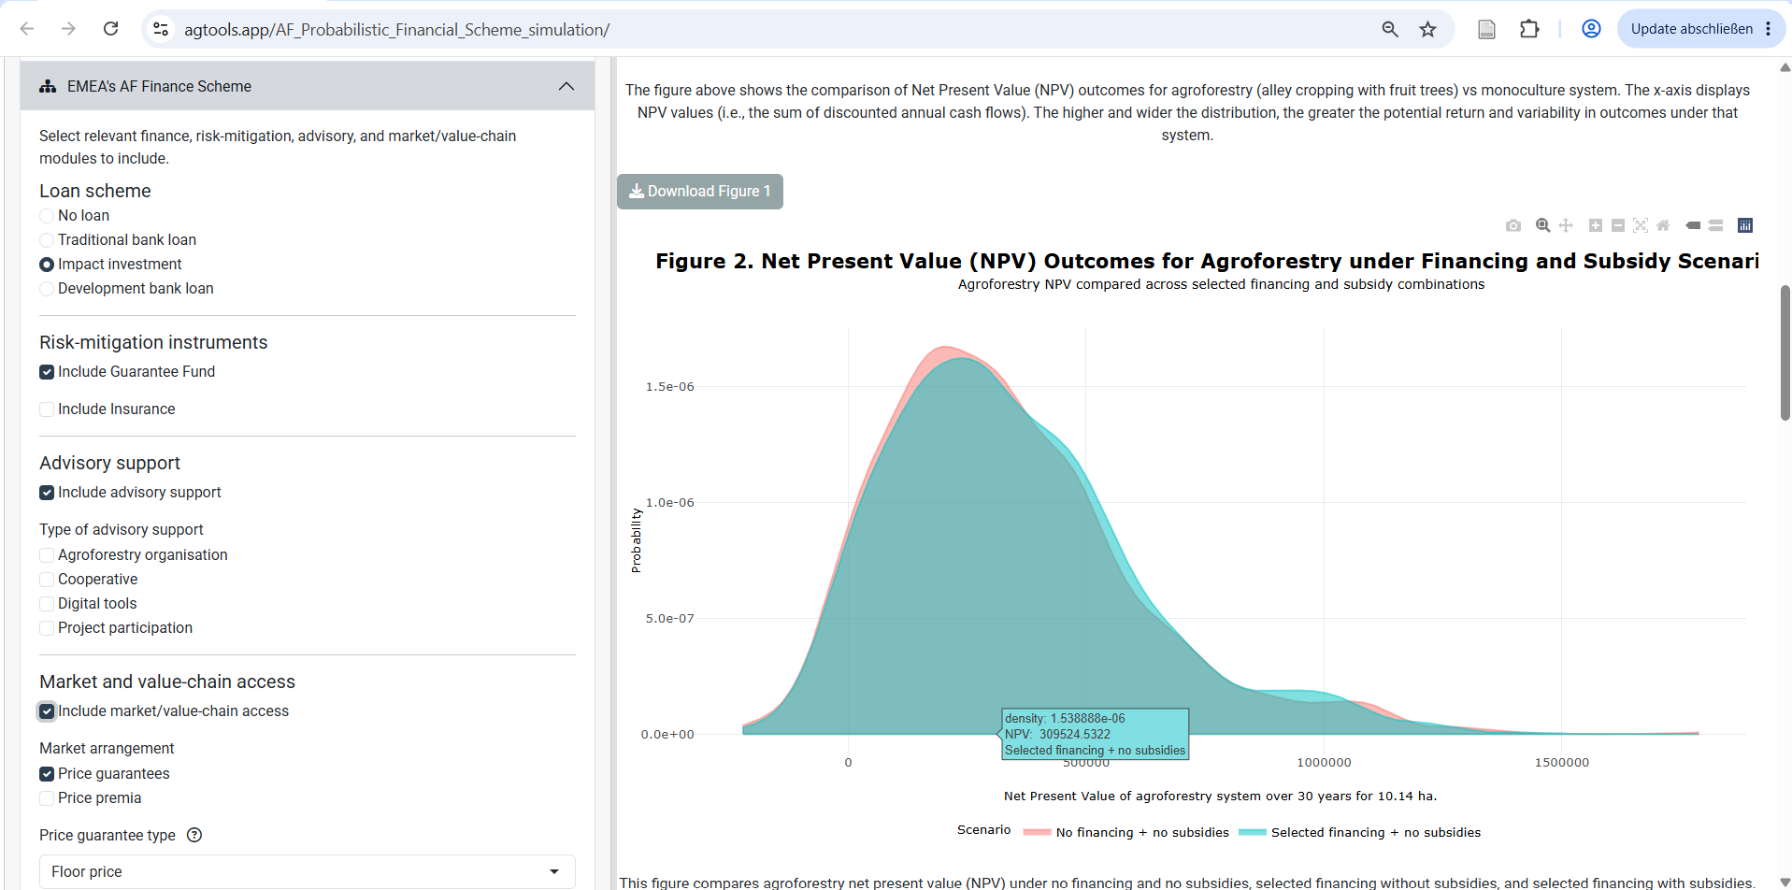
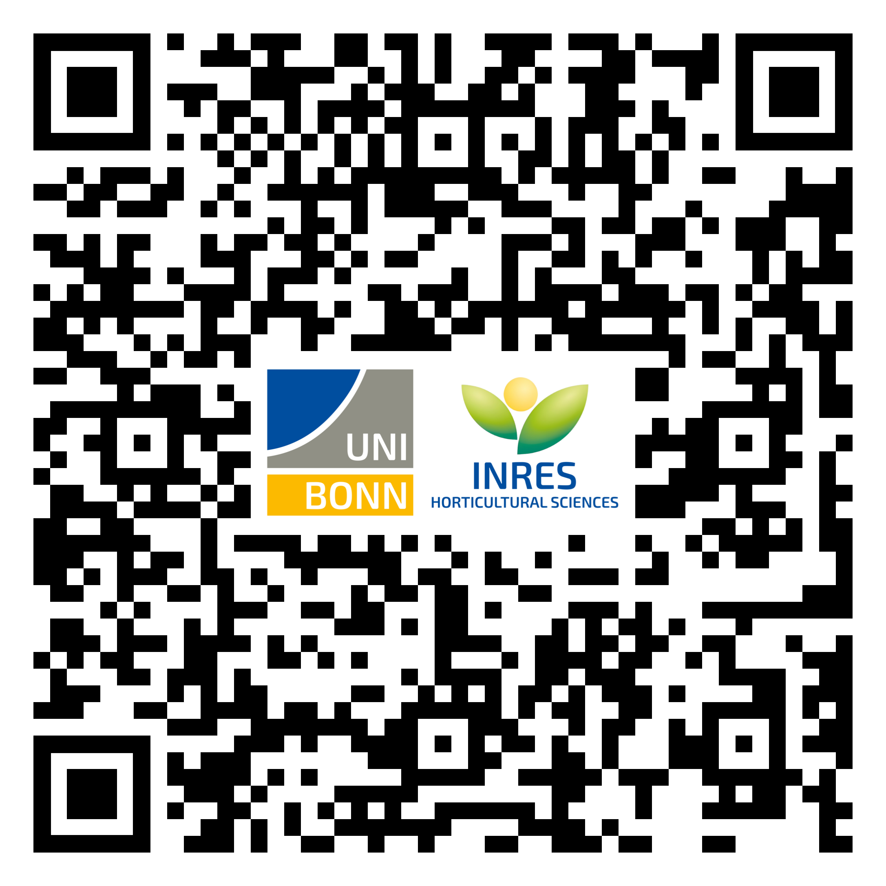
Dynamic Management tool with the Finance Scheme
Preliminary app version developed for transition from monoculture to temperate fruit alley-cropping system
Based on the apple alley-cropping system in Germany + Finance Scheme
https://agtools.app/AF_Probabilistic_Financial_Scheme_simulation/

Slide 10
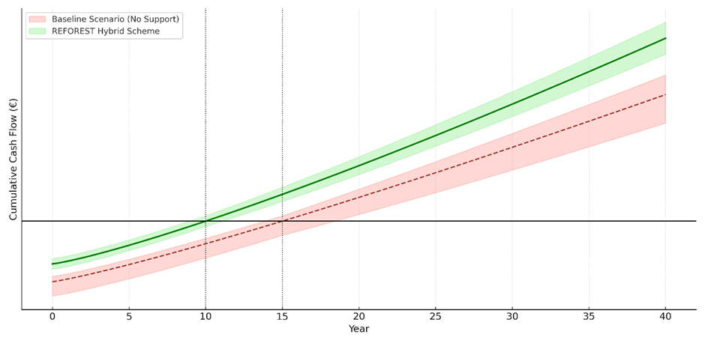
Hypothesized Cumulative Cash Flow Projection – Commercial loan & No AF subsidies vs. Finance Scheme

Slide 11
Baseline Scenario (Subsidies/ CAP based)
5 Year Prototype Phases* | Proposed Scheme | Traditional / Subsidiary Based Payments
Prior to Project Implementation (Upfront) | Ex-ante payments | - CAP Pillar I & II -> Planning and initial setup grants for feasibility studies, land assessment, and initial project setup. - State Aid -> Initial research and infrastructure setup funding.
Year 1: Establishment of AF Systems | Action-based payments | - CAP Pillar I (Eco-schemes) -> Subsidies for sustainable planting practices, rewarding practices that benefit the environment and climate beyond usual requirements.
Years 1-5: Management of AF Systems | Hybrid payments | - CAP Pillar II (Rural Development) -> Funding for ongoing management and operational costs, enhancing system resilience and productivity. - Operational State Aid -> Support for sustainable agricultural operations. - Direct Payments -> Basic income for compliance with sustainability practices.
Year 5*: *or End of the Project | Result-based payments | - CAP Pillar II: Rewards for achieving sustainability targets at project completion.
Extra / Conditional Payment Services | Other existing Payments | - Young Farmers: Targeting under 40-year-old farmers - CRISS: Targets smaller farms for higher per hectare support. - PSF: Simplifies payments to reduce burdens.

Slide 12
De-Risking and Blended Finance mechanisms**(1/2)
Incentive Mechanisms | Brief Discription / Economic Rationale | CBA Model Application / Funding Channel
Seed Funding and Grants from NGO and Philantropic Foundations | Provide early-stage or transition funding for AF projects through grants, concessional loans, or catalytic capital from major donors, foundations, and impact-driven funds. *Co-funding schemes that blend donor capital with public subsidies or guarantees | One time - Upfront funding [€] Annual (periodic) - Seasonal/ Seed Funding funding [€]
Nature Capital Markets and Certification Schemes | External accredited organs that measure and certify carbon storage and biodiversity enhancements, increasing project credibility and investment appeal | Carbon Market Credits *case study: analysis on the decision to join Carbon market – size and age matters MRV funding support [€] Cost of Certification / Sponsors [€]
Impact Investment, Blended Finance & Crowdlending and Crowdfunding Platforms | Funds looking for positive social and environmental returns. Series of online platforms that raise funds from many investors, ideal for community-based, cooperatives or smaller agroforestry projects. | Loan amount [€] Interest Rate [%] Repayment of loan from year [grace periods] Annual Repayment amount [€/year]
Risk-Mitigation / Sharing Instruments | Reduce the financial exposure of farmers and lenders, enabling long-term investments with delayed returns. These instruments cover early losses, climate shocks, or credit risk, making lending more accessible and lowering financing costs. | Initial investment risk covered by Guarantee instruments (collateral component) [€] First-Loss Capital & Climate Insurance *case study: Parametric Insurance

Slide 13
De-Risking and Blended Finance mechanisms** (2/2)
Incentive Mechanisms | Brief Discription / Economic Rationale | CBA Model Application / Funding Channel
High-Quality, Site-Specific Advisory & Technical Assistance Services | Specialised advisory services improve farmer decision-making, reduce design errors, and increase long-term productivity. Also improves access to financing by providing management plans, budgets, and documentation required by lenders or public authorities. | One-time consultation cost [€] Annual Cost of Service [€/year] Rate over all experience with advisory service [%] Rate the service based on the design created for you by your advisor [%]
Integrated Value-Chain & Processing Infrastructure Finance | AF becomes economically viable when farmers have access to processing, storage, logistics, and market infrastructure. Dedicated finance for value-chain assets (e.g., nut cracking, fruit drying, timber processing, cold storage) increases product value and reduces post-harvest losses. | Specific /favoring credit lines *case study on the decision to join cooperatives Cost of shared cooperative equipment [€] Annual operation and maintenance cost for infrastructure [€/year]
Advance Purchase Agreements (APAs) & ESG-Aligned Procurement Contracts | Forward long-term contracts secure future revenue streams by guaranteeing the purchase of AF products before production. APAs reduce price volatility, support early investment decisions, and strengthen farmers’ bargaining power in value chains. | Carbon and biodiversity forward contracts / Price Guaranteed at [€/t] Reduction in price uncertainity [%] Premium price margin for agroforestry products compared to conventional [%] Additional price consumers are willing to pay for sustainable/regenerative products [%]
Digital Tools, Climate-Tech Startups & Data sharing Platforms | Collaborations that drive innovation, scale solutions, and provide financial or technical support. These partnerships can help startups with market access, funding, and expertise to accelerate agroforestry adoption. | Digital Tool Subscription [€/year] Planning and report generation cost [€/year]

