Slide 1
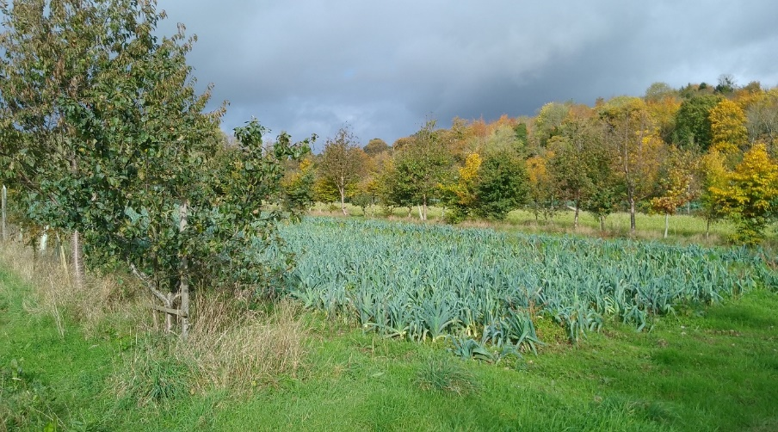
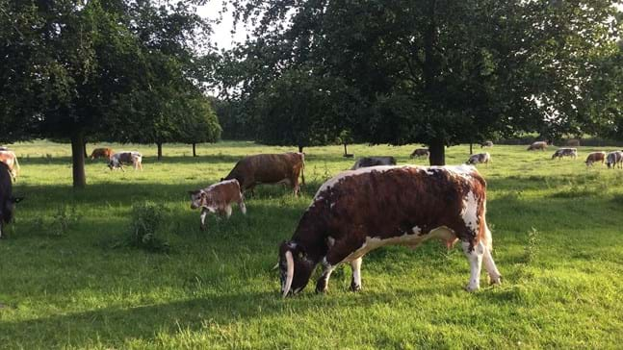
Practical applications of digital tools for agroforestry: experiences from the REFOREST project
Tom Staton, University of Reading
With contributions from Organic Research Centre and FarmTree

Slide 2
Content
Introduction to agroforestry and ReForest project
The Living Lab approach in ReForest
Assessing farm-level sustainability: the Public Goods Tool
Projecting agroforestry performance: FarmTree Tool
Questions

Slide 3
What is agroforestry?
Farming with trees
The practice of deliberately integrating woody vegetation (trees or shrubs) with crop and/or animal systems to benefit from ecological and economic interactions (Burgess et al 2015)
Intentional
Integration
Intensive
Interactions

Slide 4
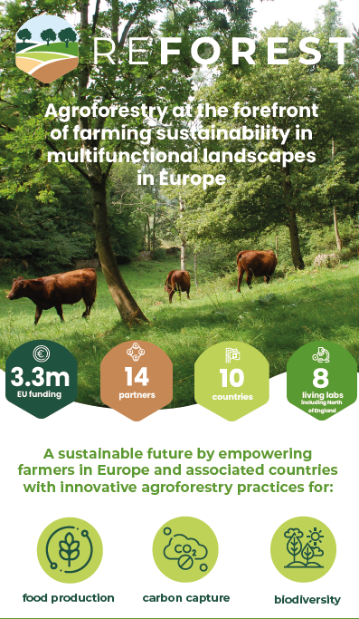
Еnhance the understanding of agroforestry systems by actors and to improve their decision-making capability within real-world limitations.
Еnable local innovation and support mechanisms for dynamic agroforestry system optimisation at farm level.
Characterise and quantify the performance of existing agroforestry systems in terms of their productivity, profitability, and ecosystem service provision.
Develop a monitoring and verification capability acceptable to key stakeholders in the agroforestry value chain.
Develop financial models specific to agroforestry.
Policy impact

Slide 5
Living Labs
Living labs are initiatives in which experimentation is conducted on real farms, in specific territorial and community contexts, with farmers and other actors involved from the beginning as equal partners in proposing ideas, testing them, improving them and promoting them further.
European R&I partnership on agroecology living labs and research infrastructures, 2024

Slide 6
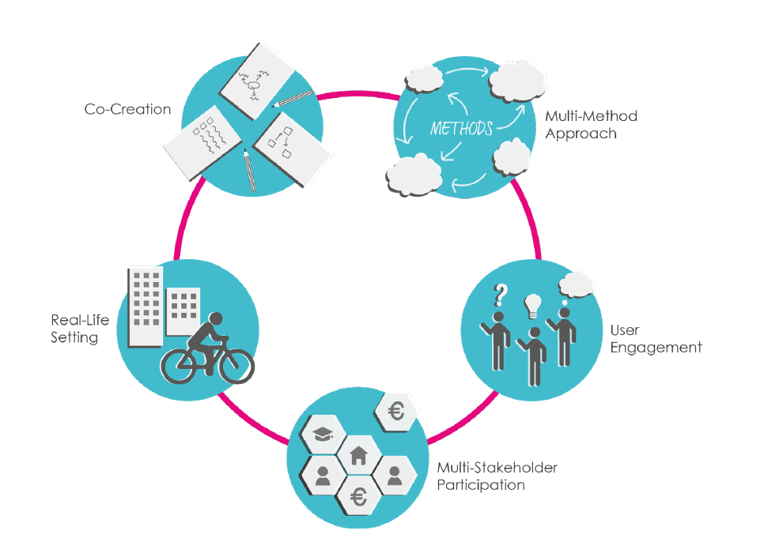
Characteristics of Living Labs
Co-creation of solution
Testing and experimentation in Real-life conditions
Active involvement of the end-users
Use of Multiple methods
Participation of Stakeholders
Living Lab Methodology Handbook. Malmberg et al (2017)

Slide 7
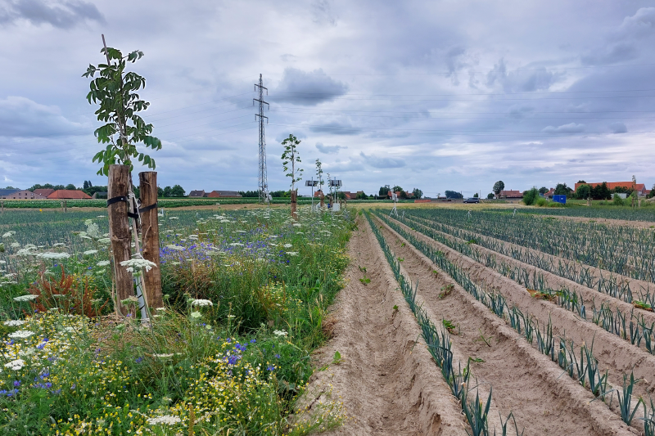
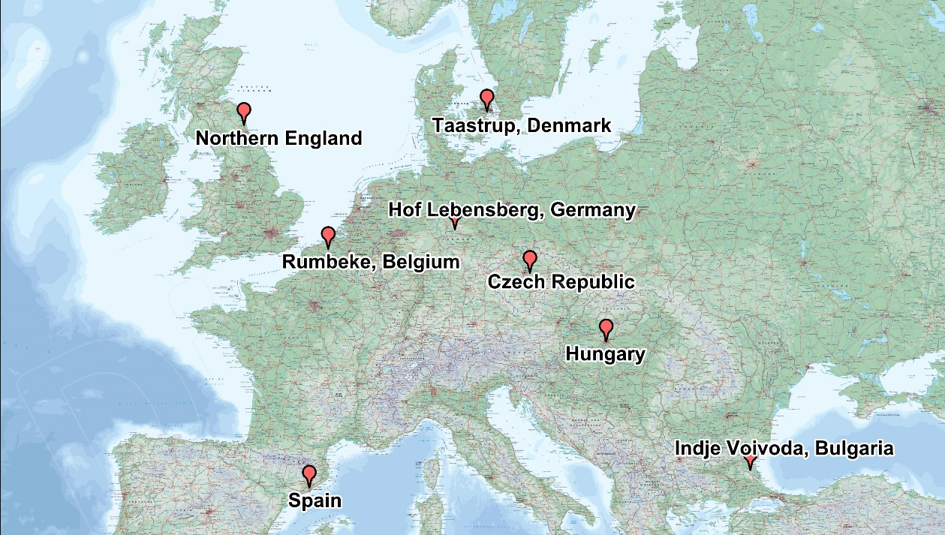
ReForest Living Labs
8 Living Labs
Diversity of agroforestry systems
Some adopting a “hub and spoke” model
Others a network of stakeholders practising agroforestry or interested/involved in associated value chains
Aim to inform and test tools for decision support

Slide 8
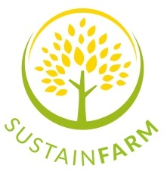
Farm-level sustainability assessment using Public Goods Tool
2011-2012
2023-2024
Further adaptation for agroforestry systems under REFOREST
2020-2022
Development of original Public Goods Tool to assess the provision of public goods on farms (Gerrard et al. 2012)
Adaptation of Public Goods Tool to include non-food biomass (Mullender et al. 2020; Smith et al. 2022)
Gerrard et al. 2012. ‘Public Goods and Farming’. https://doi.org/10.1007/978-94-007-4500-1_1
Mullender et al. 2020. A delphi-style approach for developing an integrated food/non-food system sustainability assessment tool. https://doi.org/10.1016/j.eiar.2020.106415
Smith et al. 2022. Assessing the multifunctional elements of sustainability in European agroforestry systems. https://doi.org/10.1016/j.agsy.2021.103357

Slide 9
Data Collection: Public Goods Tool
Based on Excel spreadsheet
Extended farmer interview (2-4 hours)
Nine areas of sustainability:
Soil management
Landscape and heritage
Nutrient balance
Energy use and carbon storage / sequestration
System diversity
Social capital
Business resilience
Animal welfare
Governance

Slide 10
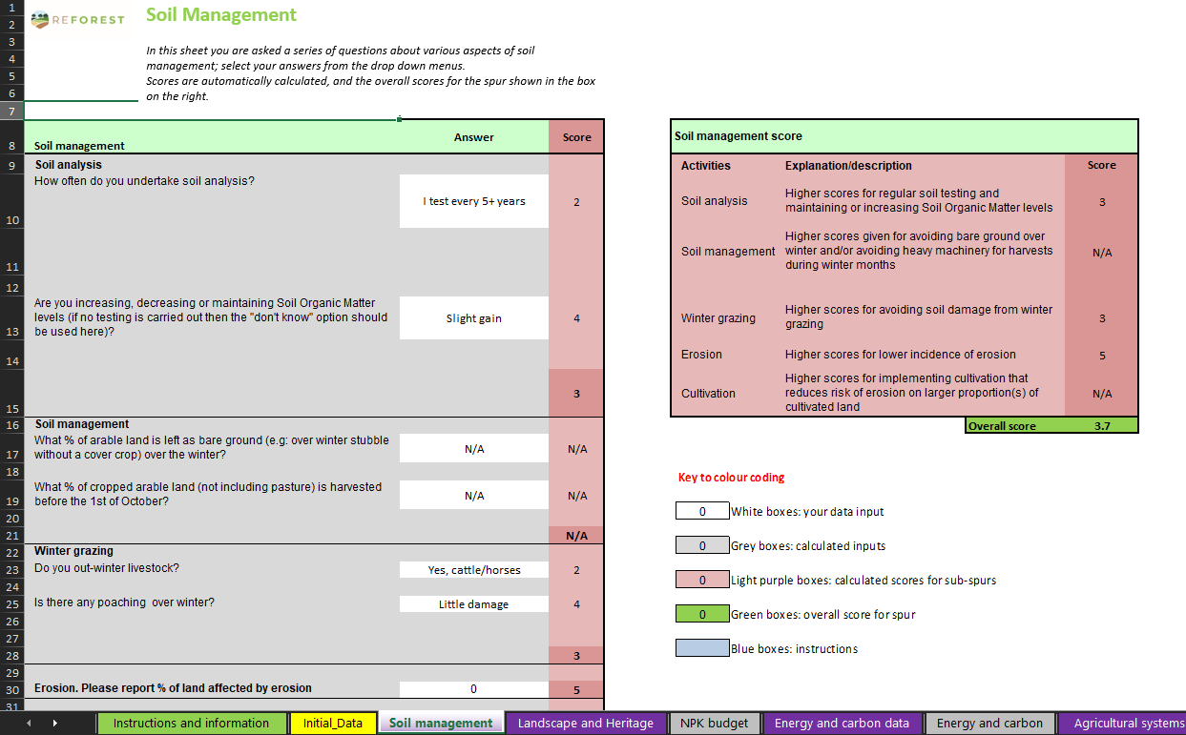
Example sheet

Slide 11
Results can be useful for researchers…
Consistently high scores (minimum > 3/5)
Preliminary data from 12 farms

Slide 12
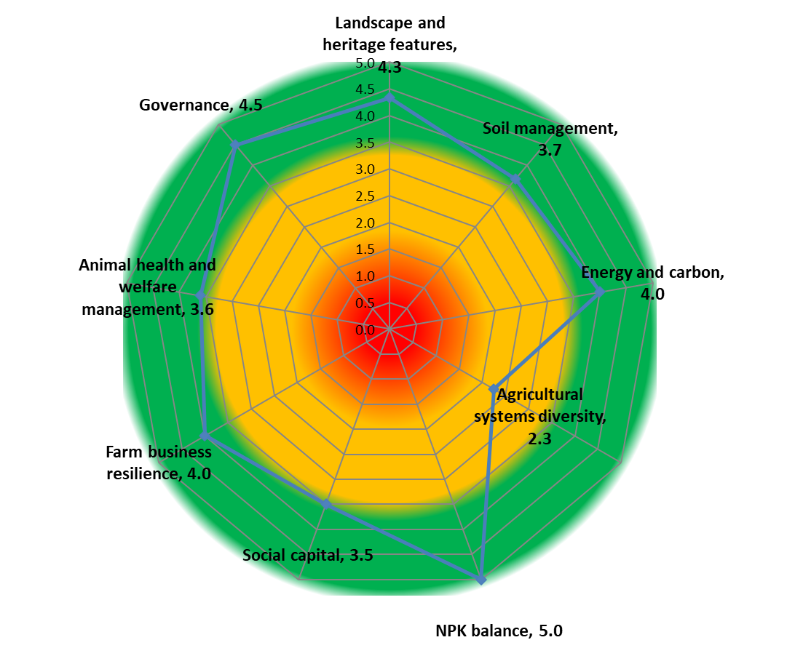
…and also for farmers
Only one livestock species
Only one marketing outlet
No on-farm processing
Limited employment levels
No external businesses or enterprise-stacking
High staff workload

Slide 13
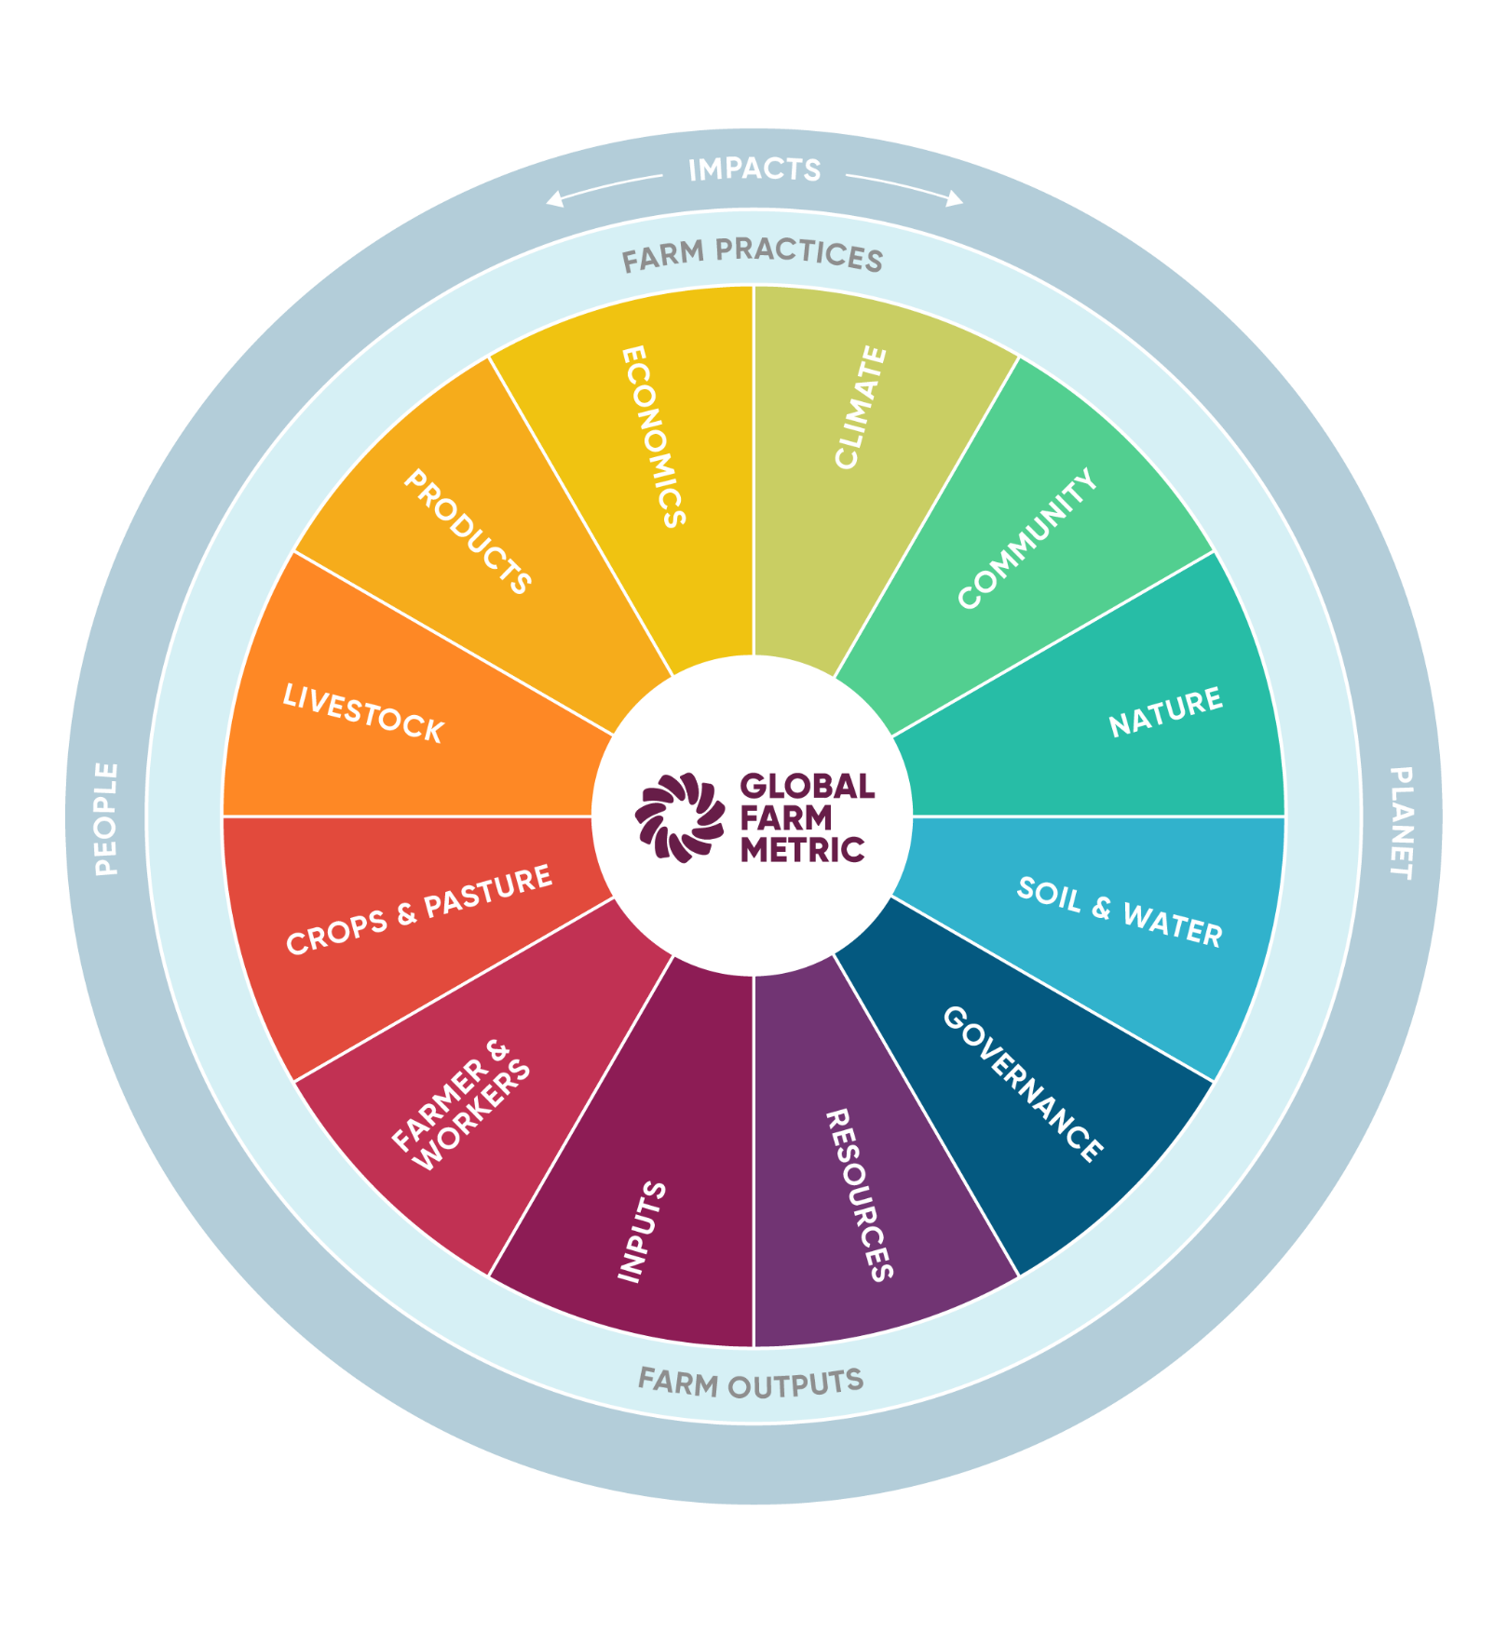
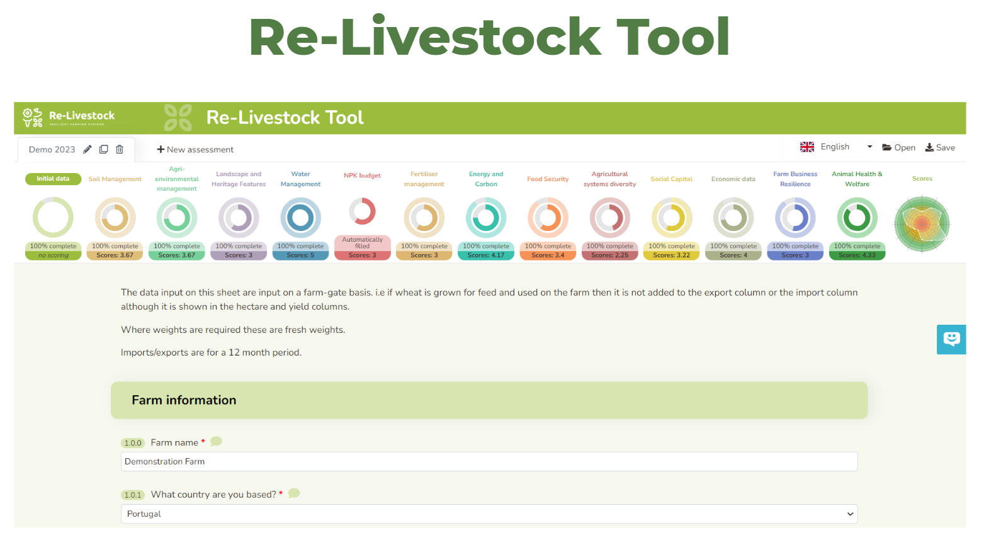
Online sustainability assessments
mvarc.eu/tools/re-livestock-tool
www.globalfarmmetric.org

Slide 15
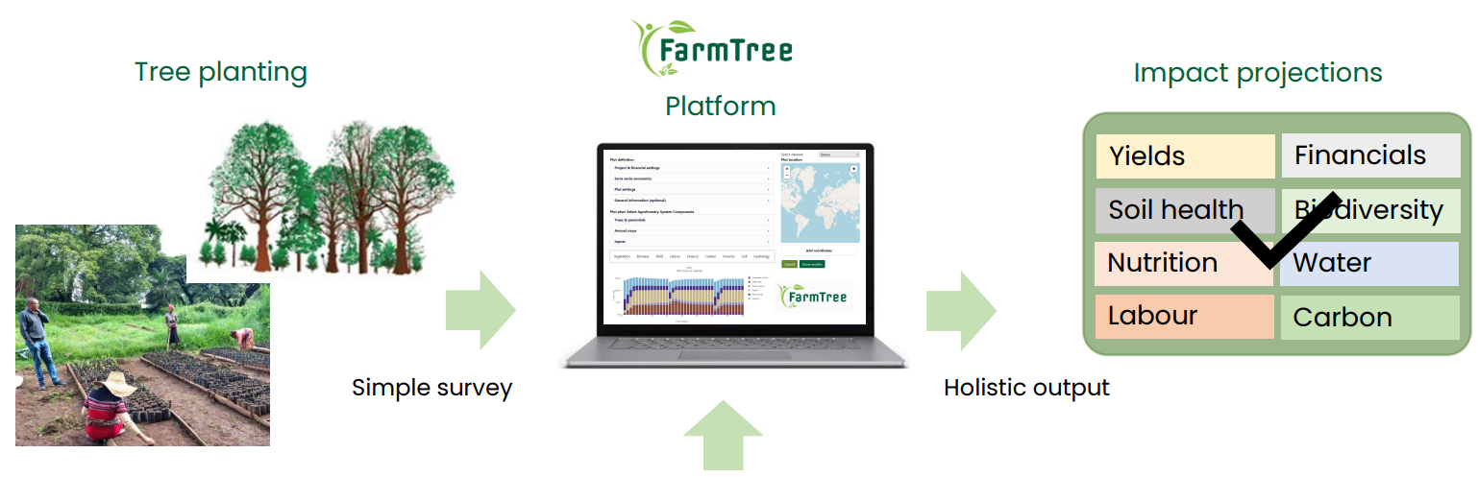
FarmTree tool: projecting agroforestry performance
FarmTree Database
Open Source:
Soil Data
Climate Forecast

Slide 16
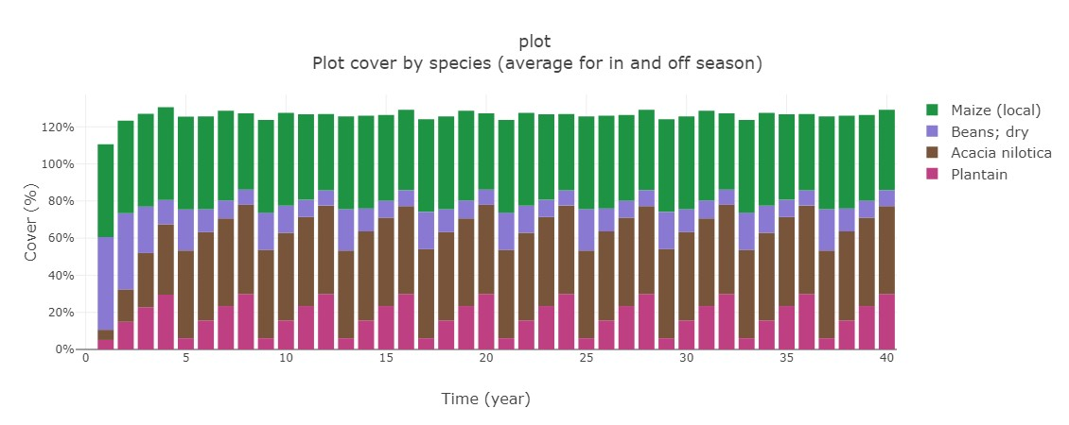
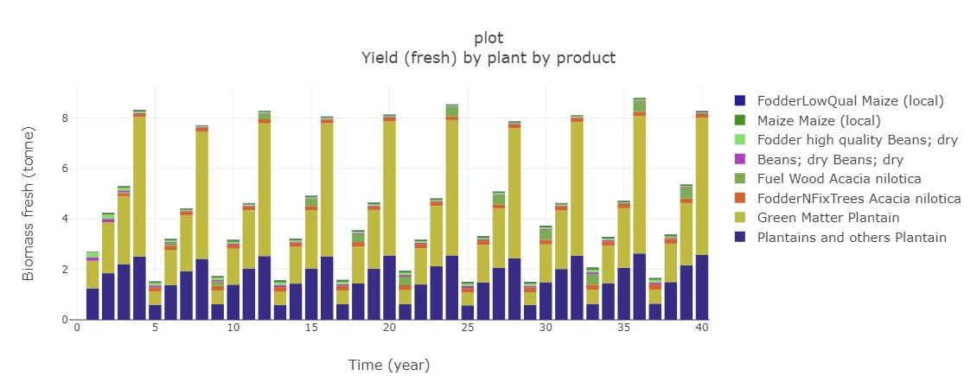
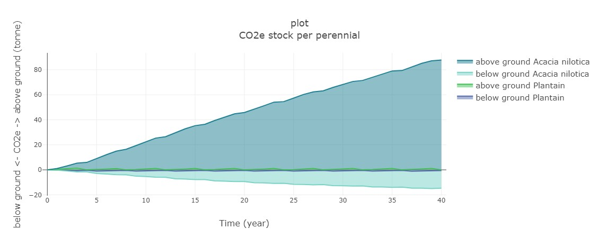
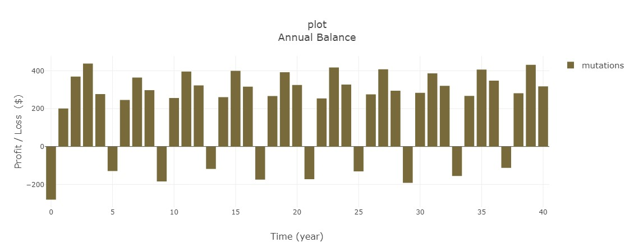
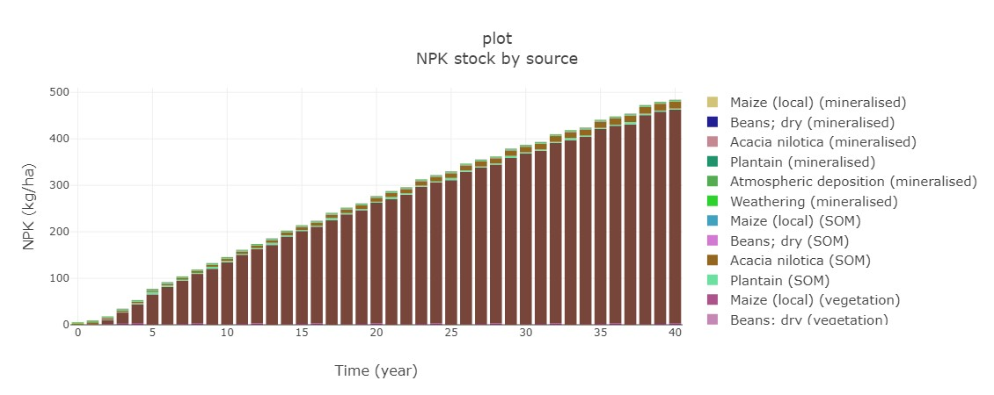
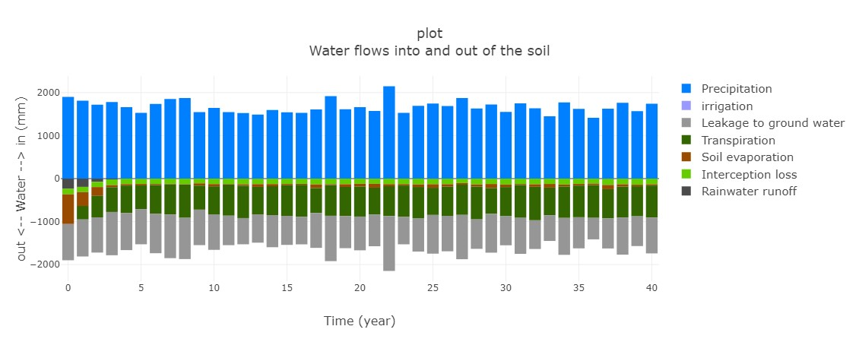
FarmTree tool
Vegetation cover
Yields
CO2e stock
Cashflow
NPK stock
Water flows

Slide 17
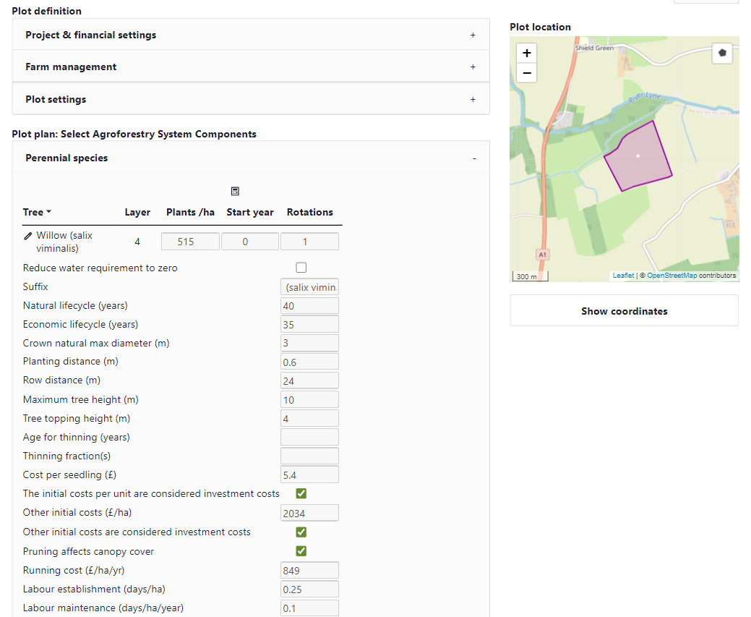
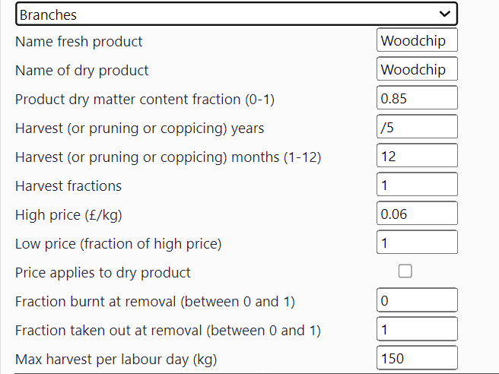

Slide 18
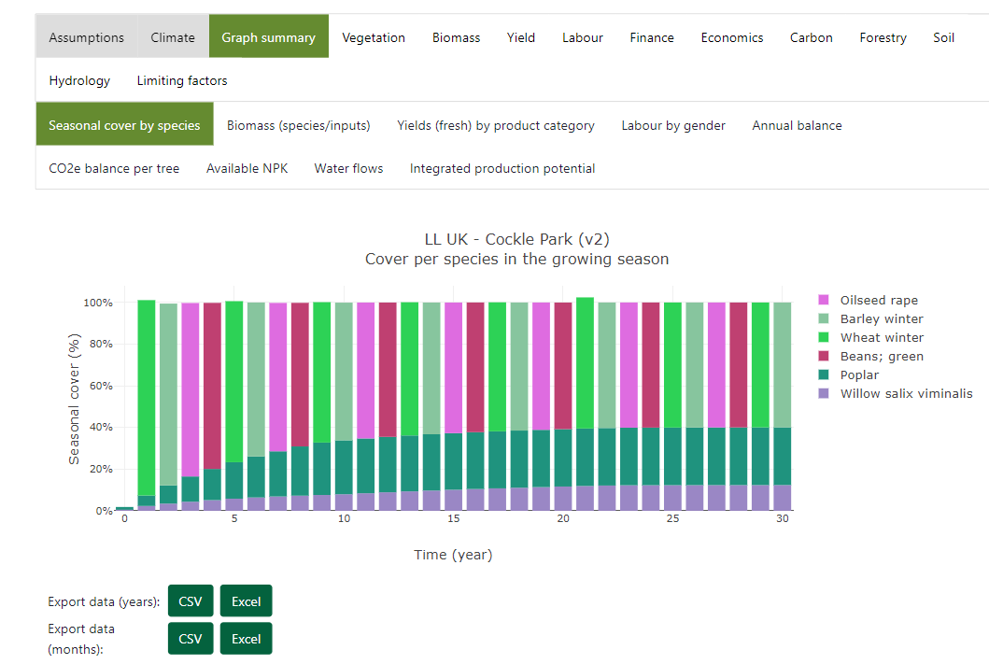

Slide 19
Thank you for listening
tom.staton@reading.ac.uk
https://agroreforest.eu/
Thanks to Will Simonson (ORC), Steffie Rijpkema & Frank van Schoubroeck (FarmTree) for providing content
We thank all the farmers who have been participating in ReForest

