Slide 1
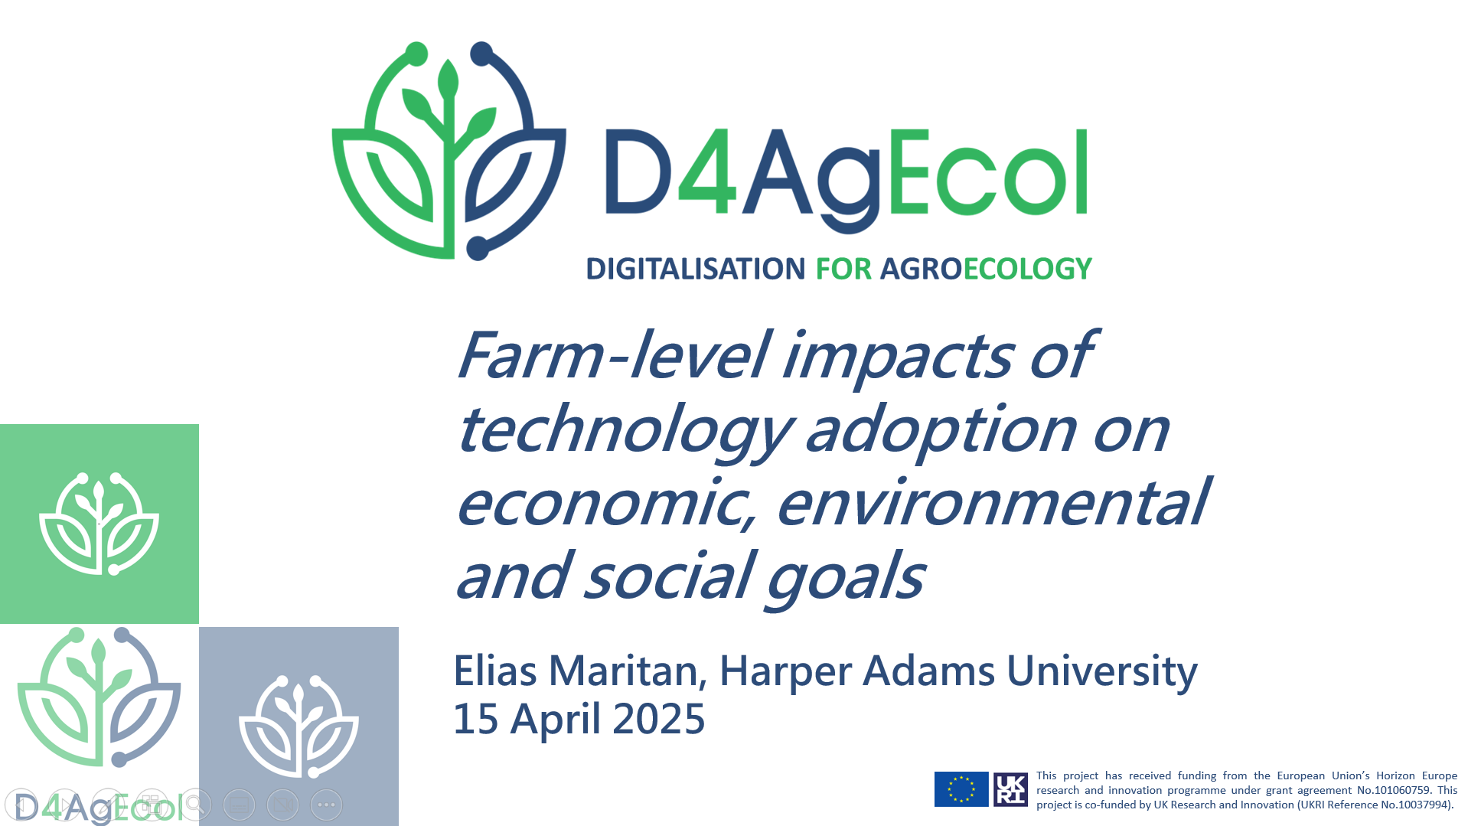

Slide 2



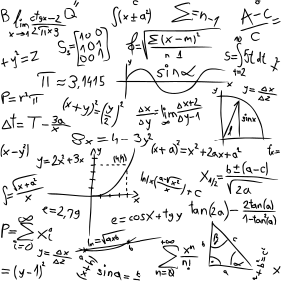






What is multiple-goal linear programming?
An automated budgeting tool using linear functions to estimate optimal whole-farm plans, usually through software packages
Whole-farm plan optimised for available resources to simultaneously meet all goals as closely as possible
Economic goals
OUTPUT
Environmental goals
Social goals
INPUT
Plans using conventional or new technology are compared
1/12

Slide 3



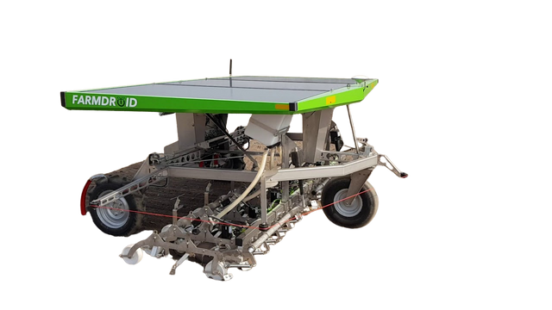
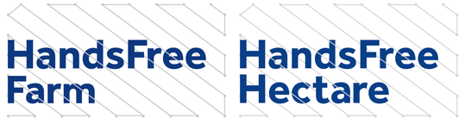


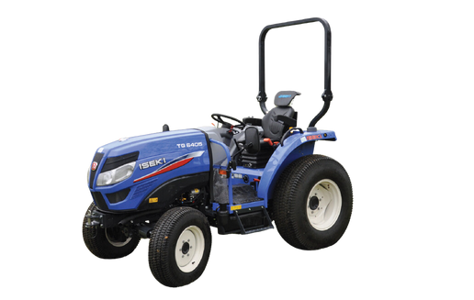
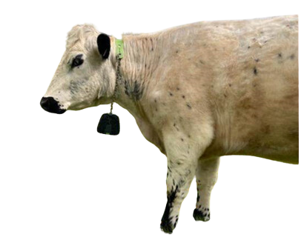
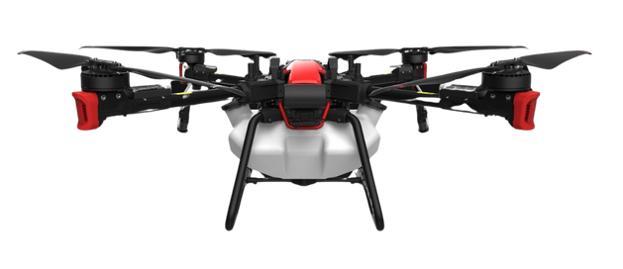

Four case studies
Robotic weeding in sugar beet cultivation
Autonomous strip intercropping in broadacre crops
Drone pesticide spraying in viticulture
Virtual fencing on cattle grazing farms
model P100
2/12

Slide 4
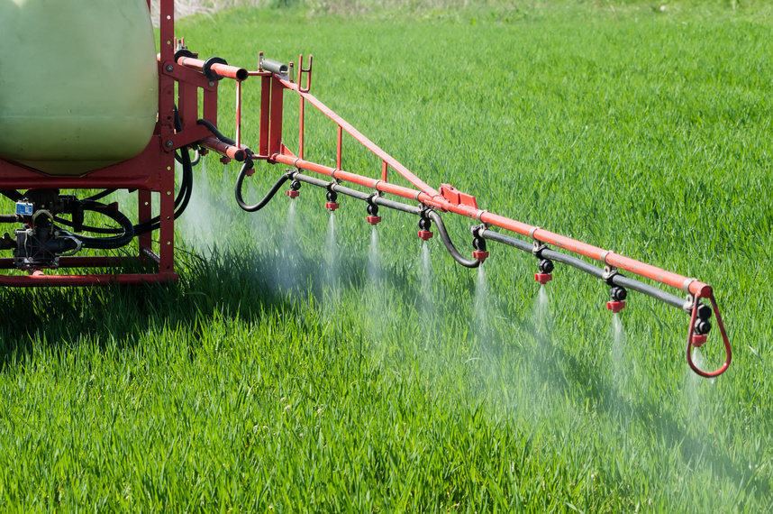
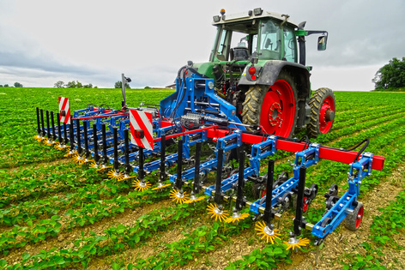
Robotic weeding in sugar beet cultivation
Conventional farming
Organic farming
Return over variable costs
+2%
Return over variable costs
+24%
Return over fixed costs
-141%
Return over fixed costs
+41%
Sugar beet production costs
+4%
Sugar beet production costs
+3%
Sugar beet carbon footprint
-1%
Sugar beet carbon footprint
-3%
Family labour productivity
-81%
Family labour productivity
-77%
Compared to...
Compared to...
Herbicide broadcast spraying
Mechanical weeding (non-robotic)
3/12

Slide 5
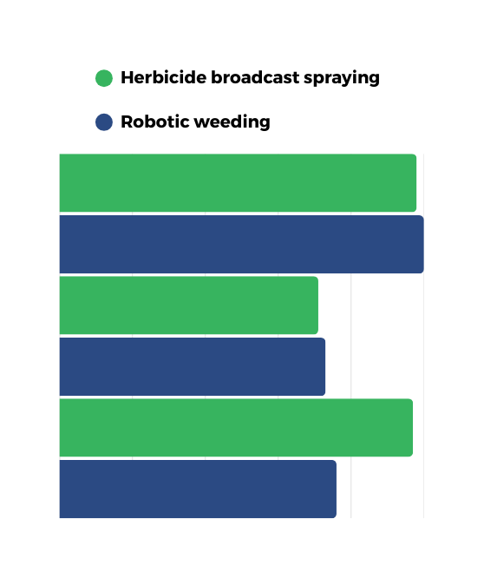
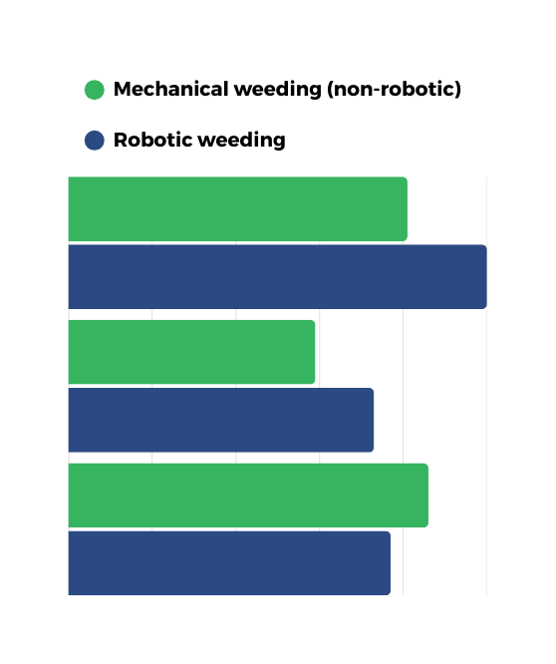

Overall achievement of farm-level goals
Conventional farming
Organic farming
98%
81%
Production-orientated farmer
Production-orientated farmer
100%
100%
Ecologically-orientated farmer
71%
59%
Ecologically-orientated farmer
73%
73%
Socially-orientated farmer
97%
Socially-orientated farmer
86%
76%
77%
0% 20% 40% 60% 80% 100%
0% 20% 40% 60% 80% 100%
Percentage of goals achievement
Percentage of goals achievement
4/12

Slide 6
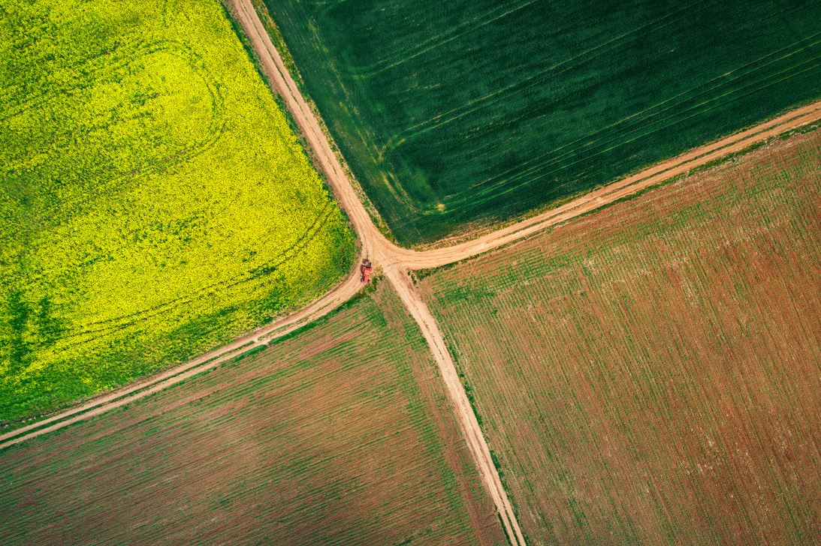
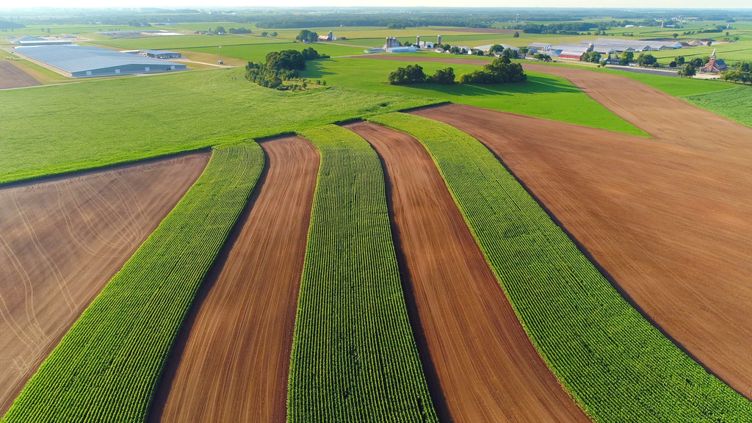
Autonomous strip intercropping in broadacre crops
Conventional farming
Return over fixed costs
+23%
Return over fixed costs
+16%
Return over operator labour cost
+35%
Return over operator labour cost
+41%
Wheat production costs
-7%
Wheat production costs
-6%
In-field agricultural biodiversity
+441%
In-field agricultural biodiversity
±0%
Soil compaction
-44%
Soil compaction
±0%
Compared to...
Compared to...
Whole-field monocropping
Non-robotic strip intercropping
5/12

Slide 7
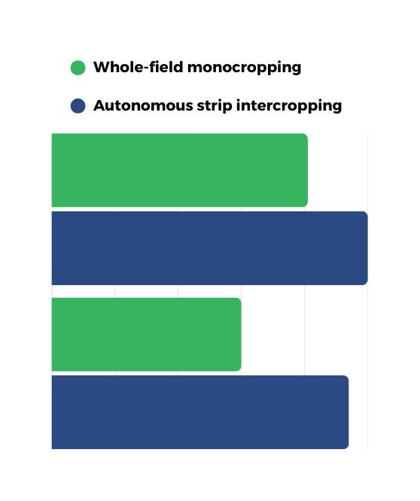
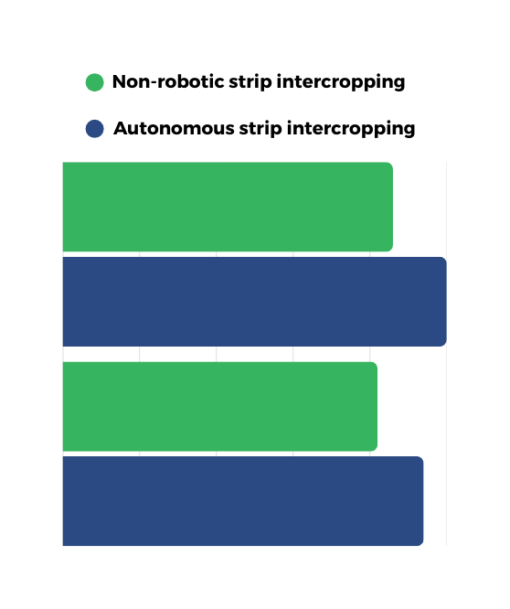
Overall achievement of farm-level goals
Conventional farming
81%
86%
Production-orientated farmer
Production-orientated farmer
100%
100%
60%
82%
Ecologically-orientated farmer
Ecologically-orientated farmer
94%
94%
0% 20% 40% 60% 80% 100%
0% 20% 40% 60% 80% 100%
Percentage of goals achievement
Percentage of goals achievement
6/12

Slide 8
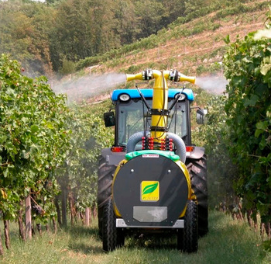
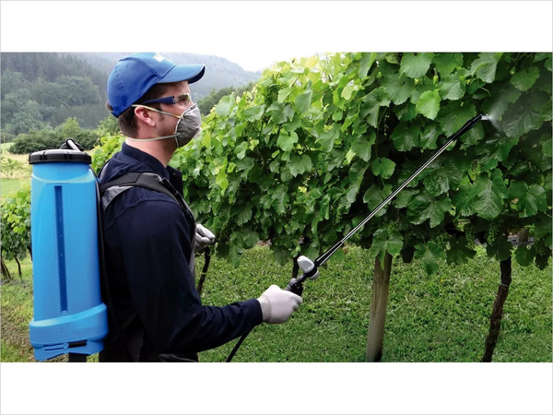
Drone pesticide spraying in viticulture
High mechanisation viticulture, flat vineyard
Low mechanisation viticulture,
steep-slope vineyard
Return over variable costs
-6%
Return over variable costs
-5%
Return over fixed costs
-13%
Return over fixed costs
-20%
Winegrape production costs
+2%
Winegrape production costs
+2%
Environmental pollution
±0%
Environmental pollution
±0%
Human exposure to pesticides
-50%
Human exposure to pesticides
-67%
Compared to...
Compared to...
Conventional vine sprayer
Backpack spraying
7/12

Slide 9
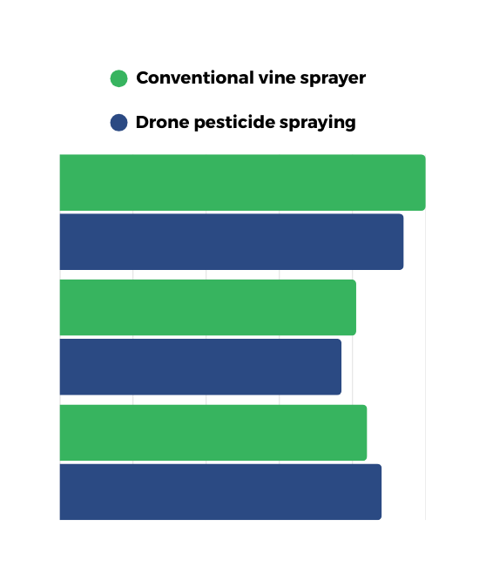
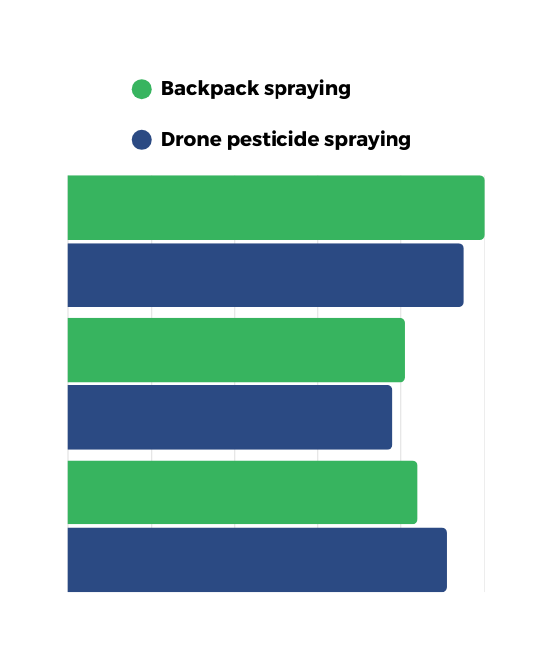
Overall achievement of farm-level goals
High mechanisation viticulture, flat vineyard
Low mechanisation viticulture,
steep-slope vineyard
100%
100%
Production-orientated farmer
Production-orientated farmer
94%
95%
81%
81%
Ecologically-orientated farmer
Ecologically-orientated farmer
77%
78%
84%
84%
Socially-orientated farmer
Socially-orientated farmer
88%
91%
0% 20% 40% 60% 80% 100%
0% 20% 40% 60% 80% 100%
Percentage of goals achievement
Percentage of goals achievement
8/12

Slide 10
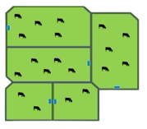
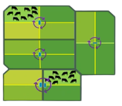
Virtual fencing on cattle grazing farms
Intensive grazing, lowlands
Extensive grazing, uplands
Return over fixed costs
-1% / -12%
Return over fixed costs
-70%
Return over operator labour cost
-6% / -27%
Return over operator labour cost
-29%
Beef production costs
-4% / +2%
Beef production costs
+14%
Absolute GHG emissions
+2% / ±0%
Absolute GHG emissions
±0%
Beef carbon footprint
-8% / ±0%
Beef carbon footprint
-2%
/
Compared to...
Compared to...
Set stocking
Rotational grazing
(Electric fencing)
Set stocking
9/12

Slide 11
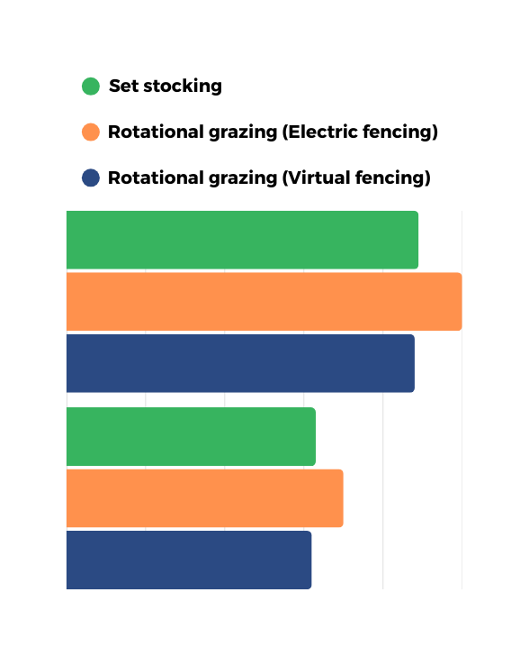
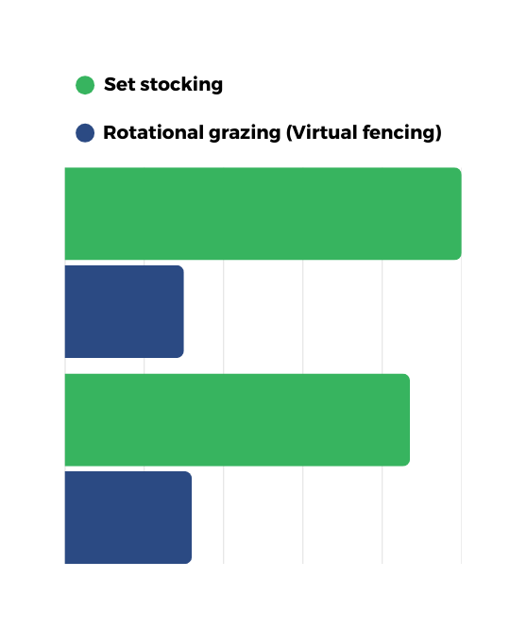
Overall achievement of farm-level goals
Intensive grazing, lowlands
Extensive grazing, uplands
89%
100%
Production-orientated farmer
100%
Production-orientated farmer
88%
30%
63%
87%
Ecologically-orientated farmer
70%
Ecologically-orientated farmer
62%
32%
0% 20% 40% 60% 80% 100%
0% 20% 40% 60% 80% 100%
Percentage of goals achievement
Percentage of goals achievement
10/12

Slide 12
Drivers and barriers of digitalisation adoption to enable agroecology
DRIVERS
BARRIERS
  Lower labour input
  Mitigation of labour shortages
  Variable and/or fixed costs savings
  Lower environmental impact
  Facilitation of ecological conservation
  Lower human exposure to pesticides
  High technology costs
  Higher production costs
  Regulatory challenges
  Low technology reliability
  Higher labour input
  Lack of relevant data and/or indicators
Economic
Environmental
Social
11/12

Slide 13
Main conclusions
  Economic, environmental and social outcomes of digitalisation adoption have substantial differences among production systems, farm types and technologies
  Many technologies can reduce labour input, especially when they are multi-purpose and have speeds comparable to conventional equipment (e.g., autonomous strip intercropping study)
  On the other hand, specialised technologies and/or lower operational speeds increase labour input (e.g., robotic weeding study)
  Some technologies may increase return over variable costs but reduce return over fixed costs due to high technology costs (e.g., robotic weeding study)
  For custom-hired technologies, an important economic challenge may be high hiring fees due to strict regulation and initially low adoption rates (e.g., drone pesticide spraying study)
  Digital technologies tend to have a positive impact on the environment and human health depending on how they are used (e.g., drone pesticide spraying study)
  However, environmental impacts may differ depending on the units of measure in which they are expressed (e.g., virtual fencing study)
12/12

Slide 14
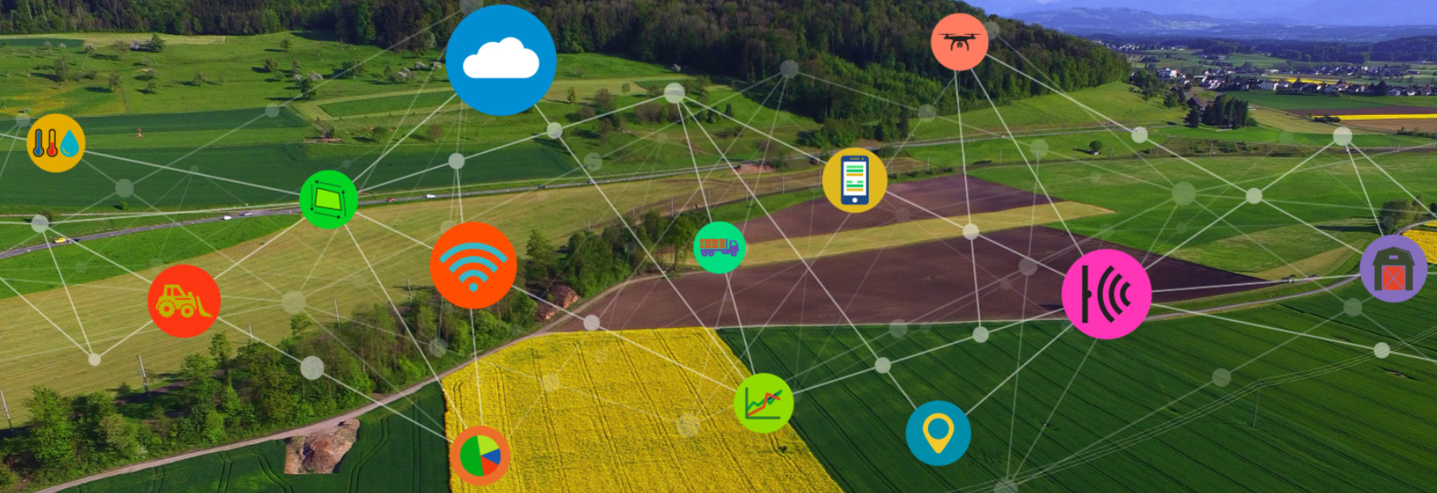


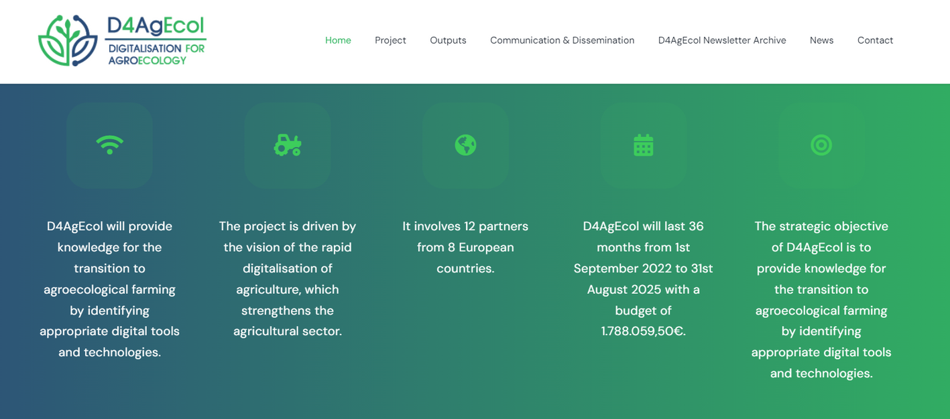






Thank you!
Visit D4AgEcol.eu or follow us on social media to stay updated on our project!
/d4agecol/
/d4agecol-project/
@d4agecol

