Slide 1

Digital tools in agriculture: perceptions and barriers to adoption.
Digital agroecology cluster
15 April 2025
Evangelia Mourmoura, European Commission
DG AGRI – Unit A4, Data Governance

Slide 2
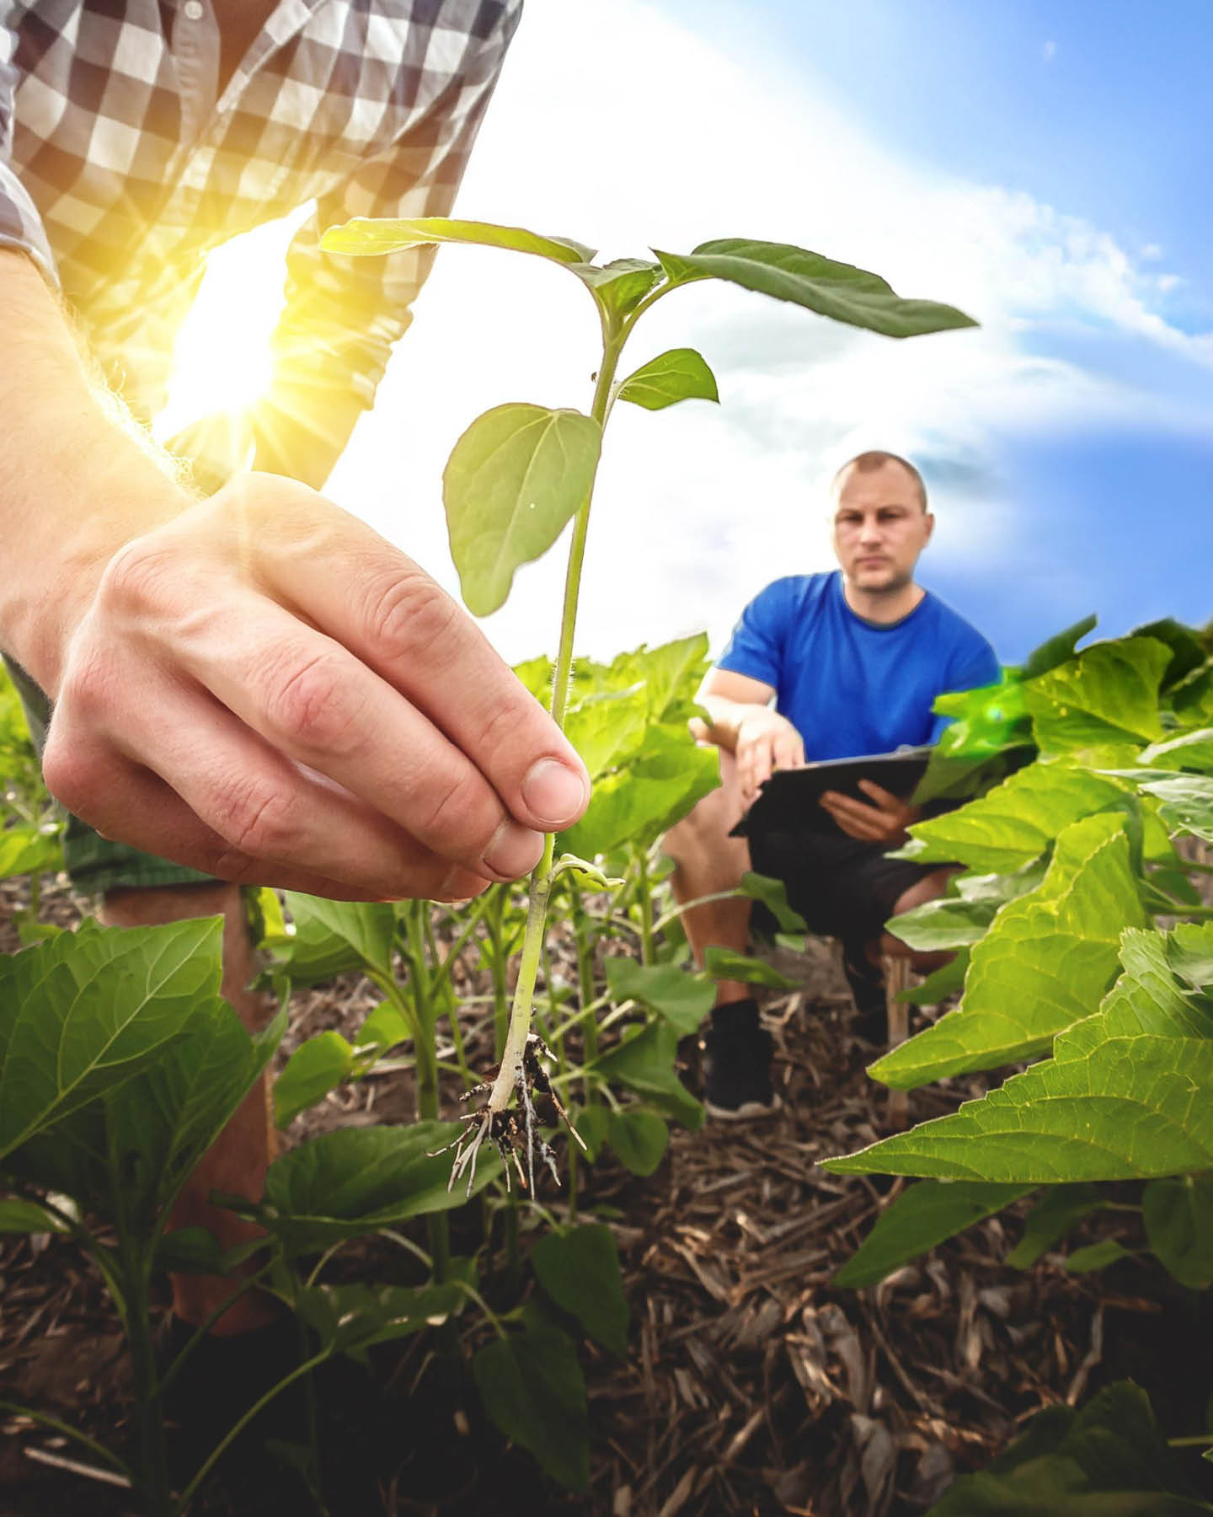

A Vision for Agriculture and Food
How to build an agri-food system that is attractive, competitive, future-proof and fair for current and future generations?
© European Union 2025 - AdobeStock

Slide 3
Digitalisation as a driver in the Vision
Digitalisation is instrumental not only to strengthen the economic performance and resilience the sector but also to contribute significantly to several sustainability-related policy objectives.
Different issues are limiting the digital transition, such as perceived high costs, lack of digital skills, trust or connectivity.
Adoption of digital tools lags behind in agriculture and other parts of the food system.
EU Digital Strategy for Agriculture​

Slide 4
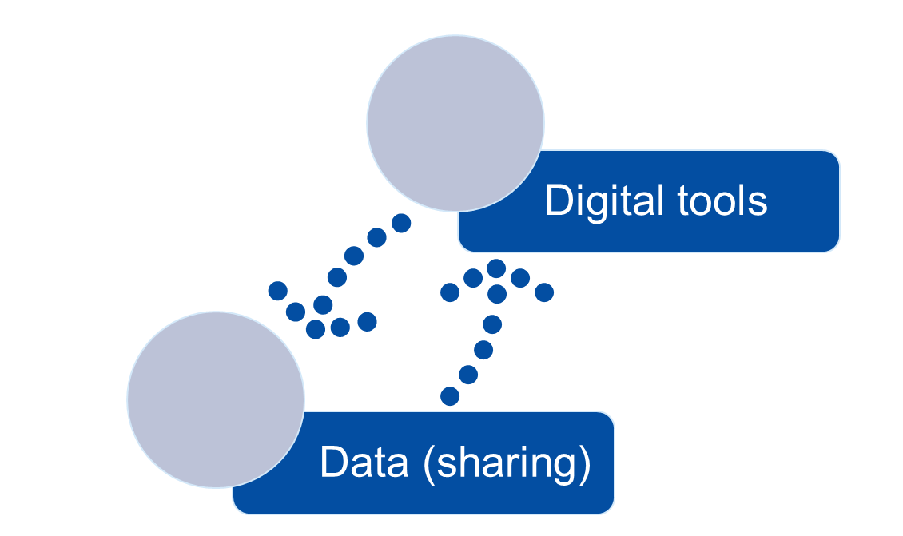
Why digitalisation?
For administrations: better policy-making & simplification
For farmers: better decision-making at farm level & new opportunities for farmers
For society: data availability → boost of technology & artificial intelligence

Slide 5
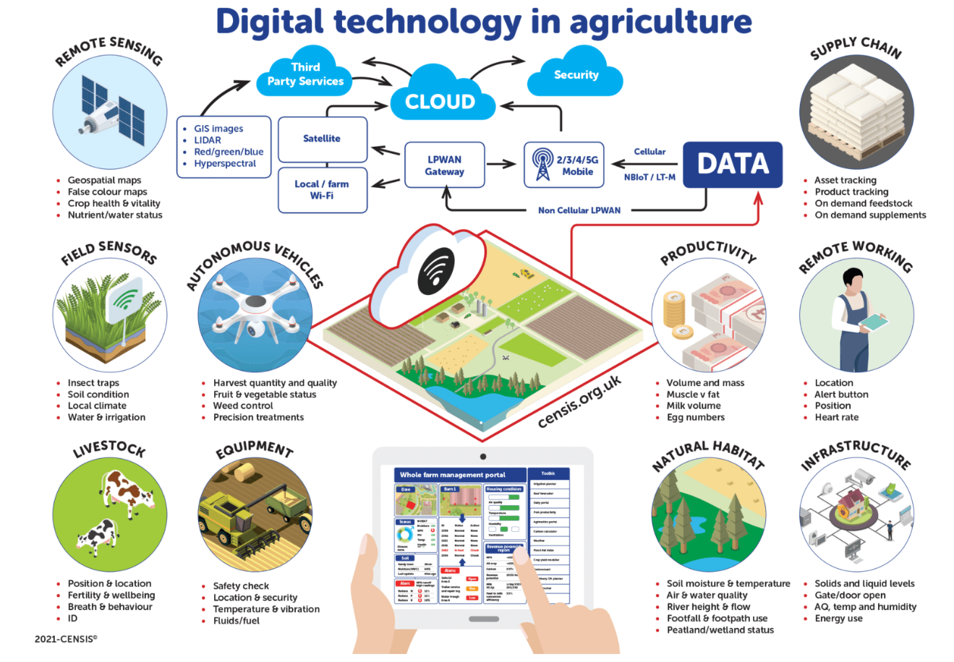
Digital is everywhere
e-government

Slide 6


Simplification survey
Commissions' online survey addressed to farmers
Running from March 7 to April 8, 2024 – 26 886 replies received
  To understand the burden placed on farmers by procedures and rules linked to
financial support under the common agricultural policy (CAP), as well as other
EU rules for food and agriculture in the EU;
  To help in identifying sources of concern and complexity in the way these policies and schemes are applied in the EU countries;
to help in identifying areas where improvements could be made.
→ Study on Simplification and Administrative Burden for Farmers under the CAP

Slide 7
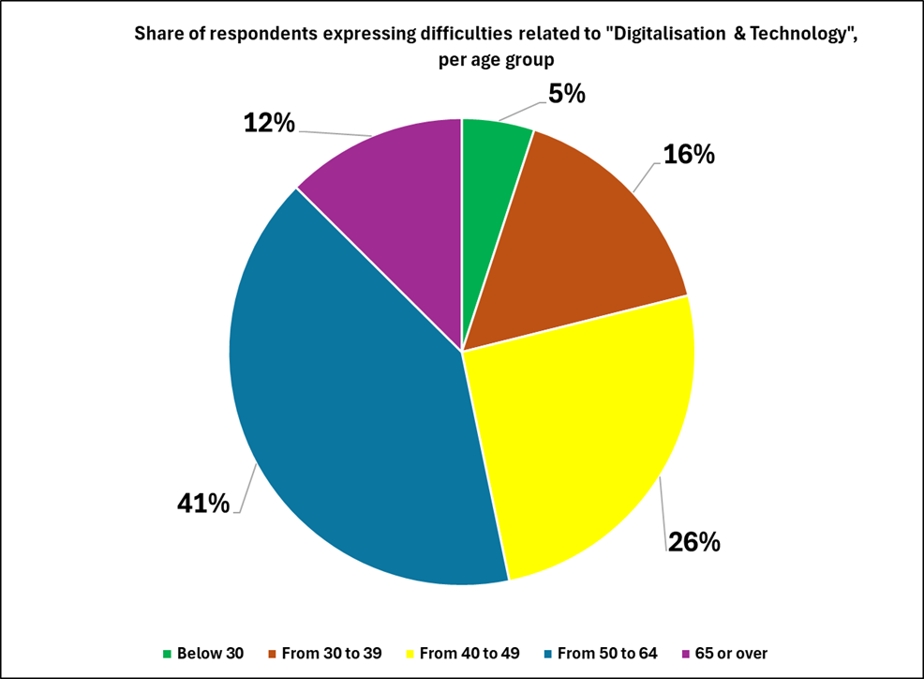
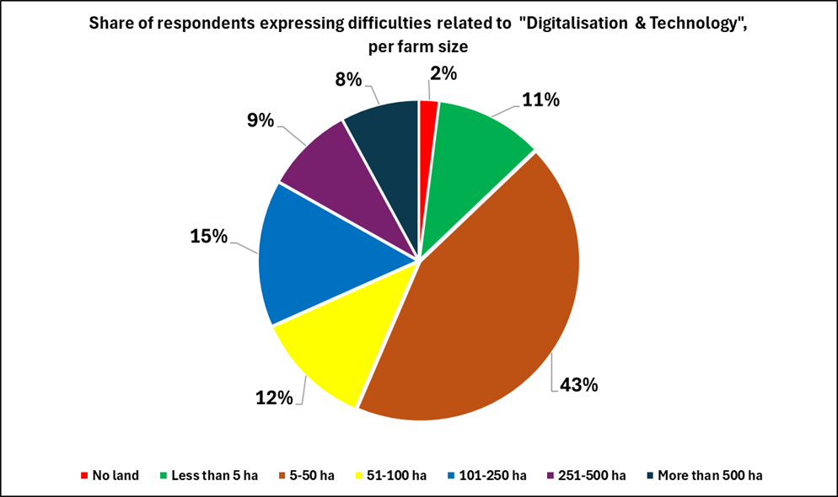
Simplification survey (2024)
Internal analysis, DG AGRI

Slide 8
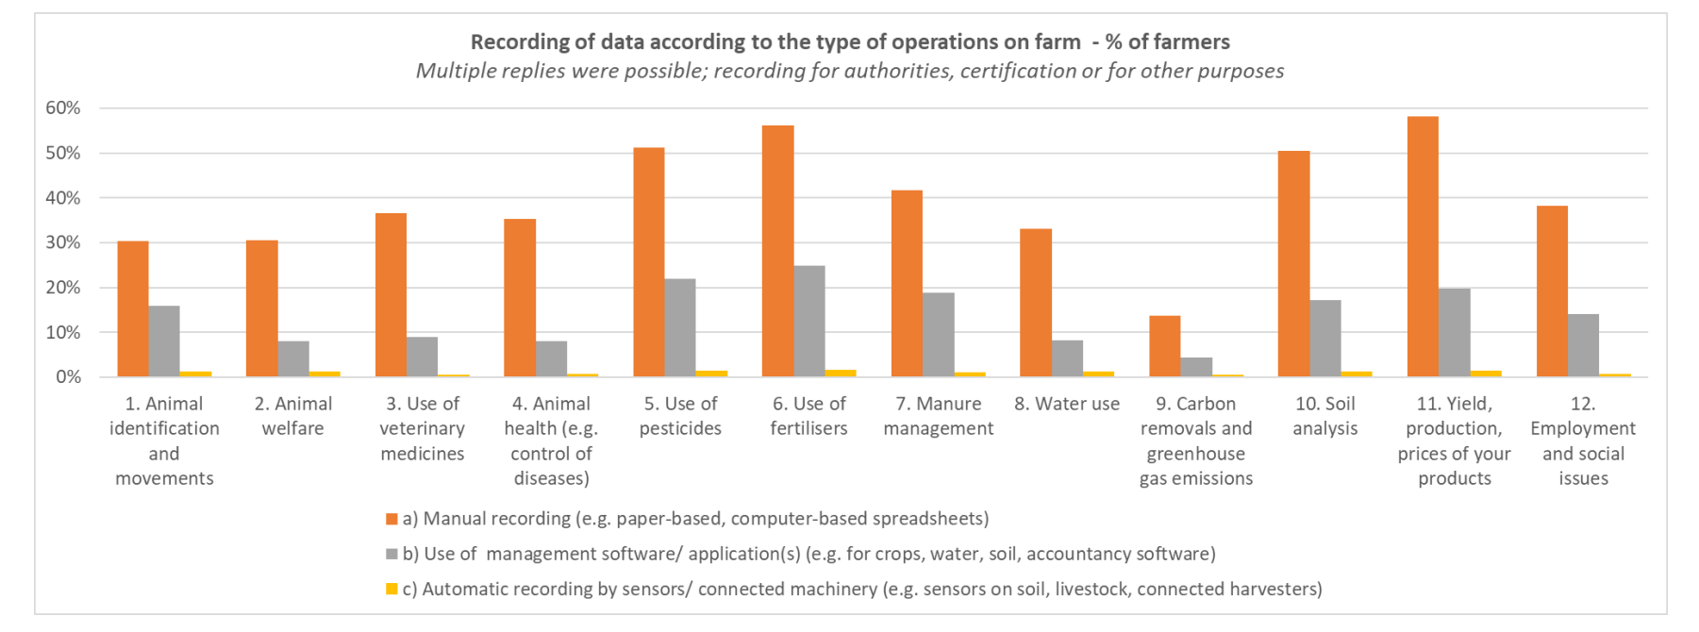
Simplification survey (2024)
Internal analysis, DG AGRI

Slide 9
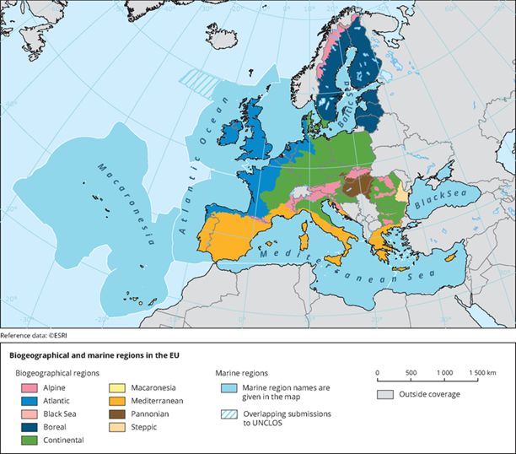
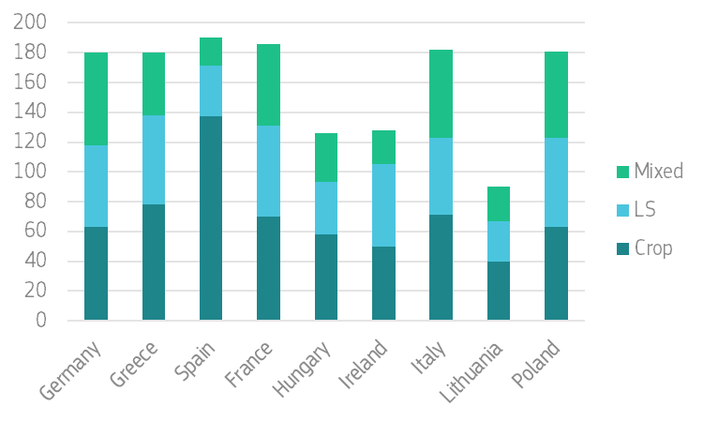
Study on the state of play of digitalisation in EU agriculture
Preliminary results of a survey-based study - Upcoming report Q2 2025
Data collection June to September 2024
Stratified sampling strategy
9 countries (France, Germany, Hungary, Ireland, Italy, Poland, Spain, Greece and Lithuania).
  Covering the different regions of Europe (North, South, East, West), including different regions per country.
  Mixture of face to face and online interviews.
Total number of 1440 Farmers: balanced number per country and farm specialization (Crop, Livestock, Mixed) and size (Small, Medium, Large).
Results are weighted to represent farm population

Slide 10
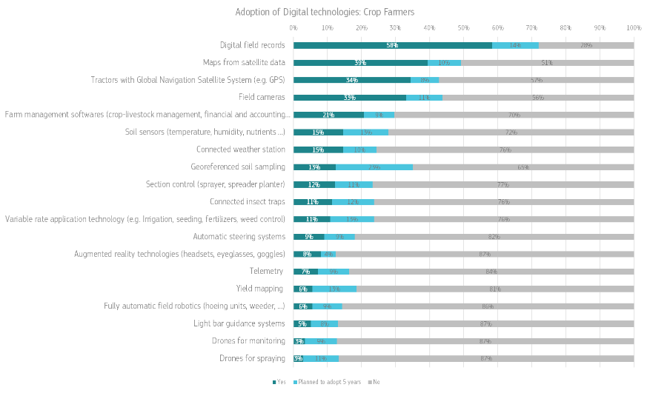
Adoption of digital tools in the EU
Survey-based study on the state of play of Digitalisation in EU agriculture
Preliminary results , Upcoming JRC report Q2 2025​

Slide 11
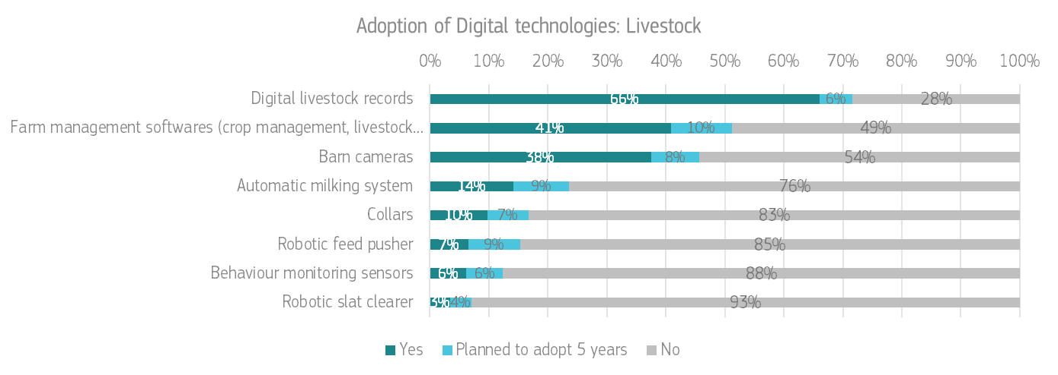
Adoption of digital tools in the EU
Survey-based study on the state of play of Digitalisation in EU agriculture
Preliminary results , Upcoming JRC report Q2 2025​

Slide 12
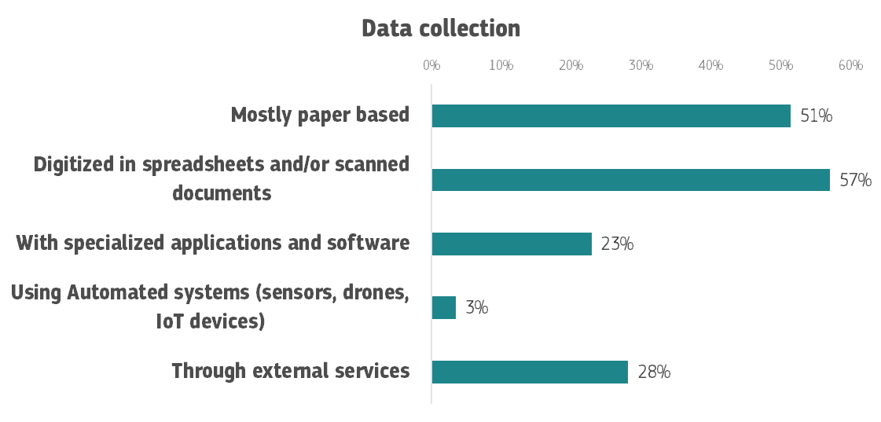
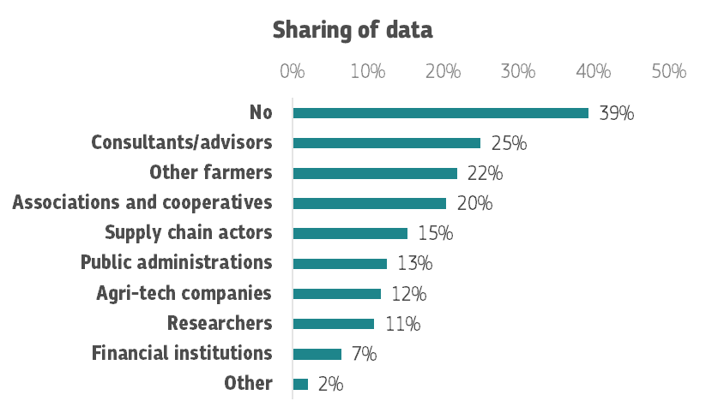
Data collection and sharing in the EU
Survey-based study on the state of play of Digitalisation in EU agriculture​
Preliminary results , Upcoming JRC report Q2 2025​​

Slide 13
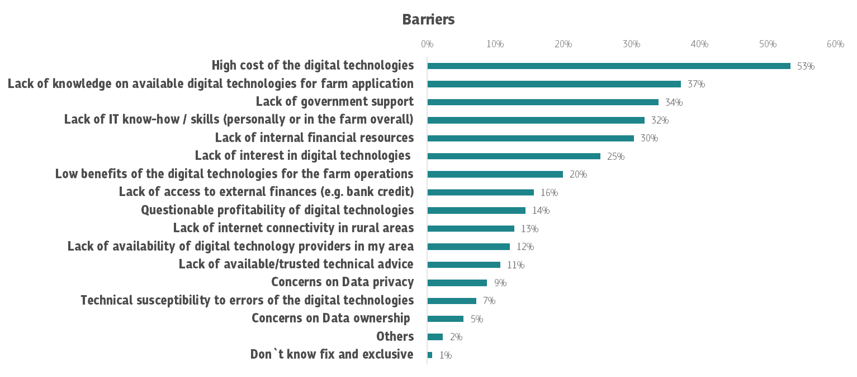
Barriers of adoption
Survey-based study on the state of play of Digitalisation in EU agriculture​
Preliminary results , Upcoming JRC report Q2 2025​​

Slide 14
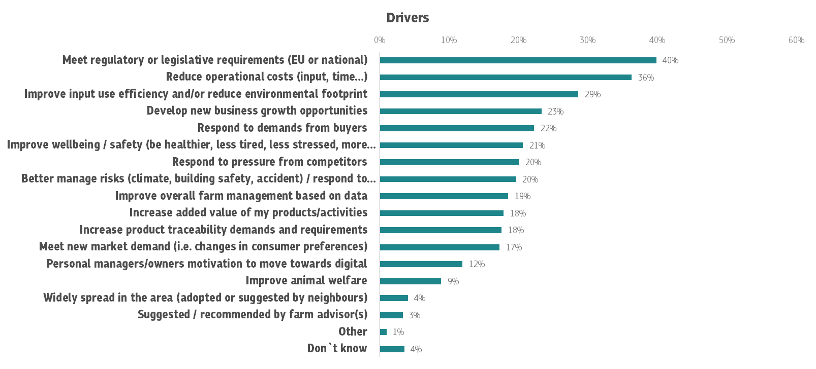
Drivers of adoption
Survey-based study on the state of play of Digitalisation in EU agriculture​
Preliminary results , Upcoming JRC report Q2 2025​​

Slide 15
Enabling environment for the uptake
infrastructure
connectivity, equipment, platforms, registries
capacity building
training, skills, advice
financial support
adequate funding mechanisms

Slide 16
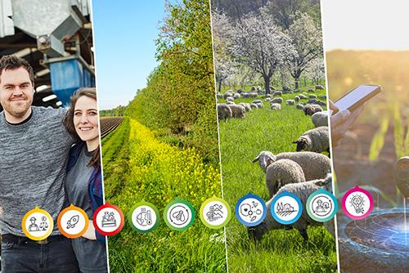
Digitalisation under the CAP 2023-2027
  Cross-cutting objective on modernising the sector.
  Digitalisation strategies.
Member States have a portfolio of tools at hand to support digitalisation under the CAP:
Investment support
Eco-schemes
AECC for adoption of digital technologies
Farm advisory services: advice on digital issues & FaST
Knowledge exchange and training (skills/training on digital matters)
Cooperation (EIP-OG, LEADER, smart villages)
Infrastructure (broadband).
CAP network & Agricultural Knowledge and Innovation System
IACS data sharing.

Slide 17
Concluding thoughts
Digital adoption is happening but unevenly
importance of bringing all actors at the same stage of digital-readiness
Barriers remain real
costs, complex tools, fragmeneted systems, lack of connectivity and skills
Drivers show the way
Collaboration across tech, policy, and farming communities is key
regulatory requirements, optimise inputs, business growth opportunities

Slide 18

Thank you
© European Union 2023
Unless otherwise noted the reuse of this presentation is authorised under the CC BY 4.0 license. For any use or reproduction of elements that are not owned by the EU, permission may need to be sought directly from the respective right holders.
Slide xx: element concerned, source: e.g. Fotolia.com; Slide xx: element concerned, source: e.g. iStock.com
Notes:
Update/add/delete parts of the copy right notice where appropriate.
More information: https://myintracomm.ec.europa.eu/corp/intellectual-property/Documents/2019_Reuse-guidelines%28CC-BY%29.pdf

